Slide 1
Alcohol Misuse
Rhonda Sturley
Consultant Geriatrician

Slide 2
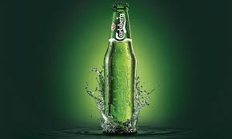
If Carlsberg did……

Slide 3
Objectives
Definitions/Terminology
Facts & figures
Adverse effects
Recognition
Management
Notes:
Physical health complications – pancreatitis, neuropathy, liver disease
Management of Wernicke’s & withdrawal on the ward

Slide 4
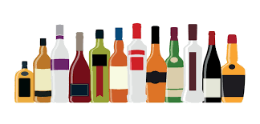
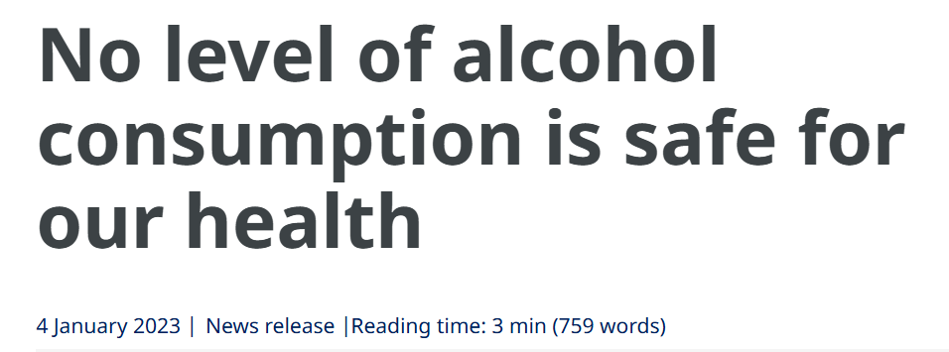
Psychoactive, toxic substance with addictive properties that acts on the central nervous system as a depressant.
Notes:
AI tells us alcohol is a drug
Specifically acts on neurotransmitters:
- Increases the effect of GABA (calmer & reduced anxiety)
- Reduced the effect of glutamate (reduced level of alertness)
It’s around 13,000 years old (& possibly much older than this)
It is the most misused drug across all age groups
In 2023 the WHO came out strong with a clear message
They highlighted its listing as a Group 1 carcinogen responsible for at least 7 different types of cancer

Slide 5
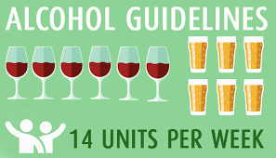
Limits
1 unit = 8g or 10ml of pure alcohol
Notes:
Introduced in 1987
Average amount of alcohol processed in 1hr (cleared from the blood stream)
Suggestion is that this is consumed over 3 days with alcohol free days
Recent change to smoking legislation
Some debate to the application of 14 units to older adults
Suggestion this should be 11 units / week & 1.5 maximum per day

Slide 6
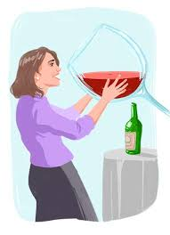

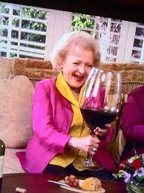
What is a unit?

Slide 7
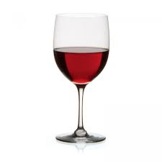
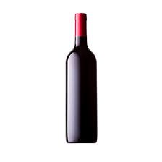
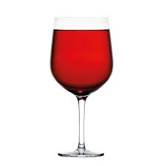
1.5 units
2.5 units
125mls wine at 12%
1 bottle of wine at 12%
3 units
9 units
250mls wine at 12%
125mls port at 20%
Notes:
Average wine in the UK has an ABV of 12%
Strongest ABV wines are port or sherry around 20%
ABV is alcohol by volume

Slide 8
1.5 units
9 units
125mls wine at 12%
1 bottle of wine at 12%
3 units
2.5 units
250mls wine at 12%
125mls port at 20%
Notes:
Average wine in the UK has an ABV of 12%
Strongest ABV wines are port or sherry around 20%
ABV is alcohol by volume

Slide 9
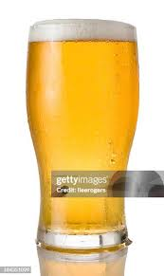

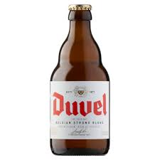
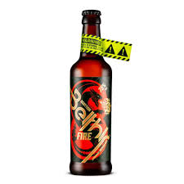
2 units
2.2 units
2.8 units
1 pint of lager at 4%
50mls of gin at 40%
24.5 units
330mls of beer at 8.5%
330mls of beer at 75%
Notes:
Average lager is 4% ABV
ABV is alcohol by volume

Slide 10
2.2 units
2 units
1 pint of lager at 4%
50mls of gin at 40%
2.8 units
24.5 units
330mls of beer at 8.5%
330mls of beer at 75%
Notes:
Average lager is 4% ABV
ABV is alcohol by volume

Slide 11
Definitions/Terminology
Unhealthy alcohol use
Hazardous
Harmful
Alcohol use disorder
Mild (2-3)
Moderate (4-5)
Severe (≥6)
Notes:
ICD 11 & DSM V
A pattern of alcohol use that appreciably increases the risk of harmful physical or mental health consequences to the user or to others to an extent that warrants attention and advice from health professionals
Hazardous – at risk of harm (typically minimum of 2 episodes/12 months)
Harmful – adverse health or psychosocial consequences
AUD – clinically significant impairment or psychosocial stress in the last 12 months
DSM V provides diagnostic criteria (2/11 = AUD)

Slide 12
Unsuccessful attempts to cut down
Drinking more or longer than intended
Craving
Spending lots of time drinking or recovering
AUD
Social or interpersonal problems
Impact on work, school or home
Giving up activities
Continuing despite physical or psychological harm
Using in hazardous situations
Tolerance
Withdrawal

Slide 13
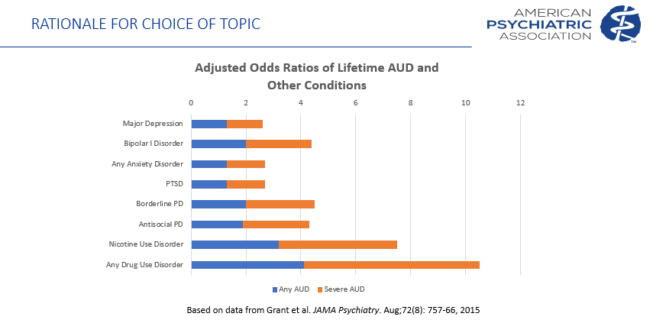
Alcohol Use Disorder
Risks
Drinking at an early age
Genetics & FHx
Trauma
Mental health conditions
Notes:
<15yrs, particularly in females
Heredibility = 60%
Interplay of genes & environment
Depression/PTSD/ADHD

Slide 14
Prevalence
84% >18yr olds have drunk at least once
11% >18yr olds have had AUD in the last year
AUD is the 4th preventable cause of death in the US
AUD is a contributor to suicide risk
55% of fatal driving events are linked to alcohol
1 in 10 ED attendances in England are alcohol related
<5% with AUD receive treatment

Slide 15
Definitions/Terminology
Binge drinking
F = ≥4 drinks in 2hrs
M = ≥5 drinks in 2hrs
Kindling
Withdrawal effects are more pronounced with each successive withdrawal event
Dependency
Loss of control
Excessive desire
Increased tolerance
Withdrawal
Notes:
Binge drinking is more associated with increased recklessness & accidents
Alcoholism

Slide 16

Notes:
How do we apply this to older adults?

Slide 17

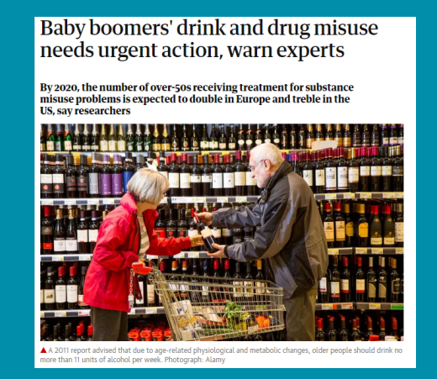
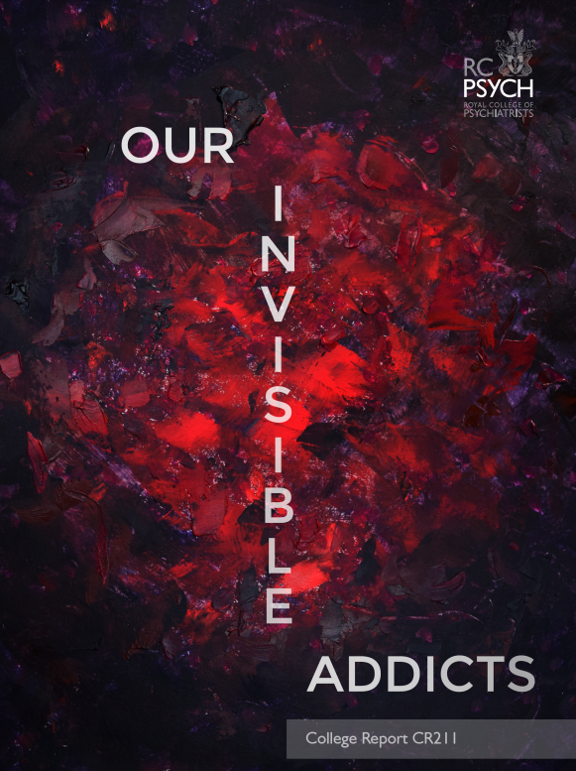
Notes:
Baby boomers refers to those born from 1946 – 1964
Witnessed a more permissive attitude towards drugs & ETOH than prior generations
New drinks were introduced such as lager
Wine producers targeted baby bloomers
Supermarket prices were cheaper (price relative to income has halved since the 60s)
Weakening of patriarchal taboos on women’s drinking
Change to the licensing act
Focus was on responsible drinking rather than harm reduction to allow a more competitive approach

Slide 18
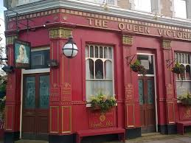
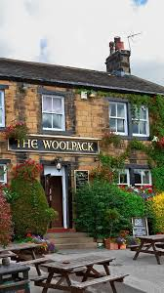
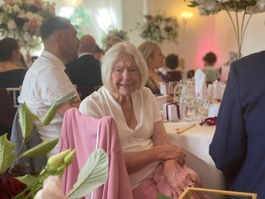
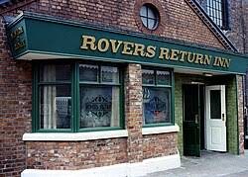
My nan
Notes:
Coronation Street
Eastenders
Emmerdale

Slide 19
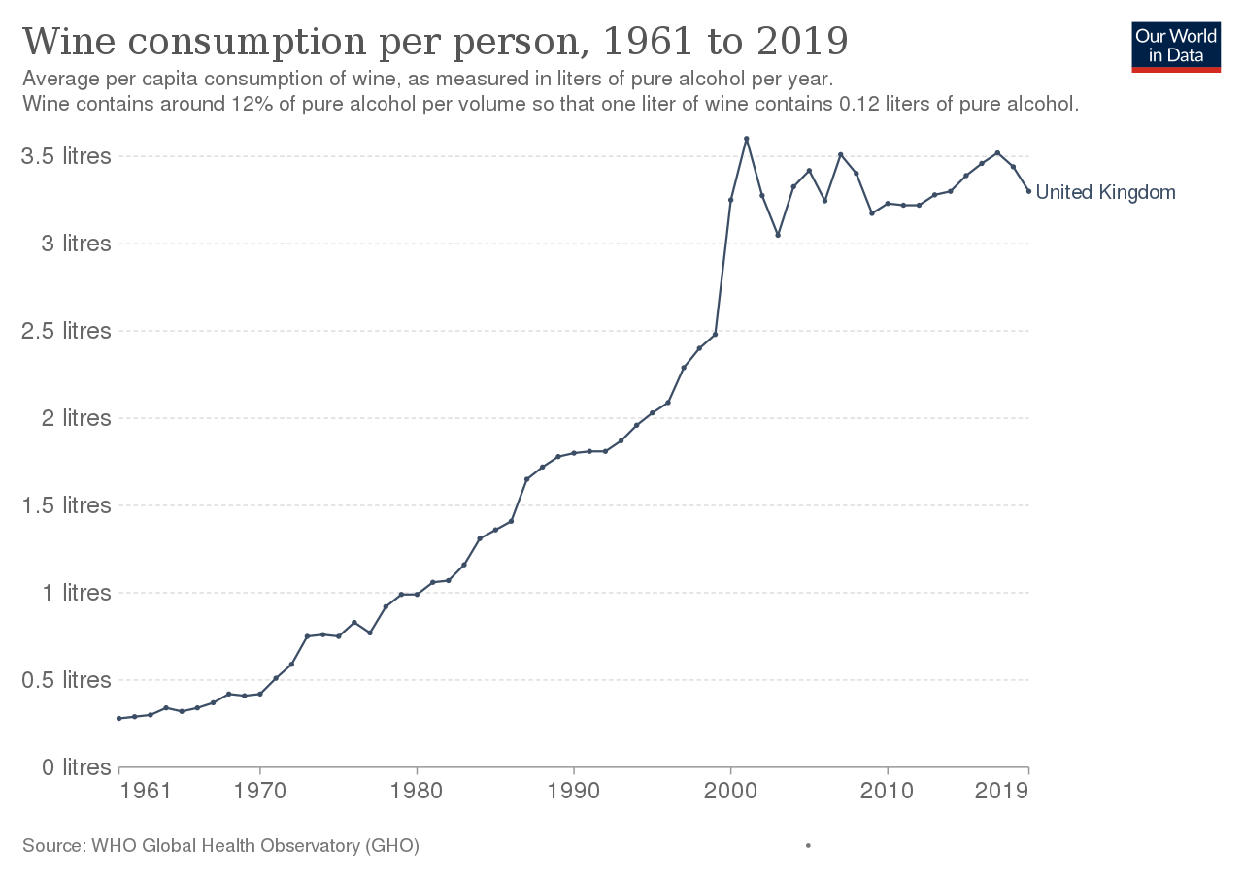
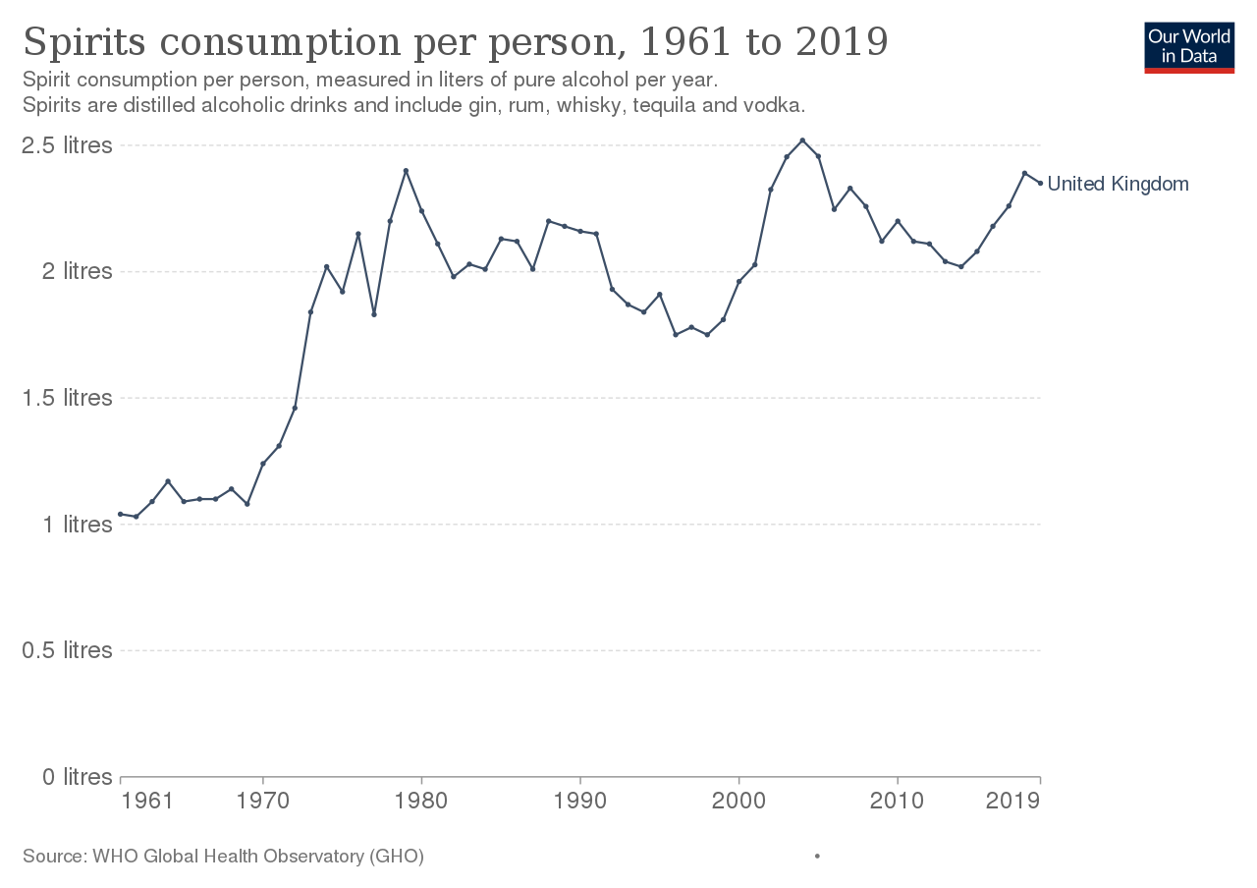
Consumption

Slide 20
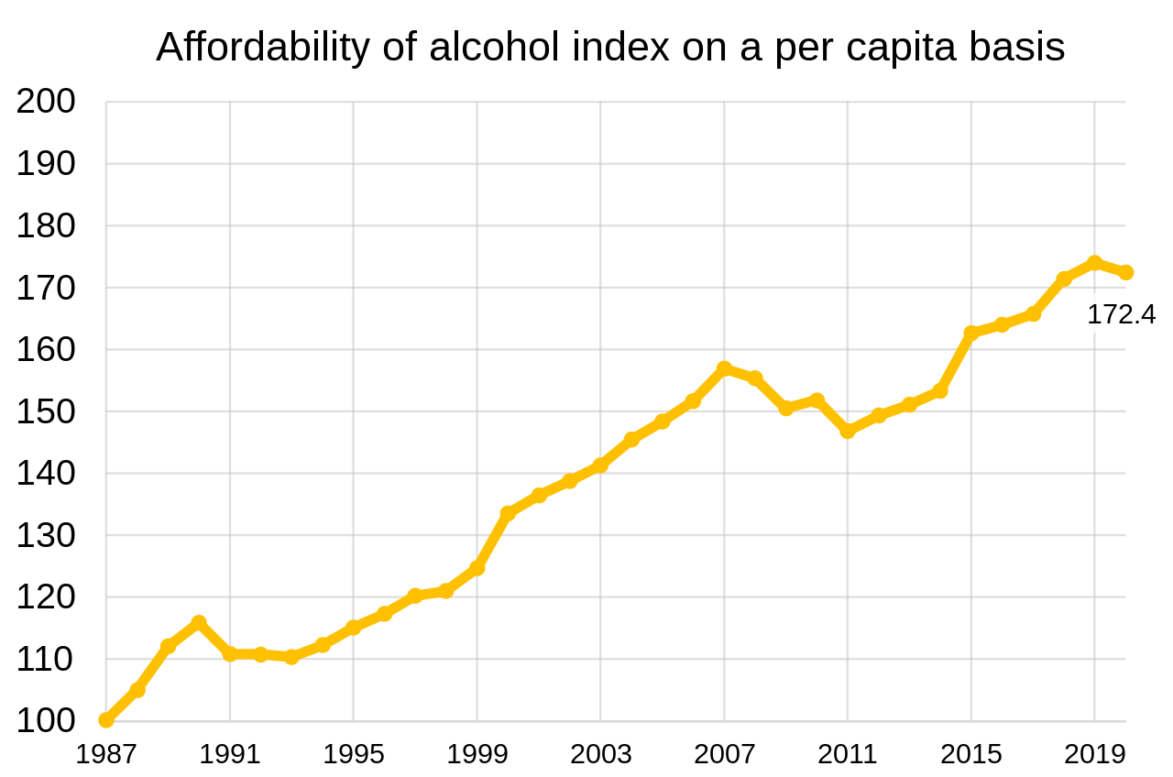
Notes:
In 2020 alcohol sold in the UK was 73% more affordable than it was in 1987

Slide 21
Older adults
NHS Digital – Health Survey England 22
30% of 55-74yr olds drinking >14 units /week
Age UK
NHS spends more on alcohol related treatment for 55-74yr olds
2/3rds of alcohol related admissions are >55yrs
Levels of alcohol intake are declining in all groups except 55-64yr olds
Notes:
Compared to 19-24% in other age groups
Compared to 16-24yr olds
Where in fact it is rising
Since 2012 this group have the highest consumption

Slide 22
Alcohol in the Elderly
1/3rd of older adults with alcohol misuse develop the problem in later life
Higher level of education
Higher level of income
More likely to have a better support network
Increased association with increased access & use of health care
2015 study
Up to 11% of elderly hospital admissions were due to drug & alcohol related issues

Slide 23
Older Drinkers – Why is it a problem?
Side effects are often overlooked or mistaken for normal ageing
Reduced disclosure
Physiological ageing – pharmacological effects of alcohol are different
As we age, alcohol consumption can make existing health problems worse
Interaction with medications
Significant overlap with depression
Notes:
Failure to look due to misperceptions/cognitive bias
In addition to delirium, cognitive impairment or medication side effects
40% of >65yr olds have polypharmacy
Overlapping mental health conditions (cognitive impairment) mean complex psychiatric co-morbidity

Slide 24
Triggers
Death of a spouse
Moving to a new home environment
Failing health
Loss of independence
Loneliness
Boredom
Anxiety

Slide 25
Pharmacology – Alcohol & Ageing
Ageing has effects at both cellular & organ level
Reduced lean body mass
Reduced distribution
Increased peak concentration with any given dose
Increased fat
Break alcohol down more slowly
Reduced blood flow through the liver
Decreased metabolic capacity
Absorption of drugs can be affected
Protein binding
Enhanced drug metabolism
Poor clearance (narrow therapeutic window)
Notes:
Reduced body water (alcohol is water soluble) – so less dilute with higher concentrations in the blood stream
Increased sensitivity to effects
Reduced ability to absorb vitamins & nutrients

Slide 26
Adverse Effects

Slide 27
Short Term Risks
Accidents & injuries
Violent behaviour
Unprotected sex/STDs
Loss of valuables
Poisoning
Notes:
Head injuries – trauma population
Perpetrator or victim (1.2m incidences/yr in England related to alcohol)

Slide 28
Long Term Effects
Heart disease
Stroke
Liver disease
Pancreatitis
Brain damage
Osteoporosis
Reduced immunity
Infertility
Cancers
Liver cancer
Bowel cancer
Oral cancer
Breast cancer

Slide 29
Social Effects/Problems
Unemployment
Divorce
Domestic abuse
Homelessness
Financial concerns

Slide 30

Adverse Effects – Falls & Fractures
Impair judgement, co-ordination & reaction time
Older adults have an increased vulnerability to falls
Chronic alcohol use:
Myopathy
Neuropathy
Cerebellar damage
Osteoporosis
Higher age-adjusted rates of hip fracture
Consider bone health in fallers
Vitamin D correction
Bisphosphonates (usually IV Zoledronate given compliance & GI side effects)
Notes:
Alcohol is a known factor in 65% of fatal falls

Slide 31
Alcoholic Neuropathy
Mechanism poorly understood
Activation of spinal cord microglia
Free radical damage by oxidative stress
Activation of mGlu5 receptors in the spinal cord
Activation of the sympathoadrenal & hypothalamo-pituitary-adrenal axis
Nutritional deficiency (thiamine)
Direct toxic effect of alcohol
Not reversible

Slide 32
Alcoholic Neuropathy
Symptoms
Progressive
Burning pain in the extremities
Hyperalgesia
Allodynia
Motor & sensory
Gait impairment
25-66% (US data) of chronic alcoholics
Associated with duration & total lifetime consumption
Increased incidence in women

Slide 33
Alcoholic Neuropathy
Treatment
Abstinence
Nutritionally balanced diet
Neuropathic agents
Gabapentin/amitriptyline (limited evidence)
Some evidence for topical capsaicin
Tricyclic antidepressants/SNRIs

Slide 34
Adverse Effects – Brain (ARBD)
Superimposed on disorders of cognition
Delirium
Hepatic encephalopathy
Wernicke’s encephalopathy
Korsakoff’s syndrome
Global cognitive impairment (alcohol related dementia)
Depression
Disturbed sleep
Notes:
ARBD – Wernicke’s/Korsakoff’s/ARD
3 in 10 with dependency will have ARBD (all ages)
F = >50 units/wk >5yrs
M = >60 units/wk >5yrs
Nerve cell damage = memory & behaviour
Vitamin B1 deficiency
Head injury
Cerebellar damage – balance & falls
Atrophy

Slide 35

Delirium Tremens
Rapid onset of confusion caused by withdrawal
Symptoms
Autonomic hyperactivity – tachycardia/hypertension
Tremor
Fevers
Sweating
Agitation/disorientation/nightmares/confusion
Visual, auditory & tactile hallucinations (illusions)
Treatment is with benzodiazepines – chlordiazepoxide
Thiamine
Quiet & well-lit environment
CIWA scoring
Mortality without treatment – 15-40%
Associated increased LOS
CIWA
Clinical Institute Withdrawal Assessment of Alcohol Scale
Notes:
Autonomic dysfunction in addition
Usually 2-3 days after stopping alcohol intake (can be up to 5)
Chlordiazepoxide is usually a fixed regime based on usual intake or PRN
Accumulates in liver disease so lorazepam preferred (shorter acting)
Limited evidence in older adults
Potentially in older adults there may be a preference for short acting benzos to avoid over sedations
CIWA – Scoring out of 67; <8-10 individuals don’t need treatment
- Series of domains such as nausea & vomiting, agitation, confusion, tremor, hallucinations

Slide 36
Withdrawal in Older Adults
Reasons for withdrawal may be different to younger individuals
Vigilant
Hospitalisation – unexpected delirium during first few days of admission
Side effects
Reduced accessibility
Financial strain
Reduced social engagement
Study of older adults withdrawing in hospital
Increased risk of delirium
Increased risk of falls
Increased risk of dependency

Slide 37
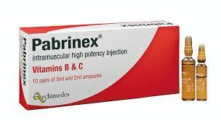
Wernicke’s Encephalopathy
Thiamine deficiency (B1)
Oxidative damage & mitochondrial injury leading to apoptosis
Triad:
Ophthalmoplegia (lateral nystagmus)
Ataxia (cerebellar signs)
Confusion
Timely replacement of thiamine
The presence of only 1 sign should be sufficient for treatment
Notes:
The body only has 2-3 weeks of thiamine stores
Can occur in non-alcohol relation pathology (nutritional deficiencies); low threshold if malnourished
10% will have all 3 features – more so in alcohol related cases
80% only have confusion
If hypoglycaemic & glucose given it rapidly consumes the remaining thiamine reserves exacerbating the condition so thiamine must be given concurrently

Slide 38
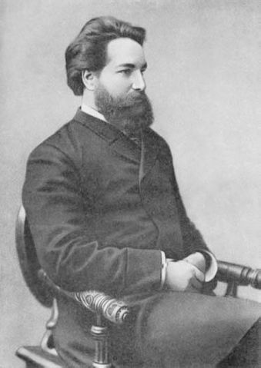
Korsakoff’s Syndrome
Thiamine deficiency
Damage to the medial thalamus & mammillary bodies of the posterior hypothalamus (limbic system)
Symptoms
Anterograde amnesia
Retrograde amnesia
Fixation amnesia (loss of immediate memory)
Confabulation
Minimal content in conversation
Lack of insight
Apathy
Personality change
Thiamine – IV followed by PO treatment for 3-12/12
Only 20% of cases are reversible (apparent within 2yrs)
Notes:
Untreated Wernicke’s
Short term memory impairment predominantly
Difficulty learning new things
Loss of memories
Recovery is often slow & incomplete

Slide 39
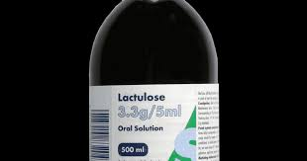
Hepatic Encephalopathy
Altered state of consciousness as a result of liver failure (20%/yr)
Triggers include:
Infection
Bleeding
Constipation
Electrolyte disturbance
Driven by a build up in ammonia
Characteristic liver flap
Classification (West Haven Criteria)
Grade 0
No obvious change other than mild reduction in co-ordination
Grade 1
Lack of awareness, anxiety, reduced attention span
Grade 2
Lethargy, mild disorientation, inappropriate behaviour
Grade 3
Confusion, significant disorientation, reduced responsiveness
Grade 4
Coma
Notes:
In those with cirrhosis risk of HE is 20% per year
NASH
Laxatives ++/bowel opening

Slide 40
Alcohol Related Dementia
Difficult to diagnose (lack of specific diagnostic criteria)
Korsakoff’s & Wernicke-Korsakoff syndromes are forms of alcohol related brain injury that may be related to alcohol related dementia
Impaired executive function
Short term memory loss
Global cognitive impairment
Usually a spectrum of global dementia & Korsakoff’s
History & accompanying signs (neuropathy & ataxia) may help with diagnosis
Notes:
Profound cerebral atrophy
Difficulty with problem solving
Personality change
No effect on language

Slide 41
Adverse Effects - Gastrointestinal
Liver disease
Fatty liver
Alcoholic hepatitis
Cirrhosis
GI bleeding
Pancreatitis
Notes:
GI bleeding is a common presentation of alcoholic liver disease in the elderly

Slide 42
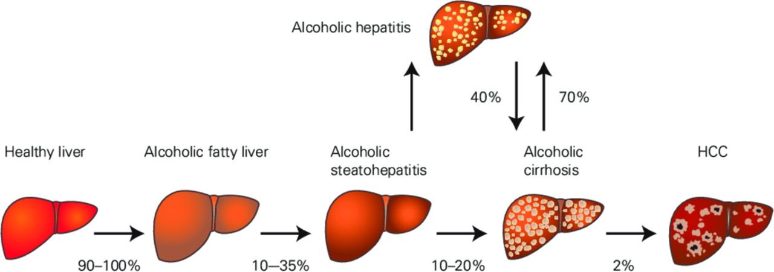
Notes:
Deranged liver function tests are seen in 18% of older adults

Slide 43
Alcoholic Hepatitis
Inflammation of the liver
Damage to the intestinal absorptive cells (enterocytes) leads to increased intestinal permeability
Gut bacteria then enter the portal circulation & travel to the liver where they cause hepatocyte damage
Inflammatory cascade
Acute or chronic
Signs & symptoms
Jaundice
Ascites
Fatigue
Hepatic encephalopathy
Mortality is 50% within 30 days of onset
Diagnosis
Hx of significant alcohol intake with worsening LFTs including bilirubin & aminotransferases with onset on jaundice within the last 8 weeks
Treatment
Abstinence
Nutritional supplementation
Corticosteroids

Slide 44
Cirrhosis
50% of elderly patients with cirrhosis die within one year of diagnosis
Damage causes tissue repair
Formation of scar tissue known as fibrosis
Replaces normal functioning tissue leading to impaired function & cirrhosis
10-20% of heavy drinkers
Diagnosis – Hx/Examination/Imaging
USS – small, shrunken liver with increased echogenicity & irregularity
Prognosis – Child-Pugh scoring
Not reversible
Symptoms
Fatigue
Loss of appetite
Nausea
Liver dysfunction
Jaundice
Pruritis
Skin changes – spider nevi
Gynaecomastia
Testicular atrophy
Bruising
Portal hypertension
Ascites
Oedema
Varices - GI bleeding
Notes:
NASH

Slide 45
Pancreatitis
Acute or chronic
Epigastric or LUQ pain radiating to the back
Nausea & vomiting that is worse with eating
Fever & jaundice may be present
Unexplained weight loss
Loose, fatty & pale stools
Alcohol is the single most common cause of chronic pancreatitis (70%)

Slide 46
Pancreatitis
Complications
Malabsorption
Osteoporosis
Diabetes (45%)
Pseudocysts
Abscesses
Diagnosis (2/3):
Characteristic pain
Amylase or lipase >3 times the upper limit of normal
Characteristic imaging appearance
Chronic
Faecal elastase levels will be low
Pancreatic insufficiency
5% >70yr olds
10% >80yr olds
Limited evidence as to whether therapeutic intervention is beneficial
Treatment
Abstinence
Management of pain
Management of complications
Treatment of insufficiency
Notes:
Marker of exocrine pancreatic function

Slide 47
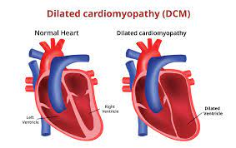
Adverse Effects - Cardiovascular
Moderate alcohol use exacerbates hypertension
Heavy alcohol use increases the risk of stroke
Alcohol binging is associated with arrhythmias
Chronic alcohol use can cause cardiomyopathy

Slide 48
Adverse Effects – Other
Immunosuppression
Increased infection risk
Aspiration pneumonia
Reactivation of TB
HIV
Nutritional deficiencies – folate & thiamine
Malignancies
Head & neck
Oesophagus
Liver
Notes:
HIV should not be overlooked in older adults with atypical infections especially with a history of polysubstance abuse
Individuals derive their calories from their alcohol

Slide 49
Case Example 1
81M
Retired GP
PC:
Unwitnessed fall from standing height
Injuries
Right hip fracture
R radial fracture
Burst T12 fracture
L 10th rib fracture
L renal laceration
Trauma CT
Liver cirrhosis with splenic varices
PMH:
Dementia
CVA
Prostate Ca – treated
SH:
Frail
Downstairs living
Ex-heavy smoker & drinker

Slide 50
Case Example 1
Recurrent pneumonia
Haematuria – needing cystoscopy x2 & SPC
Decompensated liver failure
Worsening ascites
Renal failure & difficult fluid balance
Spontaneous bacterial peritonitis – E.Coli
Unfortunately passed away

Slide 51
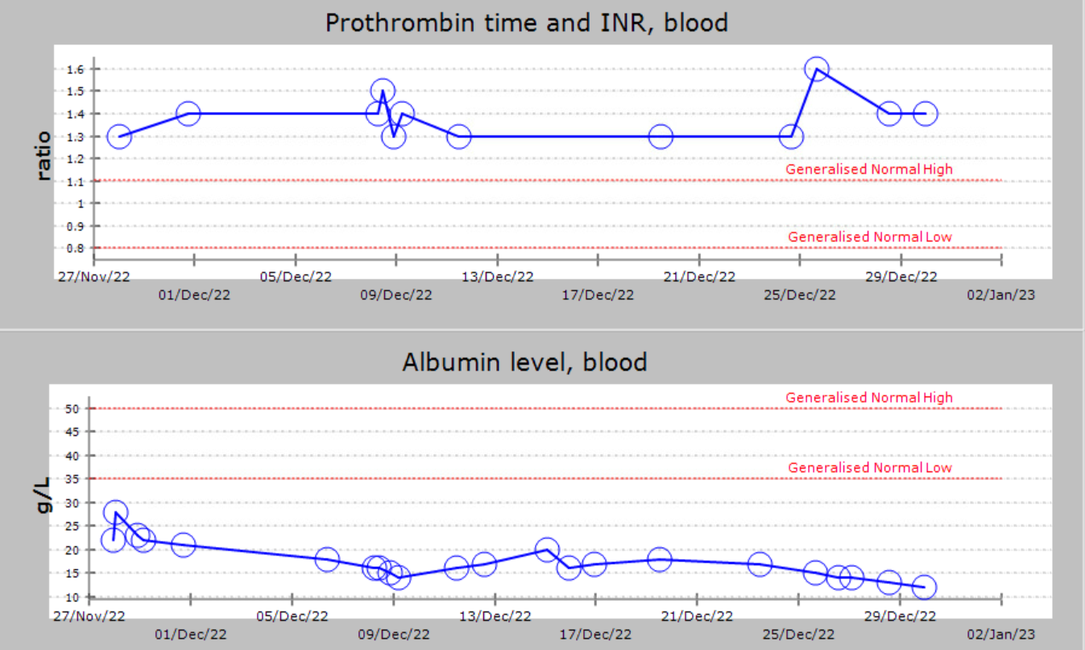

Slide 52
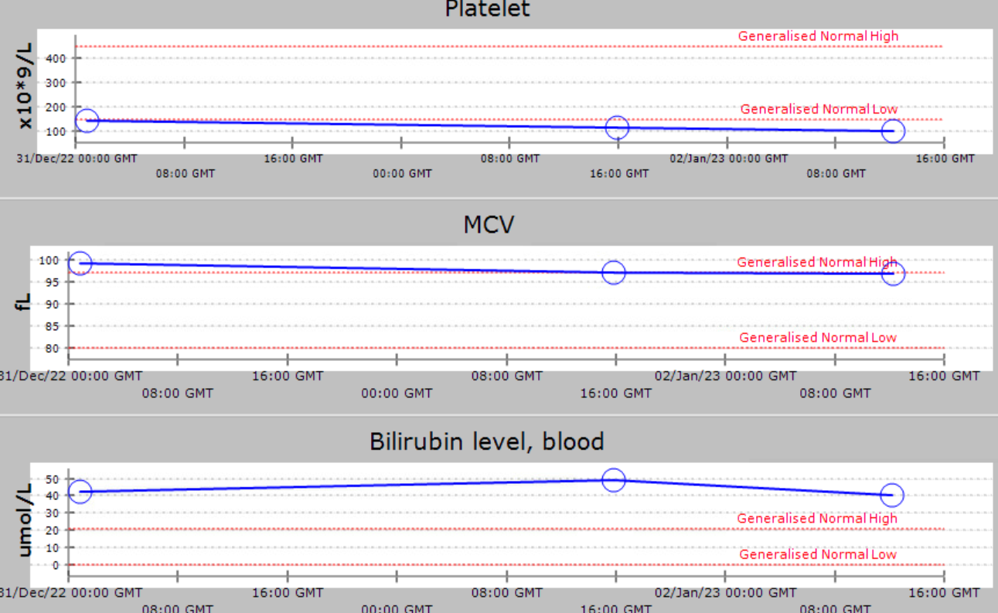

Slide 53
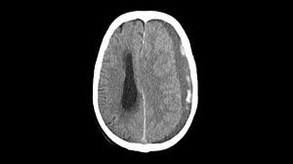
Case Example 2
88M
PC:
Fall whilst walking to the wine cellar
PMH:
CKD
AAA
Liver cirrhosis
Traumatic SAH
AF - On NOAC
SH:
Lives with wife
Independent with ADLs
Ex-smoker
Drinks a bottle of wine a night
CT head – Acute on chronic SDH
Results:
Platelets 109
MCV 100.3
INR 1.3
LFTs normal
Albumin 31
Discussion to be had about the NOAC
Notes:
Falls risk
CHADS VASC vs ORBIT
3 = 4.7 bleeds per 100pt yrs
3 = 3.2% risk of stroke & 4.6% risk of TIA/stroke
CHADS VASC 2 – 2.2%
ORBIT 5 = 8.1% bleed risk

Slide 54
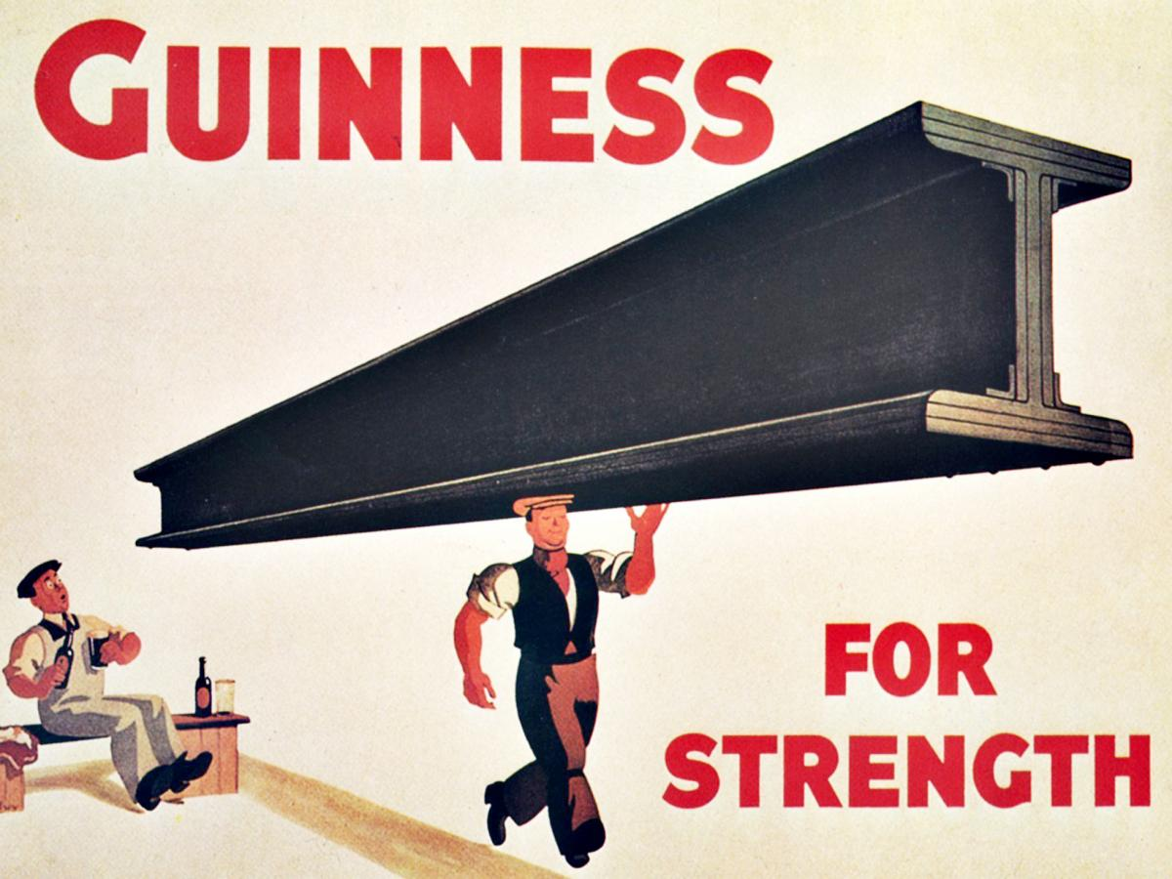

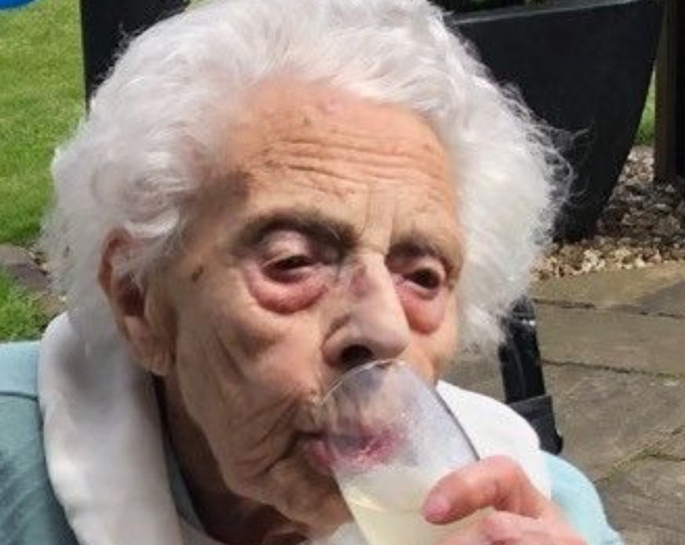
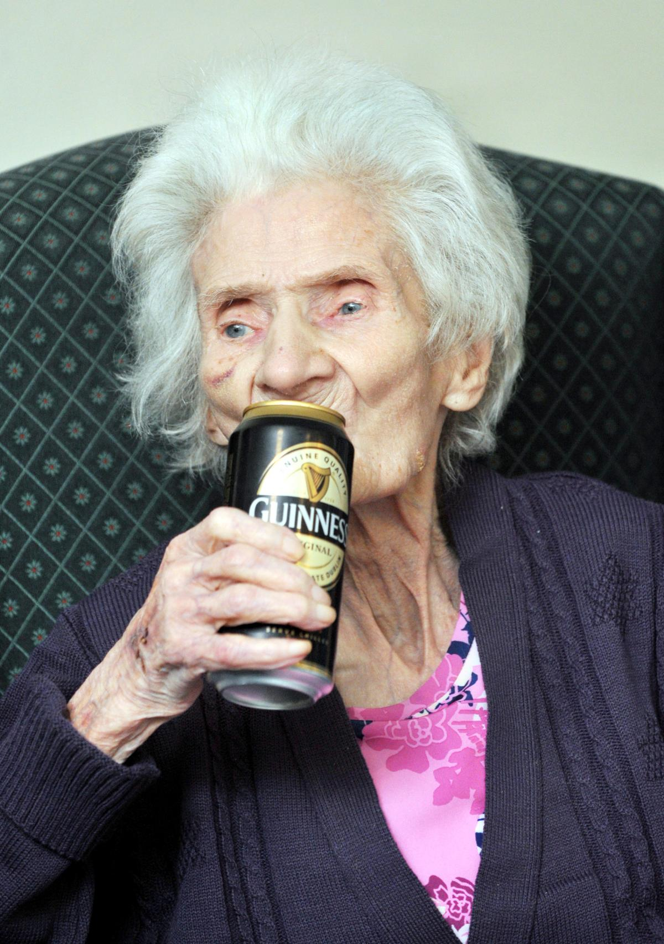
Any Health Benefits?
Notes:
Some evidence that mild/moderate alcohol intake may well be good for you
Reduced risk of MI
Study was in 40-50yr olds
There is also some potential benefit associated with reduced inflammation

Slide 55
New or worsening cognition
Neglect or reduced self care
Functional decline
Isolation
Poor adherence with treatment or appointments
Irritable or unreasonable when sober
Appearing intoxicated
RECOGNITION &
SCREENING
Running out of medications
Poorly controlled blood pressure
Increased tolerance to medications
Falls or injuries
GI problems
Chronic pain
Headaches
Decision making difficulty
Mood swings
Sleep disturbance
Unexpected delirium
Family estrangement
Raised MCV or GGT
Drinking to calm nerves
Gulping drinks
≥1 drink/day
Lying or trying to hide habits
Notes:
Investigations/Screening
- MCV
- GGT
- AST/ALT/ALP
- FBC
Those who do well in a hospital environment & badly at home/unexpected delirium

Slide 56
Recognition/Screening
Best response is to an empathic & non-confrontational approach
Open-ended questions
Tools
Vary across countries & cultures
Alcohol Use Disorders Identification Test (AUDIT)
AUDIT PC
AUDIT C
Single Question Alcohol Use Test (M SASQ)
Fast Alcohol Use Screening Test (FAST)
CAGE
Notes:
AUDIT & CAGE are insensitive >60
AUDIT PC is better
M SASQ – single question from audit; Designed for use in ED; More binge drinking focused
Primary care/ED focused

Slide 57

Longer Term Management
Counselling/medications/detox
National Initiative for the Care of the Elderly
“End goal of abstinence is not necessary or realistic for many older adults with substance use problems. Instead a more realistic goal is prioritisation of harm reduction & improved quality of life”
Better completion rate amongst the elderly
A one-time brief encounter of 15 mins or less can reduced non-dependent drinking in an older person by >20%
Notes:
Treatment of the underlying health problems/complications
Medicines – Naltrexone/Acamprosate/Disulfiram
Accessibility (physical & tech related)
Failure to address elderly/ageing specific issues
- Functional decline
- Bereavement
- Loneliness
- Co-morbidity

Slide 58

Longer Term Management
Education
Family support
Frail older adults may benefit from CGA
Care
Nutrition
Disulfiram (Antabuse) is not recommended in older adults
Counting units/keeping track/days a week/alternatives/removal/support
Notes:
Disulfiram
- Produces an acute sensitivity reaction to alcohol – essentially providing immediate withdrawal effects
- Blocks the enzyme that breaks down acetaldehyde (by product of alcohol)
Naltrexone
- Blocks opioid receptors so stopping the effects of alcohol
- More about maintenance & preventing relapse
- Reduced pleasure/cravings
Acamprosate
- Works on GABA & glutamate to restore balance
- Again, more about maintenance & preventing relapse
- Also reduces cravings

Slide 59
Summary
Unhealthy alcohol use is increasing amongst older adults
It is common but under recognised
Combined effects of alcohol & ageing cause significant problems
Be vigilant & consider screening older adults accessing health care
Think about secondary complications
Older adults have better outcomes in terms of reduction/abstinence

Slide 60

Questions

