Slide 1
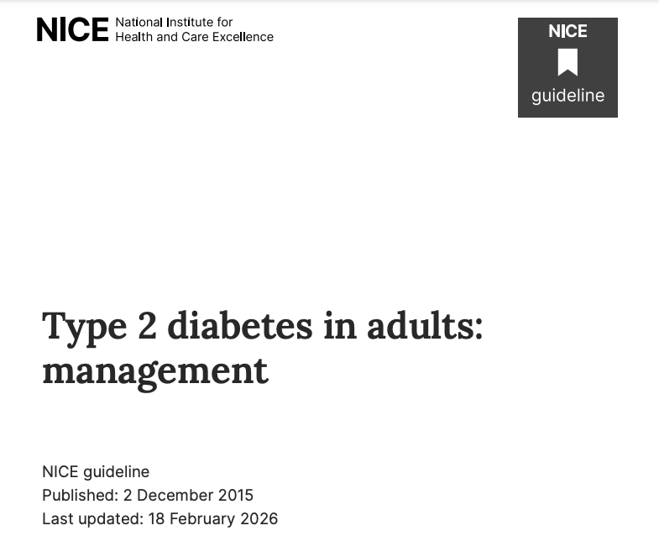

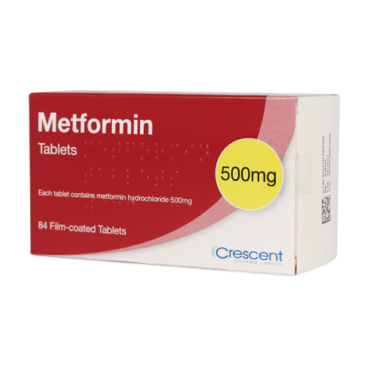
Diabetes in the older patient
Dr Louise Hogh
Consultant in General and Geriatric Medicine at Kingston & Richmond NHS Foundation Trust
&
Lead for of Year 3 & 4 of the Surrey Medical Programme (Clinical senior lecturer)

Slide 2
Aims of this session
Why an understanding of diabetes is important
Treatment goals in the management of diabetes in the elderly patient
Review of ‘newer’ diabetes medicines
    DPP-4 inhibitors (‘gliptins’) , SGLT- 2 inhibitors(‘glifozins’) and GLP-1 inhibitor
2026 NICE update (headlines)
Case study
  Common, emerging & important !
Notes:
This talk is hopefully going to cover things that are common, important, and things that are emerging /newer
“~15–20% of people >75 have diabetes (higher in frailty)” “Significant proportion undiagnosed” “Older adults often present atypically (e.g. falls, delirium, cognitive decline
Explain that diabetes management in older adults differs significantly from middle-aged populations.

Slide 3
Why diabetes is important to Old Age Psychiatrists
15–20% of people >75 yrs have diabetes (higher in frailty)
Significant proportion undiagnosed
Older adults often present atypically
  e.g. falls, delirium, cognitive decline, rec UTIs
Antipsychotics increase metabolic risk—monitoring is essential.
Diabetes is a risk factor for vascular dementia (exac. Alzheimer's dementia)
Notes:
Highlight that many patients under psychiatric care have diabetes.
Stress that hypoglycaemia may present as confusion or behavioural change. Antipsychotics (olanzapine, clozapine & quetiapine) increase metabolic risk with weight gain Insulin resistance Hyperglycemia → risk of type 2 diabetes—monitoring is essential.
Diabetes is a risk factor for vascular dementia and may cause further cognitive decline in Alzheimer’s disease (Katon et al, 2010). This may be related to tissue damage secondary to hyperglycaemia, micro- and macrovascular complications, insulin resistance and oxidative stress.

Slide 4
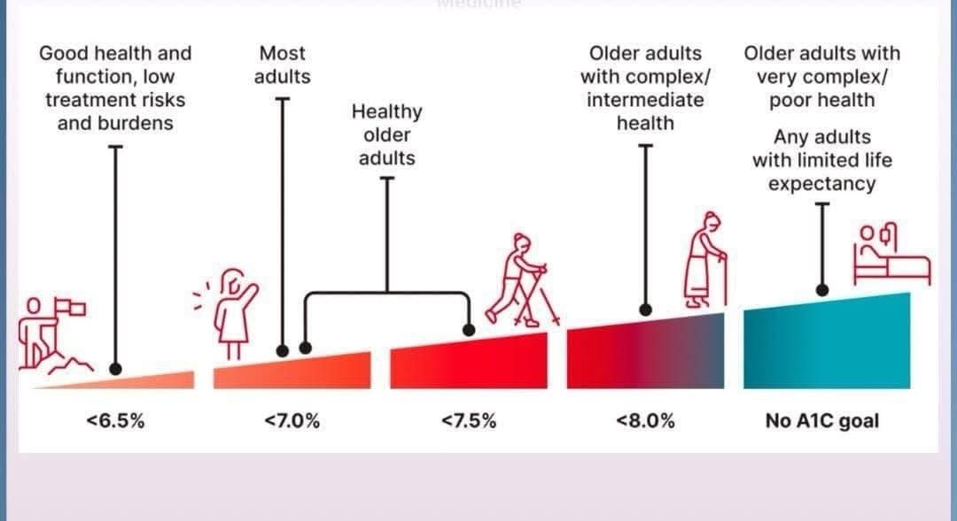
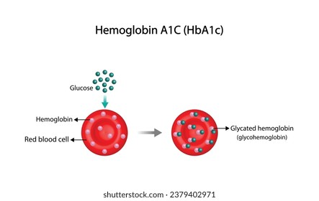
HbA1c Targets in Older Adults
Fit: 48–58 mmol/mol (6.5%)
Mild–moderate frailty:
  Aim for 58–64 mmol/mol
Severe frailty:
  avoid symptoms & hypos
End of life: comfort-focused
HbA1C
Since June 2011, the way HbA1C values are reported has switched from a percentage, to a measurement in mmols/mol.
Notes:
Discuss how tight control increases harm in frail elderly . Emphasize avoiding hypoglycaemia rather than strict numeric targets in advanced frailty as the long term risks of poor control are less relevant.
BMs 6-16 mmol/L

Slide 5
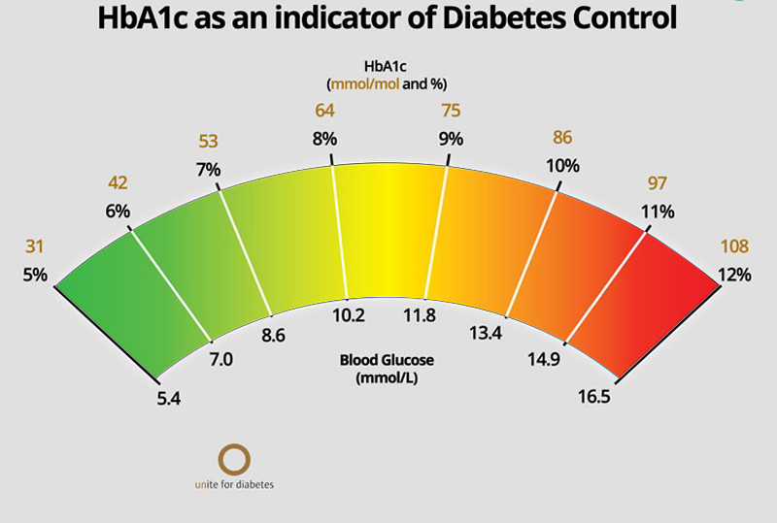
58-64
48-58

Slide 6
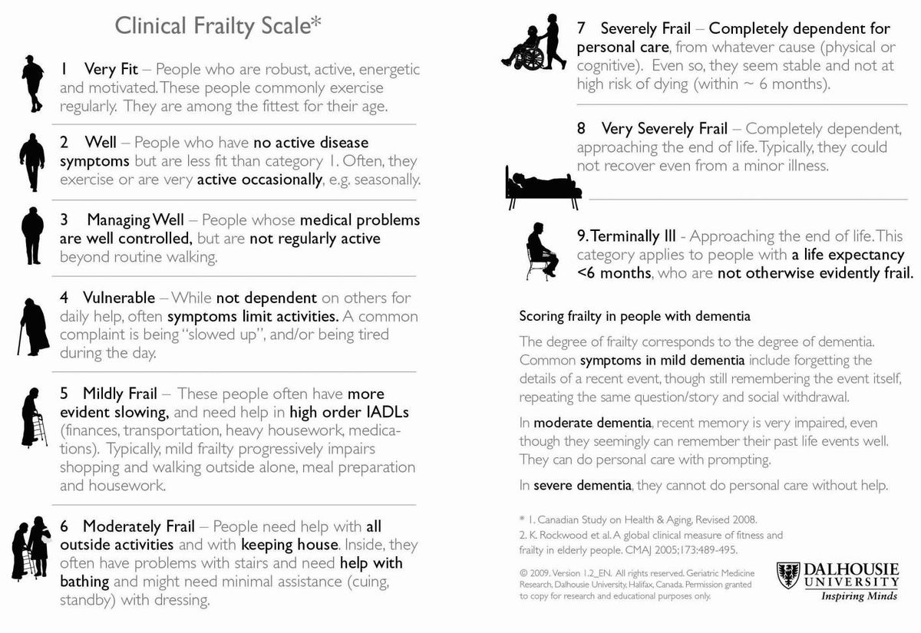
Rockwood frailty score
Notes:
Frailty may be defined as a state of reduced physiological reserve in multiple organ systems, which then may cause an increased risk of vulnerability to stressors
Frailty is more prevalent in older adults. With increasing age, frailty may encompass cognitive impairment, a reduction in cardiopulmonary function and sarcopenia, as well as psychosocial aspects of disease.

Slide 7
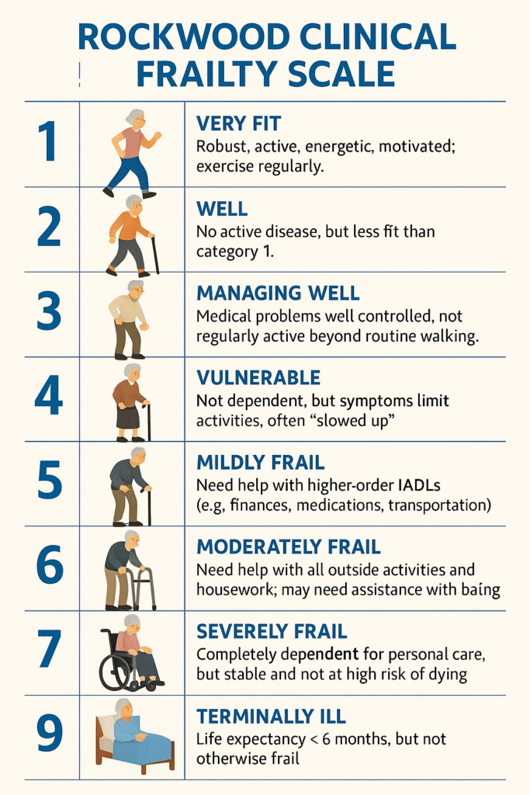
Healthy/pre-frail elderly
Status: CFS 1-4
Functional and independent, life expectancy of more than 10 years
Treatment goals
reverse frailty /limit progression
prevent or delay macrovascular and microvascular complications
Recommended interventions
Tight glycaemic control, resistance exercise and nutritional interventions, statin therapy unless contraindicated or not tolerated
Recommended targets
  HbA1c 6.5% (48 mmol/mol)
  Blood glucose 5.0 to 8.0 mmol/L
  BP less than140/90 mmHg

Slide 8
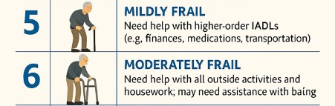
Mild-moderately frail
Status: CFS 5-6
  2 + co morbidities & reduced life expectancy
Treatment goals:
Prevent decline in quality of life,
limit the progression of microvascular complications,
avoid metabolic emergencies –hypoglycaemia
Recommended interventions:
Caution with metformin if eGFR 30-45ml/min, stop if eGFR <30ml/min.
If HbA1c <53mmol/mol reduce/stop sulfonylurea and/or insulin.
Do not use third line agents unless to control symptoms
Do not restrict diet if low weight or losing weight
Statin unless contraindicated/not tolerated
Recommended targets:
HbA1c <8% (64 mmol/mol)
BM 6-10 mmol/l but up to 11.5mmol/l, acceptable
BP less than140/90 mmHg

Slide 9
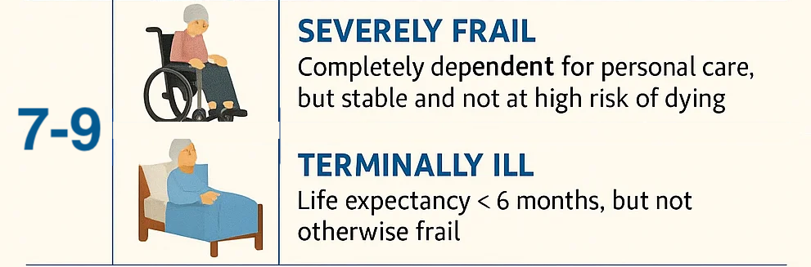
Severe frail- terminally ill
Status: CFS 7-9
Significant comorbidity, functional deficits, and limited independence, markedly reduced life expectancy
Treatment goals
Improve QOL by reducing symptoms or hospitalisations
maintain functional status, preventing significant disability
Recommended interventions
Less aggressive glycaemic targets but avoid hypoglycaemia and be aware that hyperglycaemia can increase risk of infection and cause urinary incontinence, thirst and dehydration, consider whether statin therapy is beneficial.
Recommended targets
Don’t focus on HbA1C
Focus on preventing hypos or symptomatic hyperglycaemia

Slide 10
A brief history of diabetic treatment…
1920s–1950s: Insulin, sulfonylureas, metformin
1990-2000s: DPP-4 inhibitors ‘gliptins’
2010s: SGLT2 inhibitors 'glifozins'
Personalised, early combination therapy
Notes:
Sulfonylureas work by increasing insulin secretion from pancreatic β-cells.Effective only if β-cells are functioning Risk of hypoglycaemia (insulin release is glucose-independent) Can cause weight gain
Metformin by reducing hepatic glucose production and improving insulin sensitivity.
Main effect is to ↓ Hepatic Gluconeogenesis (main effect)
Inhibits production of glucose from non-carbohydrate sources
Improves glucose uptake in:
Skeletal muscle
Peripheral tissues
Slight reduction in glucose absorbed from the gut
Weight neutral /lowering and no hypos
Insulin Lantus®, Abasaglar®, Toujeo® )
Duration: ~24 hours (Usually once daily
2. Levemir® Duration: ~12–24 hours
May require once or twice daily dosing
3. Insulin Tresiba®
Duration: >42 hours
Very flat profile
Key Features
No pronounced peak → lower hypoglycaemia risk (especially nocturnal)
Provide basal insulin coverage only
Often combined with:
Rapid-acting insulin (basal-bolus regimen)
Oral agents in T2DM
Glargine: precipitates in subcutaneous tissue → slow release Detemir: binds to albumin → prolonged action Degludec: forms multi-hexamers → very slow, steady release

Slide 11
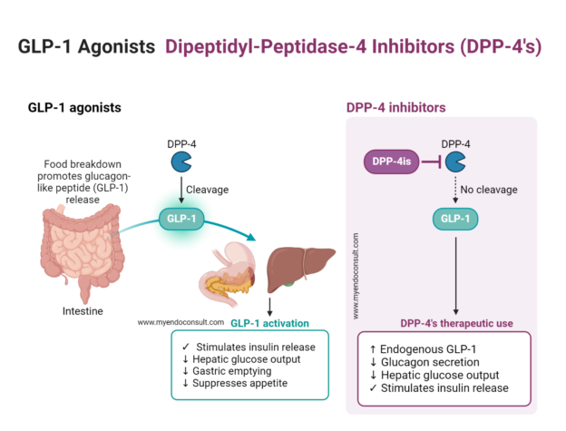
1990s–2000s: DPP-4 inhibitors (‘gliptin’)
Notes:
First introduced: ~2006–2007
First drug: Sitagliptin (FDA approved 2006, Europe 2007)
Clinical use began 20 yrs ago mid-2000s
Became widely used as second-line therapy in late 2000s–early 2010s
Dipeptidyl peptidase-4 (DPP-4) inhibitors, also called gliptins, work by blocking the DPP-4 enzyme, which normally breaks down incretin hormones such as GLP-1 and GIP. These hormones stimulate insulin release after meals and suppress glucagon secretion, which helps lower blood sugar levels. By inhibiting DPP-4, these drugs prolong incretin activity, improving both fasting and postprandial glucose control without typically causing hypoglycemia unless combined with other medications that lower blood sugar

Slide 12
DPP-4 inhibitors reduce post-prandial glucose by around 3 mmol/L and basal glycaemia by around 1.0–1.5 mmol/L.
weight-neutral
common side effects can include:
  sickness
  diarrhoea
  headache.
Generic name | Brand name
Sitagliptin | Januvia
Vildagliptin | Galvus
Saxagliptin | Onglyza
Alogliptin | Vipidia
Linagliptin | Trajenta

Slide 13
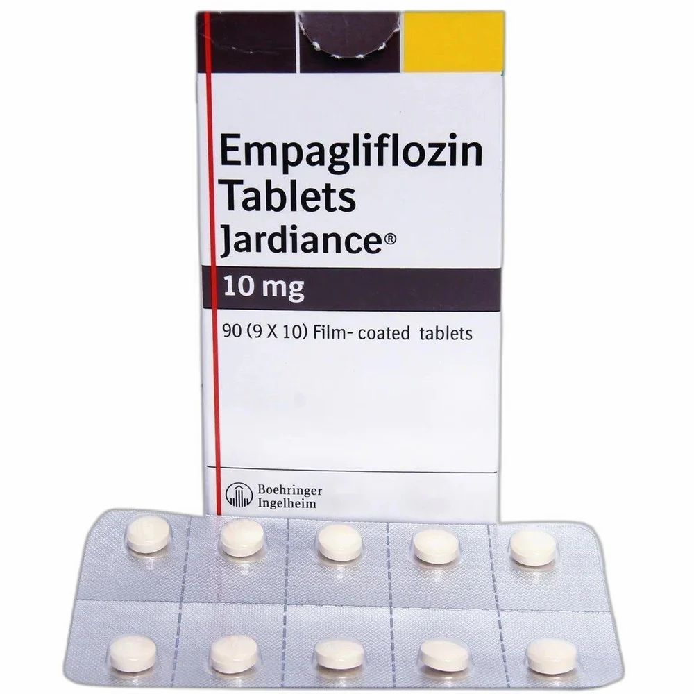
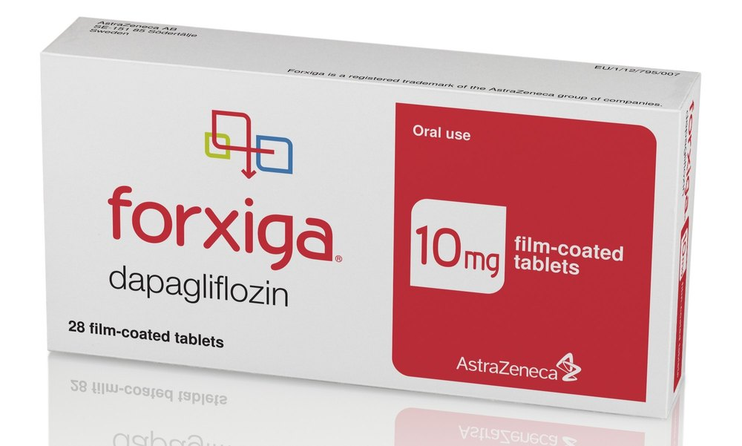
2010s: SGLT2 Inhibitors ‘gliflozins’
Sodium-glucose co-transporter-2 inhibitors
Dapagliflozin (Forxiga), Empagliflozin (Jardiance) , Canagliflozin (Invokana) and Ertugliflozin (Stegaltro)
Notes:
SGLT2 inhibitors are a type of medication you might need to take if you have T2DM. They are also known as gliflozins.
First introduced: ~2013
First drug: Canagliflozin (FDA 2013) followed by dapagliflozin, empagliflozin
Clinical use began early 2010s
Major shift in last 10 years 2015+ → cardiovascular outcome trials (e.g. EMPA-REG)

Slide 14
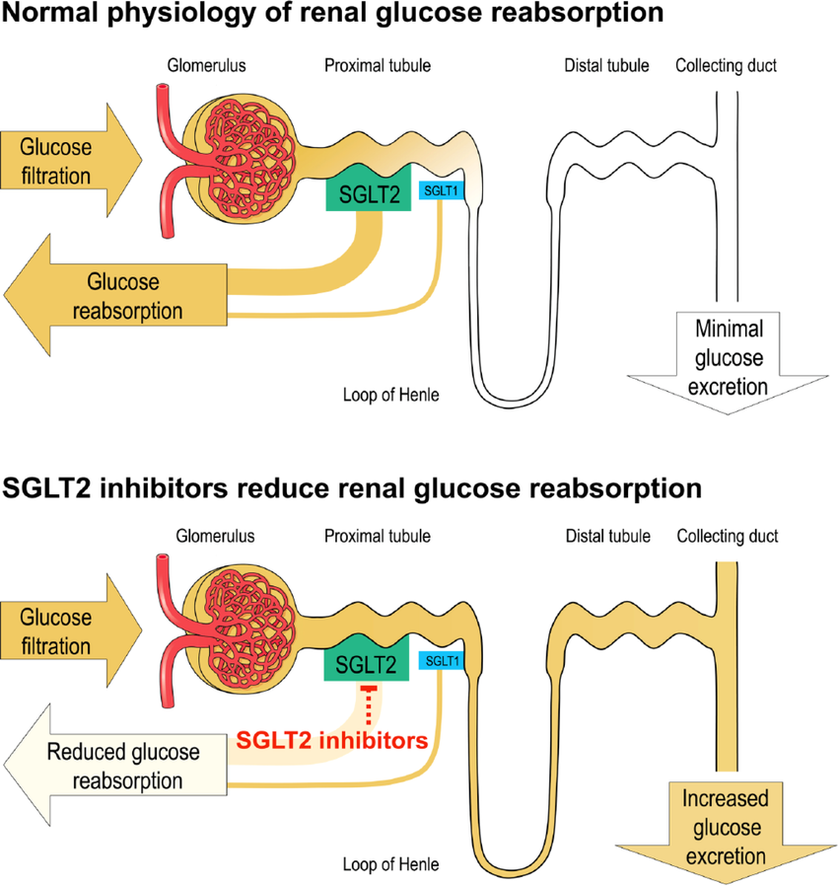
Mechanism of action
SGLT2 is a protein in humans that facilitates glucose reabsorption in the kidney.
90% of glucose is reabsorbed in S1 of the proximal tubule
10% of glucose resorbed in distal S2/3 segment via SGLT1
If SGLT2 is blocked, glucose reabsorption is blocked and excreted in the urine
Lower blood glucose levels
Notes:
Explain osmotic diuresis and BP lowering. Particularly beneficial in heart failure. Caution in frail elderly with poor intake or postural hypotension.
These medicines were first developed to treat people with type 2 diabetes. They lower blood glucose (sugar) by increasing the amount of glucose in the urine. They have added benefits too. They can protect the kidneys and heart. They can slow the decline of kidney disease. They can reduce the risk of heart failure and heart attacks. These benefits apply to all people, not just those with type 2 diabetes. Sometimes they can also reduce blood pressure and weight. This is an additional advantage. For most people, the benefits outweigh the possible side effects.

Slide 15
SGLT2 Inhibitors
Use as monotherapy or in combination with insulin or other antidiabetic drugs
Dose: 10mg od
  Heart failure benefit
  CKD progression slowed
  Low hypoglycaemia risk
  Risk: dehydration, genitourinary infections, DKA (rare)
Sick Day Rules
  interrupt SGLT2 inhibitor treatment in patients who are hospitalised for major surgery or acute serious illnesses; treatment may be restarted once the patient's condition has stabilised
Notes:
European Medicines Agency has concluded that serious, life-threatening, and fatal cases of diabetic ketoacidosis (DKA) have been reported rarely in patients taking an SGLT2 inhibitor. In several cases, the presentation of DKA was atypical with patients having only moderately elevated blood glucose levels, and some of them occurred during off-label use.
To minimise the risk of such effects when treating patients with a SGLT2 inhibitor, the European Medicines Agency has issued the following advice:
inform patients of the signs and symptoms of DKA, (including rapid weight loss, nausea or vomiting, abdominal pain, fast and deep breathing, sleepiness, a sweet smell to the breath, a sweet or metallic taste in the mouth, or a different odour to urine or sweat), and advise them to seek immediate medical advice if they develop any of these
test for raised ketones in patients with signs and symptoms of DKA, even if plasma glucose levels are near-normal
use dapagliflozin with caution in patients with risk factors for DKA, (including a low beta cell reserve, conditions leading to restricted food intake or severe dehydration, sudden reduction in insulin, increased insulin requirements due to acute illness, surgery or alcohol abuse), and discuss these risk factors with patients
discontinue treatment if DKA is suspected or diagnosed
do not restart treatment with any SGLT2 inhibitor in patients who experienced DKA during use, unless another cause for DKA was identified and resolved
interrupt SGLT2 inhibitor treatment in patients who are hospitalised for major surgery or acute serious illnesses; treatment may be restarted once the patient's condition has stabilised

Slide 16
The incretin hormones play a crucial role in a healthy insulin response
Plasma glucose
Insulin response
15
270
80
60
10
180
Plasma glucose (mmol/L)
Insulin (mU/L)
Incretin
effect
40
Plasma glucose (mg/dL)
5
90
20
0
0
0
–10
–5
60
120
180
–10
–5
60
120
180
Time (min)
Time (min)
Oral glucose load (50 g/400 mL)
IV glucose infusion
  Insulin response is greater following oral glucose than IV glucose, despite similar plasma glucose concentration
Nauck et al. Diabetologia 1986;29:46–52, healthy volunteers (n=8)
Notes:
Incretins are released in the duodenum after eating and augment the secretion of insulin from the pancreas
decrease blood glucose levels
The incretin hormones play a crucial role in a healthy insulin response
The effect of incretins on insulin secretion is clearly indicated in this study.
Healthy volunteers (n=8) fasted overnight before they received an oral glucose load of 50 g/400 ml o
r an isoglycaemic intravenous glucose infusion for 180 minutes.
As can be seen in the left figure, venous plasma glucose concentration was similar with both glucose
interventions. However, insulin concentration was greater following oral glucose ingestion than following
intravenous glucose infusion, demonstrating the contribution of incretins on insulin secretion.

Slide 17
GLP-1 Receptor Agonists – Key Points
Glucagon-like peptide-1 receptor (GLP-1R) agonists are a group of drugs that targets incretin hormone action
Receptors distributed in nerves, islets, heart, lung, skin, and other organs
Enhance glucose-dependent insulin release
  Weight loss
  CVD benefit
  Low hypoglycaemia risk
  But …GI side effects common
Notes:
Explain satiety and slowed gastric emptying.
Weight loss may be helpful in obesity but harmful in frailty or sarcopenia.

Slide 18
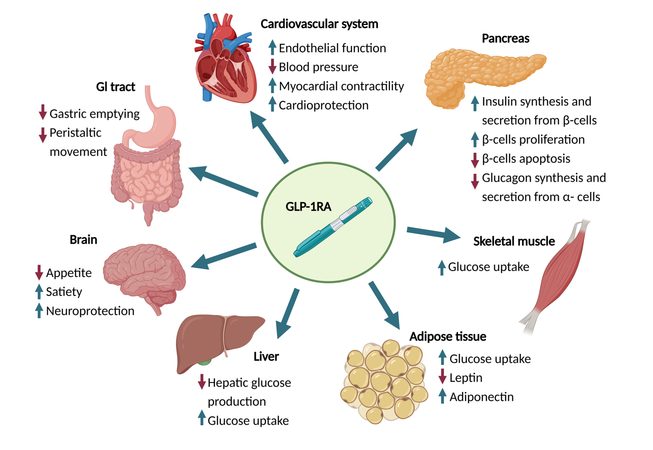
Semaglutide (Ozempic / Wegovy)
Notes:
As receptors are distributed in nerves, islets, heart, lung, skin, and other organs
This diagram highlights the effect of the enhanced incretin secretion on the end organs
Risk of gallbladder disease
Weight loss

Slide 19
NICE NG28 (2026) T2DM update– themes updated from 2015
Shift toward outcomes beyond glucose
Background
T2DM is a major driver of:
  Cardiovascular disease
  Chronic kidney disease
  Premature mortality
Older approach: Focused mainly on HbA1c
New approach: Focus on cardio-renal risk + long-term outcomes
“Treat the patient, not just the sugar”
Notes:
.
Explain that guidance increasingly prioritises organ protection rather than glucose alone. Reassure audience that simplification in frailty is supported by guidelines

Slide 20
Medication changes
First-Line Therapy Change
SGLT2 Inhibitors Early
  Metformin alone first-line
Now: Metformin + SGLT2 inhibitor early (often at diagnosis)
To
  ↓ heart failure
  ↓ CKD progression
  ↓ CV mortality
Early Combination Therapy
Move away from stepwise escalation
  Add drugs only if HbA1c rises
Now: Start combination therapy early
  Early intervention = better long-term outcomes
  Avoids “therapeutic inertia”
Notes:
Start everyone on metformin + SGLT2 early
This applies to adults with type 2 diabetes regardless of whether they have established cardiovascular disease, obesity, or chronic kidney disease.
This reflects strong evidence that SGLT2 inhibitors reduce:
Heart failure hospitalisation
Progression of chronic kidney disease
Cardiovascular mortality
This marks a clear shift from a glucose-centric model to a cardio-renal protection mode
Then branch based on comorbidities

Slide 21
Triple therapy is now recommended first-line in cardiovascular disease
High-Risk Patients
Patients with established IHD
High cardiovascular risk
Consider (early):
Metformin + SGLT2i + Semaglutide (GLP-1 RA)
  Additive cardiovascular benefit
  Weight loss + glycaemic control
GLP-1 & Newer Agents
GLP-1 receptor agonists used earlier
Tirzepatide increasingly relevant
Benefits:
Significant weight loss
CV risk reduction
Useful in obesity + early-onset T2DM
Insulin:
Dehydration, weight loss, rapid reduction or if intolerance to oral agents (poor control or
s/e: advanced CKD limiting options GI intolerance)

Slide 22
Personalised Care
Individualised Treatment considering
  Age
  Frailty
  Comorbidities
Pathways now guided by
  What risk you’re trying to reduce (CVD/ HF, CKD, frailty)
  Shared decision-making & patient preferences
No ‘one-size-fits-all’

Slide 23
In summary….
The NICE 2026 update represents a fundamental shift in the management of type 2 diabetes.
Treatment is no longer focused solely on reducing HbA1c.
Instead, must consider:
  Cardiovascular risk
  Kidney protection
  Weight
  Frailty
  Long-term outcomes
In practical terms, most newly diagnosed patients should now be started on:
Modified-release metformin and an SGLT2 inhibitor (‘glifozins)
Conclusion
These changes will improve patient outcomes by reducing cardiovascular events, slowing kidney disease progression, and supporting safer prescribing.

Slide 24
Case 1- KH
82-year-old man
Diagnosed with type 2 diabetes in 2003 and has dementia.
Weight: 70 kg
BMI: 22.4 kg/m²
HbA_{1c}: 45 mmol/mol (61 mmol/mol in January 2023)
BP: 138/90 mmHg
eGFR: 60 mL/min/1.73 m²
Past medical history: Advanced dementia; paroxysmal atrial fibrillation
Medications: Metformin 1 g twice daily; gliclazide 80 mg twice daily; Toujeo (insulin glargine) 8 units. Rivaroxaban; Omeprazole; Memantine; Risperidone; Mirtazapine
Family history: Unknown. NOK, son
Social history: Lives in care home; CFS 6-7no alcohol intake; ex-smoker
KH was refusing his oral medication for over a week.
Blood glucose testing was causing distress.
Blood test investigations were requested. After a review of his home blood glucose readings, the home was advised to test at least once a day in the morning, if possible.

Slide 25
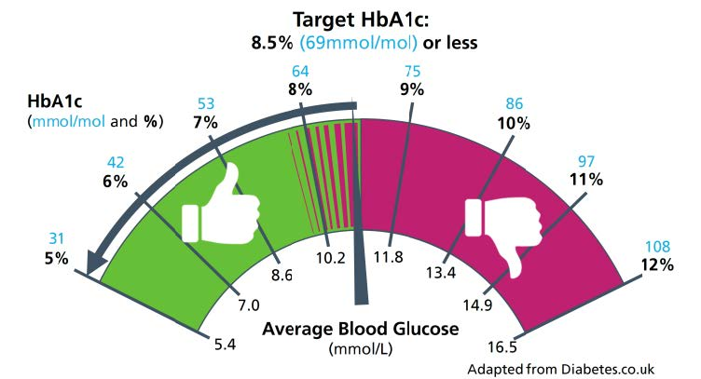
Progress
Assessing glycaemic control
HbA_{1c} was 61 mmol/mol at the start of the year- now 45 mmol/mol 3 months later.
Likely reduction in oral intake.
Plan:
1. Given his advancing dementia and frailty, the target HbA_{1c} was relaxed to <69 mmol/mol, as part of active de-escalation of treatment
2. As KH lacked the capacity to self-care and self-medicate, education and support for carers was key.
3. STOP insulin
4. Reduce the dose of gliclazide to 40 mg BD and metformin to 500 mg BD
5. Accept blood glucose readings of 15–20 mmol/L
Rationale being;
Unlikely to achieve longer-term risk-reduction benefits.
Increased risk of hypoglycaemia (& blunted symptoms of hypoglycaemia)
Notes:
Unlikely to achieve longer-term risk-reduction benefits by having lower blood glucose levels.
Increased risk of hypoglycaemia (especially with insulin being used), falls, CVD & possibly progression of dementia.
Symptoms of hypoglycaemia decline as we age, owing to a blunted autonomic response (Sinclair et al, 2022), therefore, hypoglycaemia can present with atypical symptoms, such as falls or confusion.

Slide 26
3 months later…
HbA_{1c} 60 mmol/mol (average BMs around 7 mmol/L)
Gliclazide discontinued and metformin reduced to 500 mg once daily
Considerations
  T2DM & depression can exacerbate each other, which may in turn impact on dementia
  advancing age and frailty can lead to an increase in visceral fat and reduction in body muscle mass ‘sarcopenic obese frail phenotype’ (with increased visceral fat and insulin resistance)
  Or
  ‘anorexic malnourished frail phenotype’ (with muscle loss and reduced insulin resistance).
Frailty and cardiovascular risk
In people living with diabetes, there is an increased risk of sarcopenia when compared with those without diabetes.
Deprescribing performed (based on scoring systems and reduction of pill burden)
Rivaroxaban for AF , Atorvastatin & Omeprazole stopped
Memantine and mirtazapine were switched to oro-dispersible formulations
Notes:
Diabetes and depression may be driven by shared underlying biological mechanisms, such as, inflammation, sleep disturbance, inactive lifestyle, poor dietary habits, and environmental and cultural risk factors
if glucose levels are persistently much higher than recommended, there can be an increased risk of cognitive decline in older adults with diabetes
The family were keen for a polypharmacy review to help reduce pill burden by de-prescribing, where clinically appropriate
Indeed, polypharmacy may be considered to be a comorbidity.
The benefits of primary prevention of cardiovascular disease were less likely to be applicable to KH, as his life expectancy was likely to be less than 5 years. Atorvastatin had, therefore, previously been discontinued
it was agreed to stop rivaroxaban for atrial fibrillation, after discussion about the risk of bleeding with the medication and the increased risk of stroke if discontinued.
dose of omeprazole, which had been prescribed to reduce the bleeding risk, was gradually reduced then stopped.
Memantine and mirtazapine were switched to oro-dispersible formulations.
Decisions about stopping medication can be made for pragmatic reasons, such as to reduce the risk of falls or the pill burden, while scoring systems may be used to support such decision-making.
3–4% per year
(This varies slightly by study, but clearly moderate–high risk

Slide 27
Key learning
Emphasises person-centred approach in an elderly frail individual
Risks and benefits of best practice guidance are considered.
Glucose-lowering treatments should be evaluated in the context of hypoglycaemia, cardiovascular risk and their effect on body weight.
It is important to consider life expectancy, as it may be relevant to the continuation of medication that is being used to confer a prognostic benefit.
Avoiding harm (falls risk hypo- or hyperglycaemia.
Shifting from ‘what's the matter with me?’ to
what matters to me…

Slide 28
In summary ..
Common
T2DM (15-20% of >75yr olds)
Atypical presentation of hypos
Emerging
Comorbidities guide care
Dual therapy early
Important
Patient-centred decisions
Simplify regimes
Notes:
15–20% of people >75 have diabetes (higher in frailty) but atypical -significant proportion undiagnosed” “Older adults often present atypically (e.g. falls, delirium, cognitive decline)
Management complicated by: Polypharmacy
Cognitive impairment
Biggest immediate risk: Hypoglycaemia → delirium
Psychotropics can: Worsen metabolic control
NICE 2026: use standard adult HbA1c targets as a starting point, but relax targets in older/frail adults when life expectancy is limited,

