Slide 1
FALLS
Dr T Giokarini-Royal MB.BCh, FRCP, MSC, BSc(Hons)
Consultant Orthogeriatrician
Clinical Lead in Orthogeriatrics & Falls

Slide 2
Talk Overview
Falls data
Causes of Falls
Falls assessment
Interventions for falls prevention

Slide 3

Falls definition
A fall is an event which causes a person to unintentionally rest on the ground or on a lower level, excluding major intrinsic events (such as a stroke) or overwhelming hazard.

Slide 4
Falls Data
Falls are common among the ageing population:
-Approximately 30% of people over the age of 65, and 50% of people over the age of 80 suffer at least one fall every year.
-The risk of falling is 3 fold higher among people in care homes.
Approximately 10% of the falls result in major injury such as #NOF or head trauma
No difference in injury rates among 2 sexes

Slide 5
Data from GOV.UK, NICE & AGE UK
England 2023-24: Approx. 219,000 emergency admissions due to falls
Inpatient falls in England: Over 250,000 annually
Falls related mortality in England (2022-24 data): over 25,000 deaths annually, mainly among older population
Cost: Hundreds of millions annually for the NHS across the UK
Additional cost:
Social & community care cost can be up to four times higher in the following 12/12 compared to the cost for the acute admission itself
Personal impact
Effect on carers

Slide 6
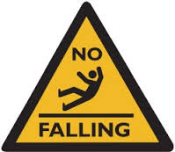
Falls are NOT a Diagnosis
Falls are a symptom often in a syndrome presentation.
Falls are not an inevitable part of ageing.
There are various causes that predispose to falling, many of which are modifiable.

Slide 7
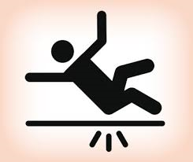
Causes of Falls

Slide 8
Medical causes of falls
Neurological
Stroke, cerebellar disorders, Parkinsonism, seizures, visual problems
Cardiovascular
MI, arrhythmia, orthostatic / postural hypotension
Metabolic
Hypoglycaemia, hypothyroidism, dehydration
Musculoskeletal
Genitourinary
Psychological
Gastrointestinal
Diarrhoea, constipation, bleeding
Arthritis, muscular weakness
Incontinence, nocturia
Delirium, dementia, depression

Slide 9
Medication and Falls
Categories of medication
Medication side effects
Psychotropic medication (e.g. PD medication, antipsychotics, sedatives, opioids)
Drugs acting on heart or circulation (e.g. antihypertensives, antiarrhythmics, diuretics)
Diabetes medication
Steroids
May affect cognition or level of alertness.
Postural hypotension.
Arrhythmias
Continence issues
Altered bowel habits
Hypoglycaemia
Muscle weakness, myopathy

Slide 10
Polypharmacy and Falls
Definition
Common issues increasing falls
Taking five or more medicines
Commoner among the older population & among pts with multiple morbidities
Independent risk factor associated with increasing falls
Interactions
Prescribing cascade
Compliance issues
Less evidenced benefit associated with higher incidence of side effects
There remains a lack of evidence for the frail “oldest-old” (85+ years), complicating evidence-based prescribing.

Slide 11
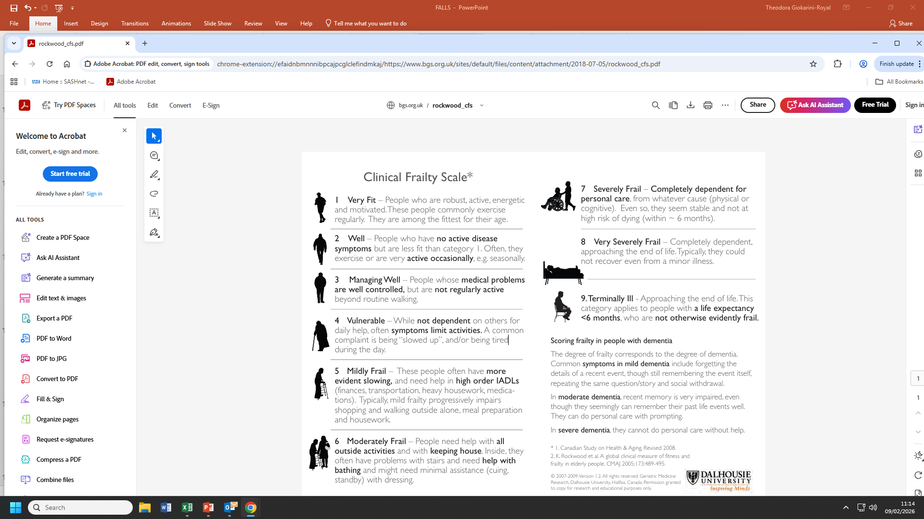
Frailty
It is a clinical health state related to decline in the body’s physical and psychological reserves, and leads to increased vulnerability
It relates to the ageing process and it’s incidence increases with ageing but is it is not an inevitable part of ageing
It is a long term condition, which is not static and can vary in severity

Slide 12
Additional Causes of Falls
Environment
Uneven flooring, ill fitted carpets
Behavioural/Functional issues
Alcohol excess or substance abuse
Multifactorial
Mechanical/Accidental
Due to tripping or slipping on a surface
Due to a combination of all causes already listed
Poor safety awareness due to cognitive issues
Using wrong type of walking aids, or not using them appropriately
Poor lighting
Footwear

Slide 13

Multifactorial Falls Risk Assessment

Slide 14
Falls: assessment & prevention in older people & in people 50 an over at higher risk
NICE guideline: NG249, Published: 29 April 2025
New age range of targeted population for falls assessment
Three tier approach with primary, secondary & tertiary prevention incl. clinical review & management across community, care homes (newly added) and hospitals
Frailty identified as an independent falls risk factor

Slide 15
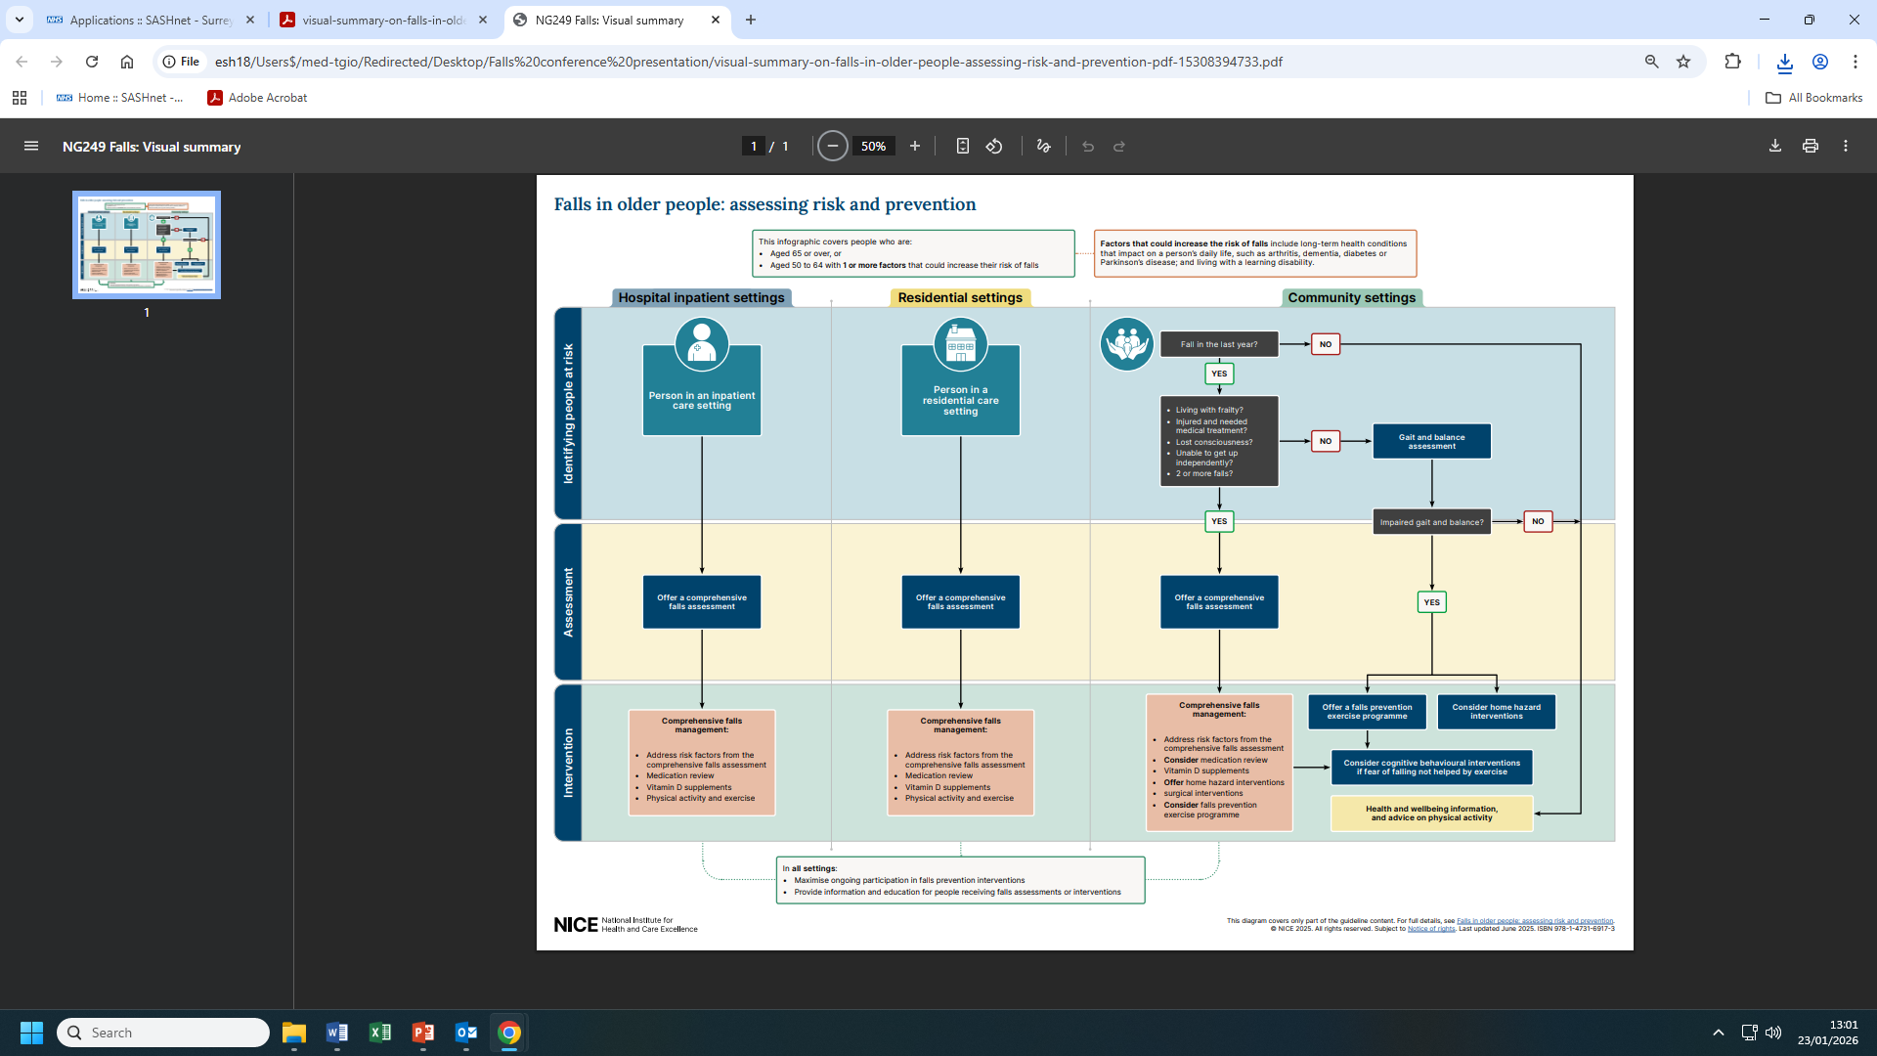

Slide 16
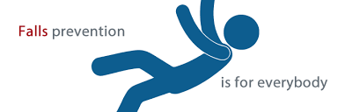
Multifactorial Risk Assessment
Falls reduction can occur by multifactorial risk assessment aiming at identifying all modifiable risk factors for falls, with subsequent individualised interventions.
There are no predictive falls tools that can correctly identify all pts at risk of falling, therefore they should not be routinely used.

Slide 17
Multifactorial falls assessment
Detailed falls Hx. Red Flags
Thorough PMH & SH
ETOH misuse
Medication review
Visual assessment
Continence review
Bone health
Balance, dizziness & mobility
Cognitive/ delirium assessment
Footwear & foot health

Slide 18
Initial assessment post fall
Careful history of the fall from patient and from witnesses and paramedics. Ensure you enquire also about previous falls.
ECG- although it has low yield (5%) it might lead to a diagnosis that demands immediate action
Check BMs
Ensure there are no injuries (look specifically for NOF # and head injury).
Multiple injuries (#) could be present
Thorough neurological & cardiovascular examination
Assess visual impairment.
Refer to ophthalmology for cataracts repair. Suggest optician review
Assess cognitive impairment (4AT)
Consider need for specialist tests (24hr tape, ECHO, CT brain)
Check lying & standing BP

Slide 19
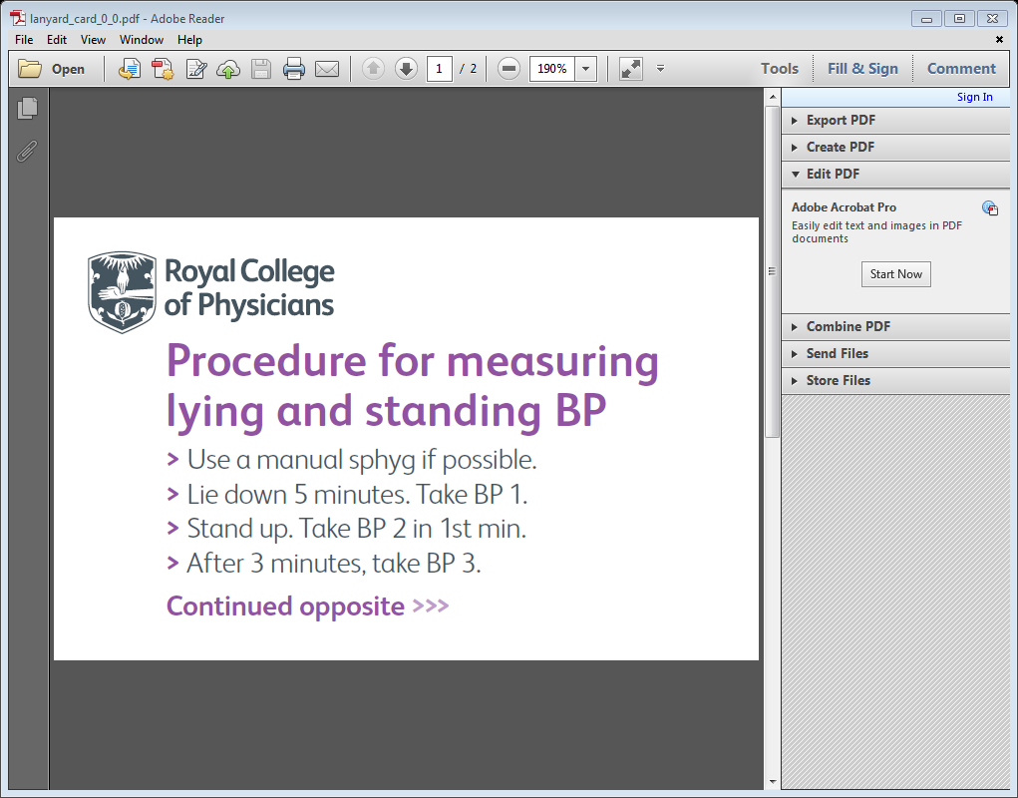
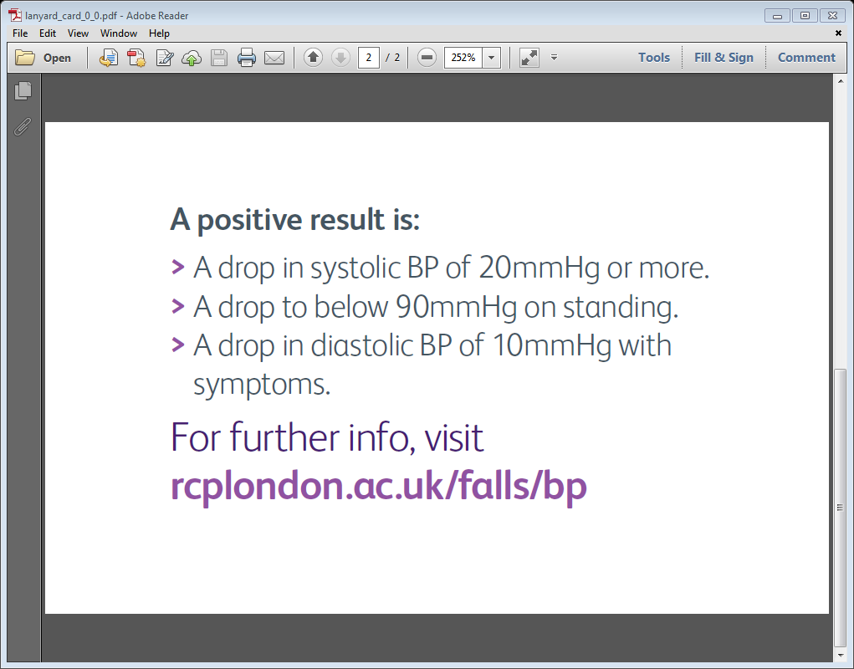
Checking for Postural Hypotension

Slide 20
NICE Guidelines: Hypertension in adults
Reference no: NG136, Published 28 Aug 2019, Last updated: 21 Nov 2023
1.4.16
Check for postural hypotension in people with hypertension and:
type 2 diabetes or
symptoms of postural hypotension (see also recommendation 1.1.7) or
aged 80 and over.
In people with a significant postural drop or symptoms of postural hypotension, treat to a blood pressure target based on standing blood pressure. [2019, amended 2023]

Slide 21
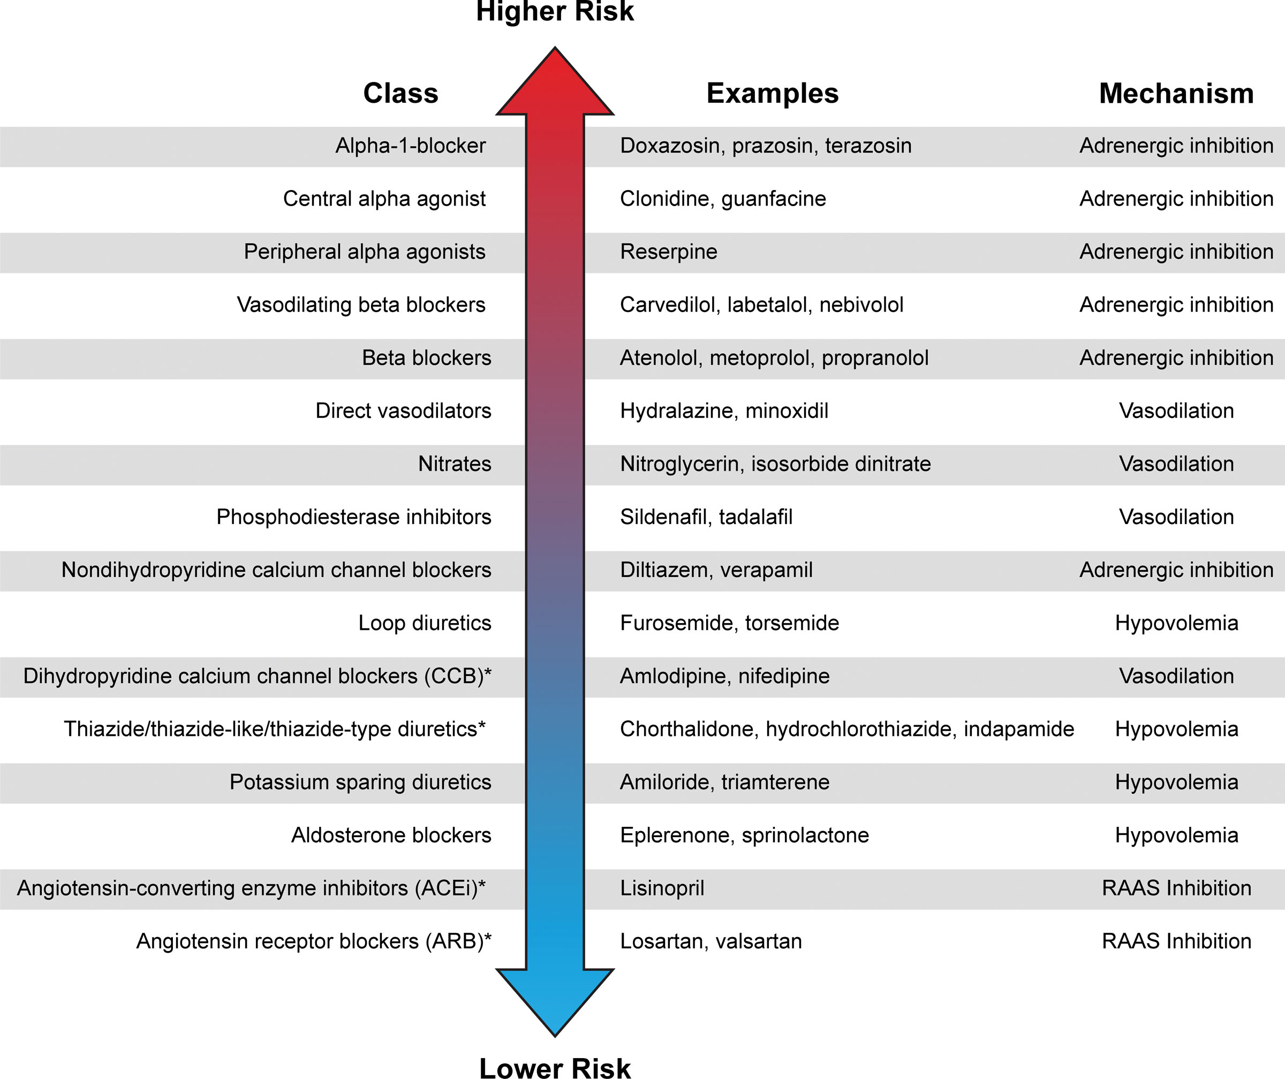
Risk of postural hypotension is class-dependent
Juraschek SP, Cortez MM, Flack JM, Ghazi L, Kenny RA, Rahman M, Spikes T, Shibao CA, Biaggioni I; American Heart Association Council on Hypertension. Orthostatic Hypotension in Adults With Hypertension: A Scientific Statement From the American Heart Association. Hypertension. 2024 Mar;81(3):e16-e30
Notes:
If in doubt, monitor your patient

Slide 22
Interventions for Falls Prevention

Slide 23
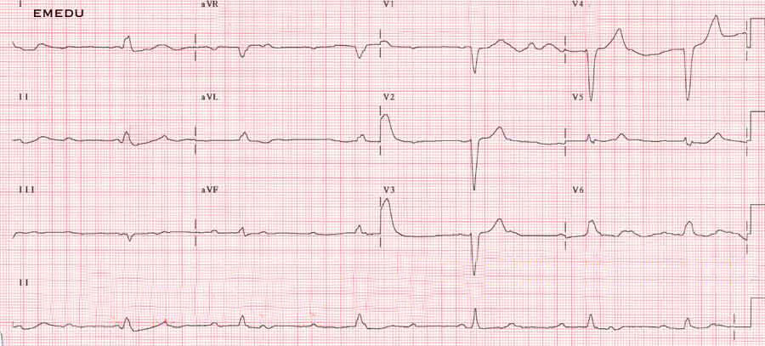
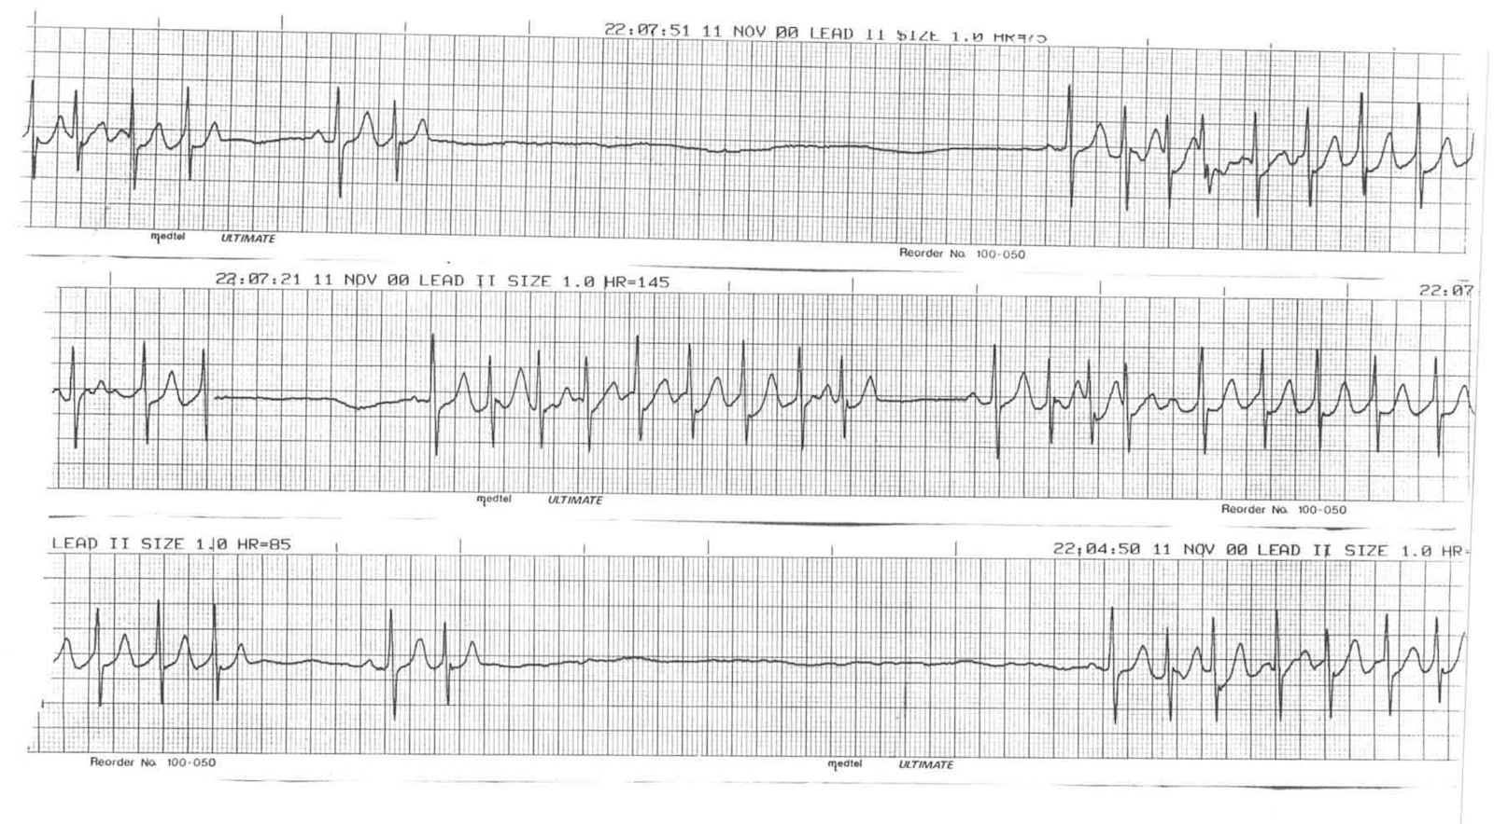
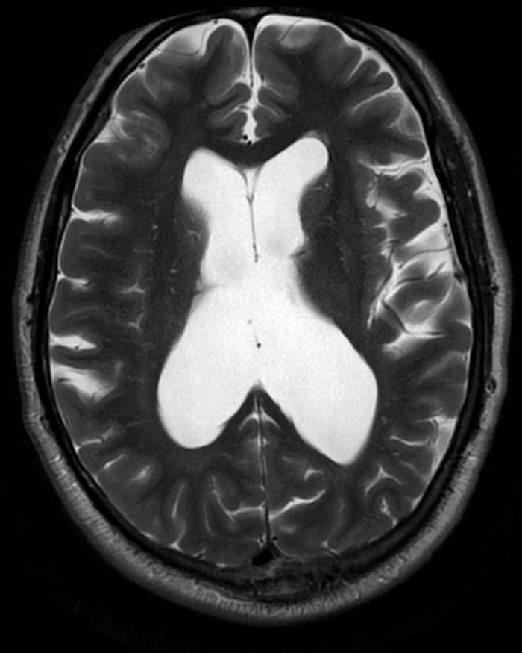
Medical & Surgical interventions
Ophthalmology referral for Cataract repair
PPM for sick sinus syn, pauses or CHB
Antiarrhythmics/ICD for NSVT
VP shunt for NPH

Slide 24
Bone Health
Vit D important for bone and muscle health but there is insufficient evidence linking it directly to falls prevention
NICE recommends to check vit D and treat when indicated
High risk population for low vit D:
aged over 65 years,
are not exposed to much sunlight (because they are confined indoors for long periods or because they wear clothes that cover the whole body).
A vitamin D intake of at least 1000 mg/day is recommended for people at increased risk of a fragility fracture.

Slide 25
NICE: Osteoporosis- prevention of fragility fractures (Last revised April 2025)
Consider assessment of fracture risk:
Women of/or >65yr & men of/or >75yr age
Women <65 & men<75 with risk factors:
-Previous fragility fracture
-Current/frequent steroid use
-Hx of falls
-Causes of secondary osteoporosis (eg. COPD, CKD, chronic liver dis., immobility, endocrine cond., RA, coeliac or other malabsorptive syn…)
-Low BMI
-Smoking &/or ETOH XS (>14U/wk)
-Family Hx of hip fracture
Treat patients over the age of 75yr with fragility fractures. Bisphosphonates are the first line Rx

Slide 26




Foot & Footwear
Appropriate footwear
Foot Health
Visual inspection (ulcers, corns, issues with toenails..)
Ensure no issues with sensation/proprioception
Podiatry referral if indicated

Slide 27
Review of Inpatient/Care Home Environment
Re-orientation of confused patients
Visual cues
Large clocks
Adequate lighting
Brighter bulbs
Night lights
Flooring
No colour changes among rooms
Make stairs bright & different from walls
Avoid blue or green, shiny floor or speckled pattern
Walking aids
Make safe outside areas
Ensure easy reach to patient
Regular safety checks
Avoid uneven areas
Bed Rails
Avoid using for people that are well mobile, esp those who are confused enough to climb over them

Slide 28
Incident Reporting
Hospital Trusts and Care Homes should have a robust way to report falls.
Incident reporting is a means of showing transparency & monitoring falls rates BUT more importantly it is also a learning tool that can highlight areas in service management & provision that can be improved within an organisation so as to prevent future falls.

Slide 29
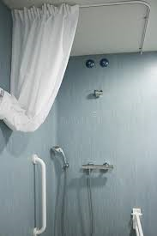
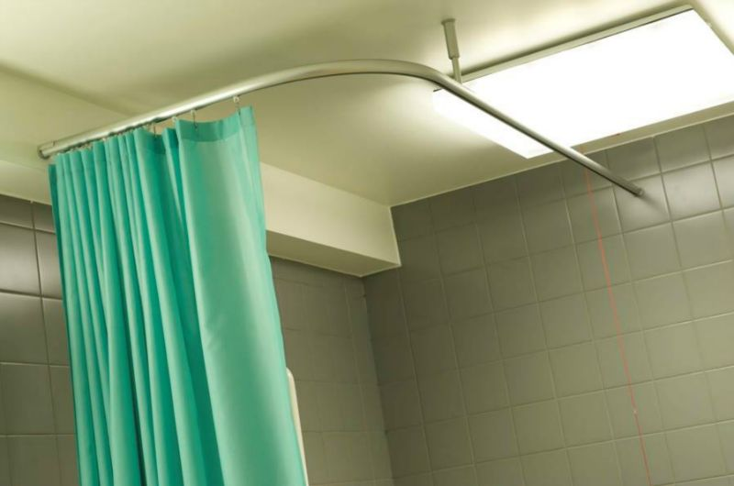
Lessons Learned from Incident reporting

Slide 30
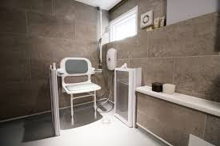
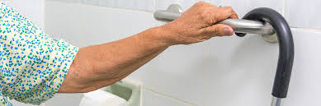
Falls Prevention in Community Settings
Community Falls teams:
Therapy led
Home hazards assessments & interventions
Pendant alarms vs intelligent alarms (falls detectors)
Important to map the area for all available local & national organisations and support groups

Slide 31
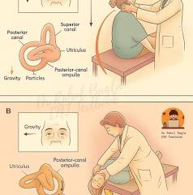
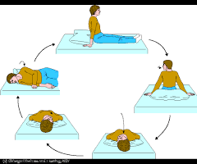
Benign Paroxysmal Positional Vertigo (BPPV)
Dix-Hallpike manoeuvre for Dx
Epley Maneuver for Rx

Slide 32
Strength & Balance Training
NICE recommendations, 2017 & revised 2025
‘A muscle-strengthening and balance programme is likely to benefit older people living in the community with a history of falls and/or balance and gait deficit.
It needs to be monitored by appropriately trained professionals.’
It should be individually prescribed based on a person’s abilities and preferences addressing balance, coordination, strength and power.
Exercises can de delivered in classes or at an individual basis.
Cognitive behavioural therapy is recommended for ongoing concerns about falling that have not been helped by exercise

Slide 33
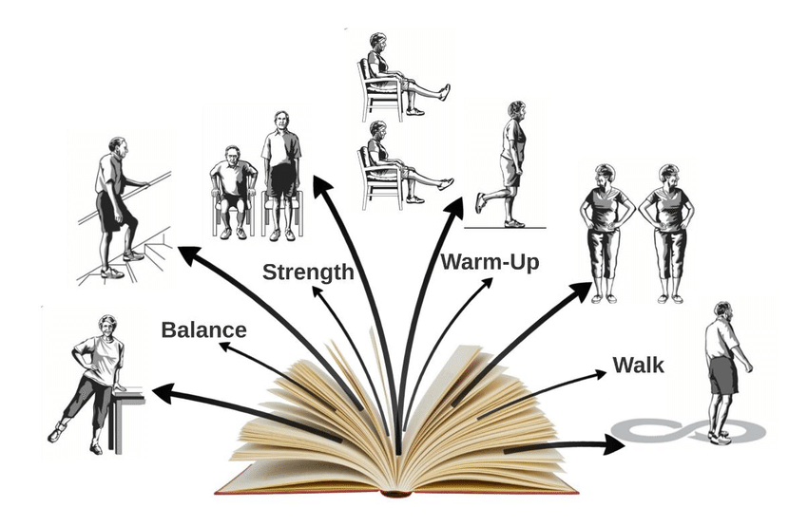
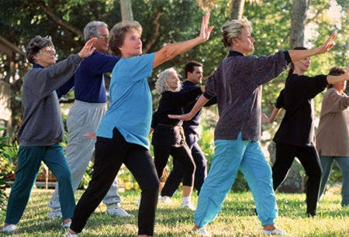
Strength & Balance Exercises
Exercise interventions also lead to a reduction in the risk of fractures
Effective programs must be continued over a duration of at least 50hrs, must be progressive and must be carried out 2-3 times a week

Slide 34

Patient/Public Education

Slide 35
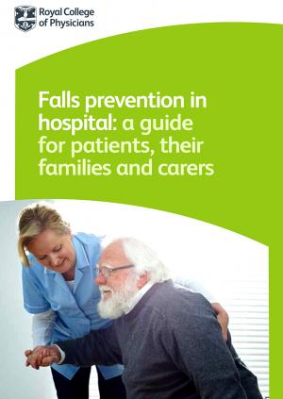
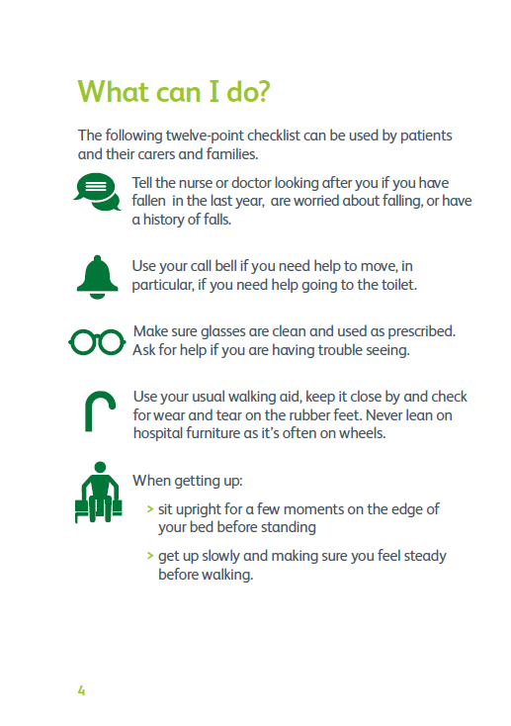
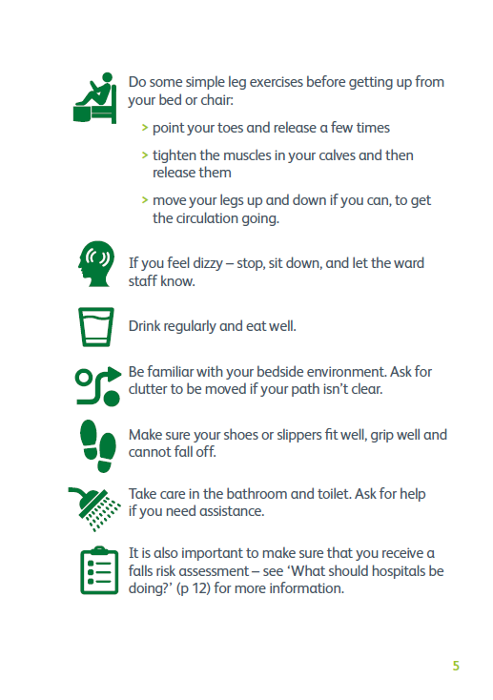

Slide 36




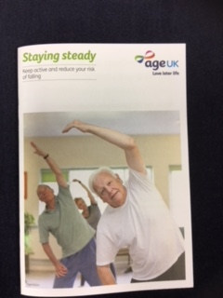
Patient Education On Falls Prevention

Slide 37
Multifactorial Assessment & Intervention
My own experience

Slide 38
Mr BSB
82 year old gentleman
Admitted from neurology clinic for ‘comprehensive geriatric assessment and social input’.
Hx of frequent falls (5xdaily), worsening mobility and deteriorating memory

Slide 39
Mr BSB
PH | DH
PD- Dx 10yr ago Prostate ca TIAs Falls No Dx of dementia | Madopar 125mg VI/daily Entacapone 200mg VI/dy Madopar CR 350mg od Ropinirole 6mg Quetiapine 12.5mg od Bicalutamide 150mg od

Slide 40
SH of Mr BSB
Lives with disabled wife
No carers
Mobile with one stick
No ETOH
Wife reported increasing confusion, poor sleeping pattern and ongoing hallucinations. Falls were attributed to his reduced mobility and bad nightmares at night.

Slide 41
Examination of Mr BSB
He reported vivid dreams & hallucinations
Leadpipe rigidity L>R. No tremor
Significant dyskinesia
No cerebellar signs & no focal neurology
Slurred speech- at times difficult to understand.
Confusion, AMTS 6/10
Normal cardiovasc, abdo, resp, visual exam
No postural drop
Bloods unremarkable; confusion screen normal
ECG: sinus bradycardia (56bpm)

Slide 42
Day 1- cons review
DD
REM sleep disorder
?Lewy body dementia
?Ropinirole-induced hallucinations
Dyskinesia 2ndary to PD Rx
Multifactorial cause for falls- at high risk of falls
Plan
CT brain (?subdural)
Complete septic screen
Psychogeriatric review
NOT for haloperidol
Clonazepam 500mg
Reduce gradually ropinirole
24hr tape
PT & OT
High visibility bed
No bed rails

Slide 43
Multifactorial Assessment
Septic screen was normal
CT head: Movement artefact. No evident SOL of haemorrhage
Psychogeriatrics review: Hallucinations mainly due to PD medication. Possibility of Lewy body dementia. To start AchE-I
24hr Tape: Sinus bradycardia with 1st degree heart block. Slowest HR 22 bpm.3 pauses- longest 3.66 sec.

Slide 44
Multifactorial Intervention
PPM inserted as an inpatient
Rolinirole was gradually stopped
Started rivastigmine
PT assessment: was issued with ZF and had rehabilitation
OT assessment: provided home adjustments & referred to ss for POC

Slide 45
Week 5
Significant improvement of his hallucinations
MTS 9/10
Dysarthria much improved
Good progress with PT- though still poor safety awareness & unrealistic expectations
Was D/C on week 6 with ZF and TDS POC
No ropinirole upon D/C

Slide 46

SUMMARY
Falls are a very common presentation and can happen to anyone, though patients over the age of 65, or younger (50-64yr) frailer patients are more prone to it.
Always try to identify the mechanism of fall- a fall is mechanical only when more sinister causes have been excluded first.
Thorough falls assessment is multifactorial and individualized.
Falls assessment includes bone health review.
Multidisciplinary approach for falls prevention.

Slide 47
