Slide 1
Sleep and Ageing
Hugh Selsick
President, Sleep Medicine Section, Royal Society of Medicine

Slide 2
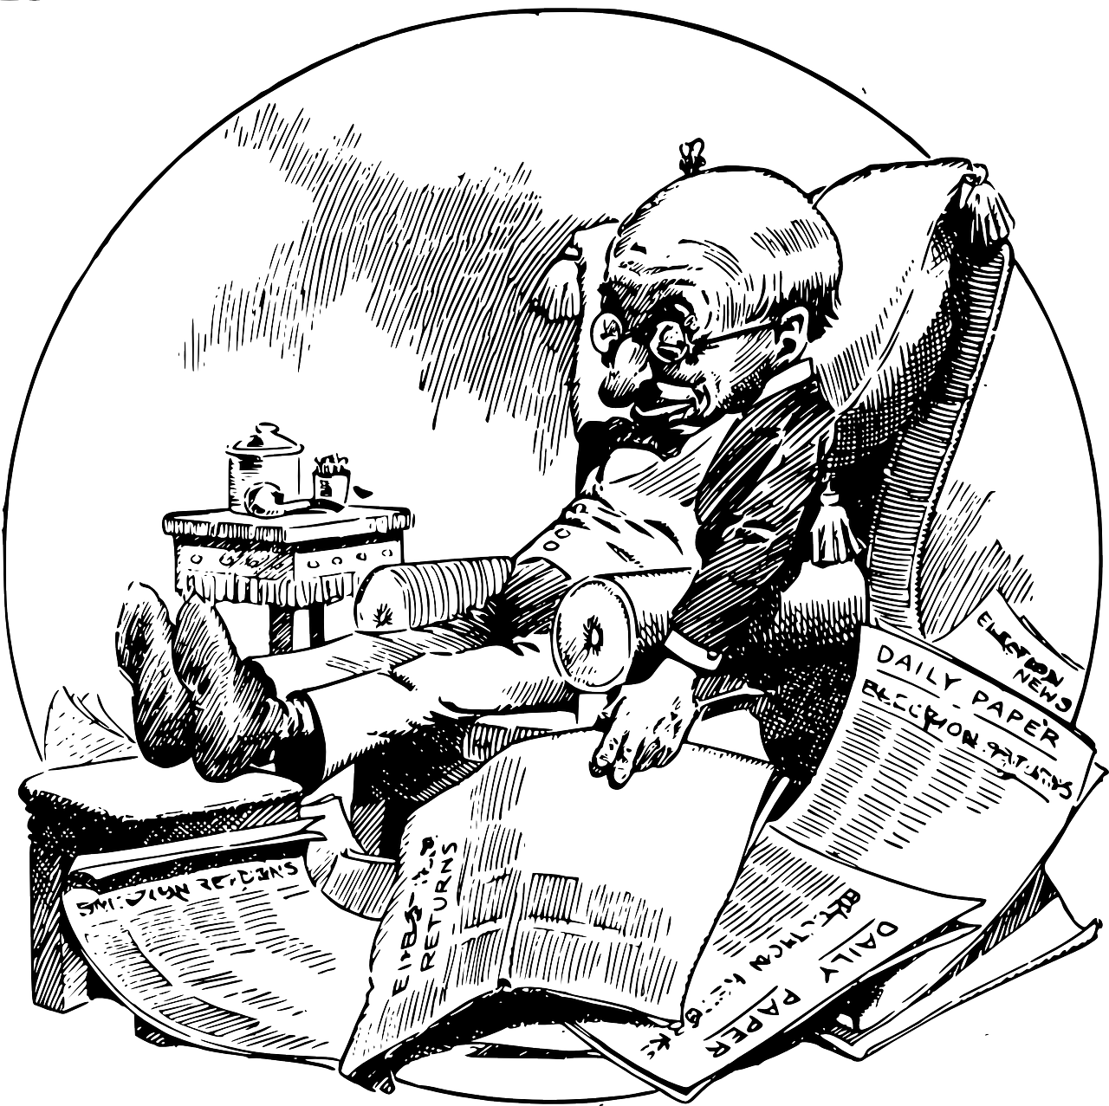
Introduction
This
Is
Normal!

Slide 3
Structure
Sleep architecture and ageing
Circadian rhythm and ageing
Circadian preference and ageing
Sleep need and ageing
Daytime sleepiness in older adults
Obstructive Sleep Apnoea
Restless Legs
REM Sleep Behaviour Disorder
Insomnia

Slide 4
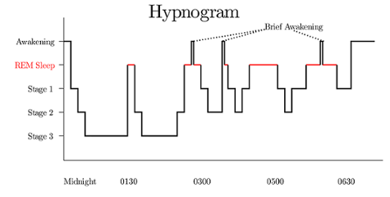
Sleep Architecture

Slide 5

Sleep Time
Total sleep time declines with age.
Average sleep time in 20’s = 7.5hrs.
Average sleep time in 70’s = 6hrs.
This appears to be at least partly due to reduced sleep need.

Slide 6


Circadian Preference
The world is divided into Larks, Owls and Inbetweeners.
This is largely genetically determined and relatively fixed.
But older adults have a tendency to go to bed earlier and wake earlier.

Slide 7
Sleepiness
It is a common misperception that daytime sleepiness is a normal part of ageing.
In fact healthy older sleepers are less sleepy than younger adults.
This is true for both subjective and objective measures.
Yet, on a population level there are more sleepy older adults than younger adults.
This is because healthy older sleepers are rarer than younger healthy sleepers.

Slide 8
Why Are Healthy Older Sleepers Rarer?
The longer you live the more chance you have of getting a chronic sleep disorder.
Increased physical and psychiatric conditions e.g. pain, prostatic hypertrophy, dementia.
Increased burden of medication.
Social changes e.g. losing a partner, loss of role when retiring.

Slide 9

Which Sleep Disorders Are More Common?
Obstructive sleep apnoea
Restless Legs
REM Sleep Behaviour Disorder
Insomnia

Slide 10
Obstructive Sleep Apnoea
Affects over 69% of over 65s with 20% moderate or severe.
Severe OSA impairs attention, concentration, executive function, memory etc.
Some of these are due to sleep disruption, but some are due to hypoxic damage to the brain.
Increases risk of coronary artery disease, congestive heart failure, ischaemic stroke, depression and dementia.

Slide 11
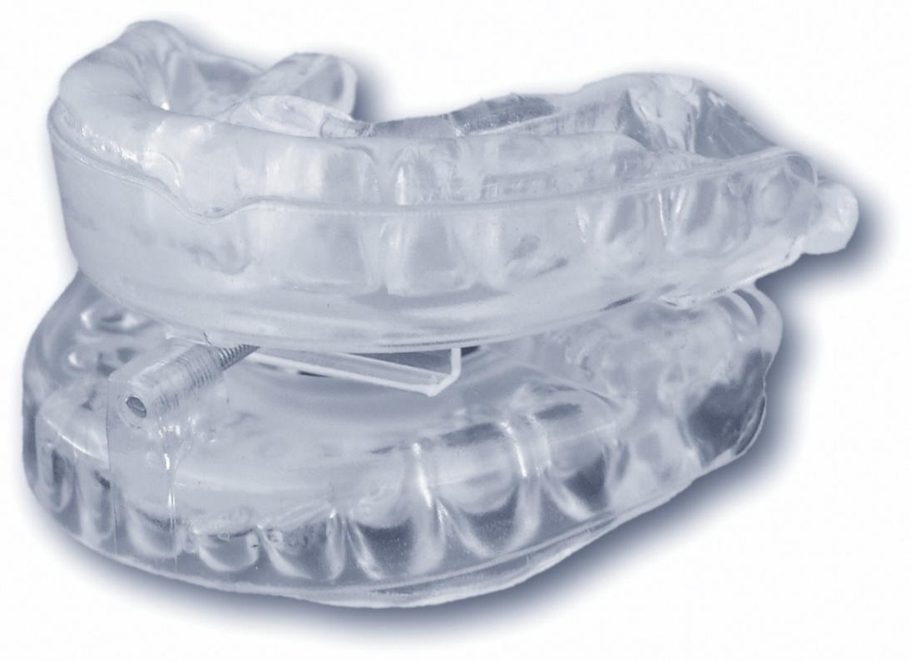
Treating Obstructive Sleep Apnoea 1
Mild to moderate OSA:
Weight loss
Position therapy.
Mandibular advancement splint.

Slide 12
Treating Obstructive Sleep Apnoea 2
CPAP is the gold standard.
Compliance is often poor.
Problems include aerophagia, mask discomfort, dry mouth and claustrophobia.
Treating OSA may lead to improvements in depressive symptoms.
Depression predicts a better response to CPAP.
But depression predicts poorer CPAP adherence.

Slide 13
OSA in Dementia
Treating OSA in early Alzheimer’s dementia may slow the progression of the dementia.
In mild Alzheimer’s average CPAP use is 5 hours/night – this is good compliance.
Poor compliance associated with depression not severity of dementia.
Not known if treating depression will improve compliance – but may be worth retrying non-compliant patients when depression resolved.
Carer involvement is helpful.

Slide 14
Restless Legs Syndrome
Uncomfortable sensation – can be anywhere in the body, but usually the legs.
Worse at night.
Worse at rest.
Temporarily relieved by movement.
Easy to localise but hard to describe.
Manifests as sleep onset insomnia.

Slide 15

RLS & Depression
Symptoms of depression are common in RLS.
35% of patients with Restless Legs and Depression report suicidal ideation as a result of their restless legs.

Slide 16
Diagnosing RLS
It is surprisingly rare for patients to volunteer RLS symptoms. You need to specifically ask about them.
A single question has been shown to have 100% sensitivity and 96.8% specificity for RLS in a neurology outpatient population (Ferri, 2007):
“When you try to relax in the evening or sleep at night, do you ever have unpleasant, restless feelings in your legs that can be relieved by walking or movement?”
If the answer is yes, check it is worse at night, worse at rest and relieved by movement.

Slide 17
Aetiology
Genetics
Antihistamines
Renal dysfunction
Iron deficiency
Peripheral nerve irritation.
Neuropathy
Antidepressants
Antipsychotics
Vitamin D or B12 deficiency

Slide 18
Restless Legs Treatment - Iron
Oral iron supplementation should be offered if the ferritin is below 100mcg/L.
This is well above the laboratory “normal minimum”.
In cases where patients can’t tolerate oral iron or in treatment resistant cases i.v. iron infusions can be effective, though the effect is not immediate.

Slide 19
Treatment - Medications
The licensed 1st line treatments in the UK are the dopaminergic (anti – Parkinson's) medications. They increase dopamine at night.
Ropinirole: 250mcg nightly x 2d, then 500mcg nightly x 5d, then 1 mg nightly x 7d, increased by 500mcg each week; max 4 mg per day.
Pramipexole: 88mcg nightly, doubled every 4 – 7d; max 540mcg.
Take tablets 1 – 3 hours before onset of symptoms.
Rotigotine: 1mg/24hr, increased by 1mg/24 each week; max 3mg/24hr.
Can change patch at any time as long as they are consistent.

Slide 20
Problems With the 1st Line Treatment
Compulsive behaviours. These can be subtle so family should be on the lookout.
Can cause “augmentation”, a rapid escalation in symptoms, which also start much earlier in the day.
Risk factors for augmentation: dose of dopaminergic drug, duration of treatment, smoking.

Slide 21
A Better (Unlicensed) 1st Line - α2δ Ligands
Gabapentin and Pregabalin do not cause compulsive behaviours or augmentation.
Gabapentin: start at 300mg nightly, increase by 300mg a week up to 1200mg nightly if needed.
But if the dose exceeds 600mg it can be better to split the dose as absorption of higher doses is poor.
E.g.: for a dose of 900mg, take 300mg 3hr before symptom onset and 600mg an hour before symptom onset.
Pregabalin: start at 25 – 50mg nightly and increase by 25 – 50mg weekly up to 300mg if needed. Check for QT prolongation.

Slide 22
3rd Line - Opiates
Oxycodone with naloxone (Targinact) licensed as second line if dopaminergic drugs fail.
Start 5/2.5 mg every 12 hours, adjusted weekly according to response, usual dose 10/5 mg every 12 hours; maximum 60/30 mg per day.
However, I tend to start with night time doses only.

Slide 23
Practice Points
Always ask about restless legs.
Always ask again after changing medication.
Be aware of the risk of exacerbating or causing RLS when prescribing, particularly drugs with anti-histamine action.
RLS is a clinical diagnosis. You can diagnose it and initiate treatment in your clinic.

Slide 24
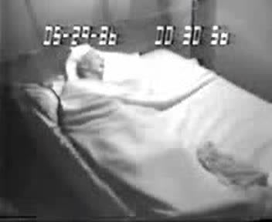
REM Sleep Behaviour Disorder
Loss of normal atonia in REM so person acts out their dreams.
This presents as vocalizations and movements.
They rarely leave the bed.
Their eyes are closed.
Dream recall is common and corresponds to observed actions.
Occurs in second half of the night.

Slide 25
Drugs That Cause/Exacerbate RBD:
Beta blockers
Mirtazapine
SSRIs
SNRIs
Tricyclics
Cholinesterase inhibitors

Slide 26
RBD and Neurodegenerative Disorders
81 – 90% RBD patients develop a neurodegenerative disease.
Parkinson‘s Disease – 80% of Idiopathic RBD pts go on to develop PD within 15 yrs (probably an underestimate); about 50% of PD patients have RBD.
Dementia with Lewy Bodies – 70-80% have RBD.

Slide 27
Screening for and diagnosing RBD
A single question has been found to have a sensitivity of 93.8% and a specificity of 87.2%:
‘Have you ever been told, or suspected yourself, that you seem to ‘act out your dreams’ while asleep (for example, punching, flailing your arms in the air, making running movements, etc.)?
A yes answer to this question should trigger a referral to a sleep clinic for a polysomnogram.

Slide 28
Treatment - Behavioural
Safety first!
While getting control of the RBD it may be wise for bed partners to sleep separately.
Physical barriers between partners.
Remove glass/sharp objects from bedside.
Remove bedside table and put pillows on floor.

Slide 29
Treatment – Medical - Melatonin
Melatonin 2-12 mg effective.
Effective within 1st week.
Effect maintained even if occasional dose missed.

Slide 30
Treatment – Medical - Clonazepam
Clonazepam (0.25-4mg) effective with tolerance rarely a problem.
Clonazepam effective within 1st week.
Occasionally it can be useful to combine melatonin and clonazepam.

Slide 31

Insomnia
Difficulty initiating or maintaining sleep.
Despite adequate opportunity.
Leading to daytime consequences.
Such as tiredness, low mood, cognitive dysfunction, irritability.

Slide 32
Why Treat Insomnia?
Insomnia, in adults without prior psychiatric symptoms, increased risk for depression, anxiety disorders and substance abuse.
Ford (1989) found that if insomnia persists for a year it is associated with an increased rate of a new major depression (O.R. 39.8 relative to non-insomniacs), while if it resolves the risk is similar to non-insomniacs.
It is a risk factor for suicide.
Treating depression doesn’t necessarily result in relief from insomnia, and residual insomnia is a risk factor for depressive relapse.

Slide 33
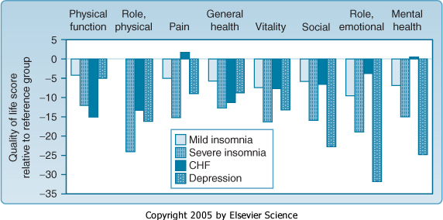
Insomnia is a Serious Psychiatric Illness
Numerous studies have demonstrated a correlation between insomnia severity and reduced QoL e.g. Katz 2002.

Slide 34
Hypnotics: GABA-ergic Drugs
Benzodiazepines and cyclopyrrolones (z drugs).
GABA-A receptor positive allosteric modulators with varying degrees of specificity for the various alpha subunits.
Z drugs are more specific hypnotics with fewer muscle relaxant, respiratory depressant, anticonvulsive and anxiolytic effects.
This may make them safer and less addictive than benzos.
Despite their reputation addiction is not inevitable with these medications.

Slide 35
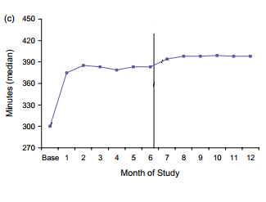
Do they work in the long term?
(Roth, 2005).

Slide 36
Do They Work When You Stop Taking Them?
Once the medication is discontinued the effect is lost.
Therefore a “short course of hypnotics just to reset the sleep cycle” doesn’t work.
When the doctor discontinues the medication the patient will experience a recurrence of symptoms and will ask for more.
This is often mistaken for addiction.

Slide 37
Z - drugs and Benzos
 | Tmax (hours) | T_{1/2} (hours) | Hangover
Zopiclone | 0.5-2 | 5-6 | Yes
Zolpidem | 1.7-2.5 | 1.5-2.5 | Probably not
Temazepam | 1-3 | 8-20 | Maybe
Clonazepam | 1-2 | 35-40 | Yes

Slide 38
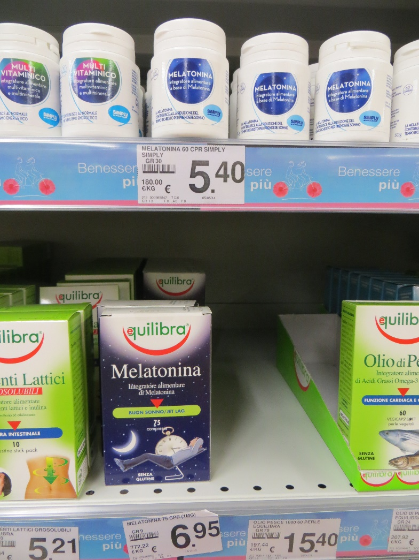
Melatonin for Insomnia
Reduces sleep onset latency.
Improves sleep quality.
Short acting, so not useful for sleep maintenance insomnia.
Effect is modest compared to other hypnotics.
Excellent safety profile.
BAP consensus statement on evidence-based treatment of insomnia, parasomnias and circadian rhythm disorders 2010

Slide 39
Antihistamines
Can be useful for sleep maintenance insomnia or early morning waking.
In the USA very low dose (3-6mg) Doxepin is licensed as a hypnotic. At this dose it is a remarkably pure antihistamine.
Over the counter antihistamines have significant anticholinergic effects.
Promethazine is one of the most anticholinergic antihistamines.
Long term anticholinergic meds increases risk of cardiovascular disease and dementia.

Slide 40
Daridorexant
1/3 of subjects in phase 3 trials were over 65.
No dose adjustment required in over 65s – start at 50mg.
No dose adjustment required for kidney dysfunction.
But use 25mg or avoid in liver dysfunction.
Advise patients there may be a delayed onset of action – I recommend a 3 month trial.
If it works, can continue prescribing for as long as needed.
No increased risk of falls.

Slide 41
Hypnotics in the Elderly and Falls
There is evidence that hypnotics, antidepressants and anticonvulsants are associated with an increased risk of falls in the elderly.
There is also evidence that insomnia itself increases the risk of falls. A recent study found the highest risk of falls was in the 3 months before starting the hypnotic.(Rozing, 2023)
Some data suggests that hypnotics are less risky than antidepressants.

Slide 42
Drug Choice
Duration of Action | Drug | Good For | Likelihood of Hangover
Short | Melatonin, Zolpidem | Sleep initiation | Low
Medium | Temazepam, Oxazepam, Zopiclone, Daridorexant | Sleep initiation and maintenance | Medium
Long | Clonazepam, Promethazine, Diphenhydramine, TCAs | Sleep maintenance | High
Promethazine, diphenhydramine and TCAs carry a significant anticholinergic burden. This causes significant side effects and raises the risk of dementia. They are therefore not safer alternatives to hypnotics.
Mirtazapine and trazodone are less anticholinergic and are better choices if you want to use an antihistaminergic or anti-noradrenergic drug.

Slide 43
Cognitive Behaviour Therapy for Insomnia
There is a large and growing evidence base for the efficacy of CBT for Insomnia (CBT-I).
Unlike medication this often has durable effects and continues to work long after the therapy has finished.
It can be delivered individually, in groups, in books, or online.
It is composed of a number of individual, circumscribed techniques that can be taught quickly as part of a regular consultation.
It is effective in older adults and chronicity of insomnia is no bar to it getting better.

Slide 44
Take Home Message
This
Is
Not
Normal!

