Slide 1
Stroke
Medicine for Old Age Psychiatrists Conference
27 April 2026, London
Dr Youssif Abousleiman FRCP
Consultant Stroke Physician
St George’s Hospital, London

Slide 2
Topics covered
Brief overview
SVD and its relevance
Interactive cases
Neuropsychiatric stroke symptoms localization and their management

Slide 3
Epidemiology of stroke
100,000 new & recurrent Strokes annually
60-79 yrs old: 6-8%; 80 yrs and over 10% or more
1.4 million are living with the effects of Stroke
11% of all death
5-6% death rate/annum (decreasing and hospital admissions increasing)
High burden in deprived areas
Most survivors are women
Mortality 25% at 30 days
Leading cause of cognitive impairment
Costs £8 billions/year ( 3-4 for NHS care)

Slide 4
74 yr old male
Brought in by 999 ambulance
Patient conscious but unable to speak
Obvious weakness of right arm and leg

Slide 5
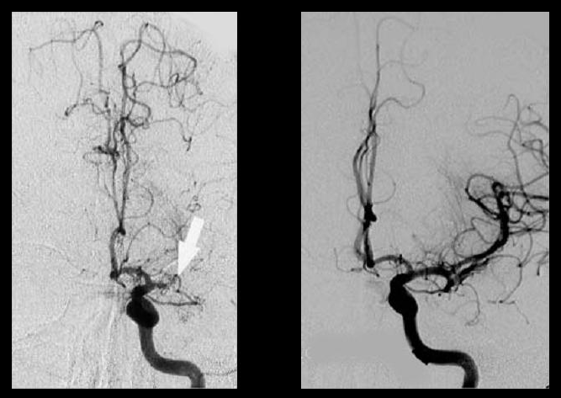
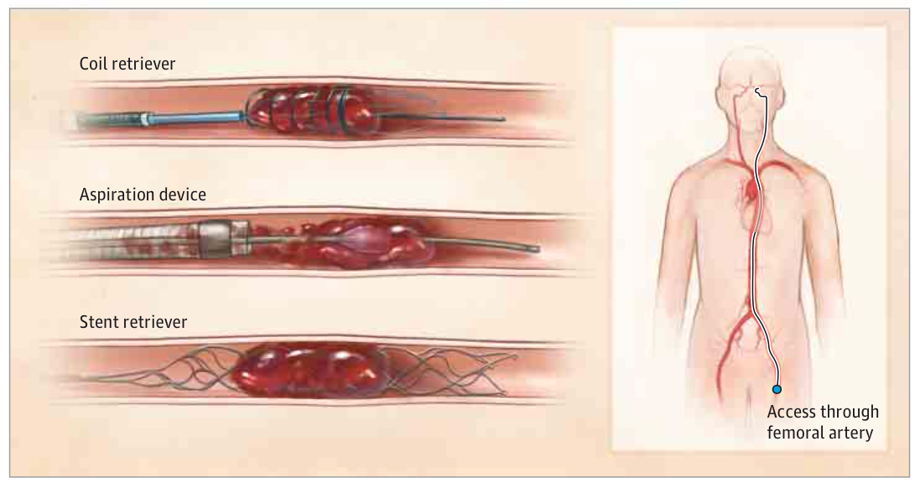
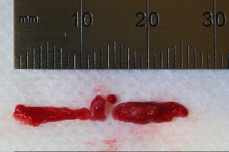
Management of Stroke
Make a diagnosis
Urgent treatment
Determine aetiology
Secondary prevention
Anticipate complications
Thrombolysis
Thrombectomy
The disease
https://www.cathflo.com/images/moa.gif. Prabhakaran, JAMA Neurology 2015

Slide 6
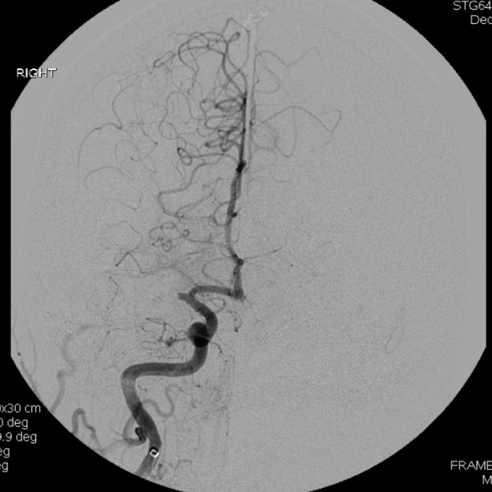

Mechanical thrombectomy (MT)
Patients with large clots unlikely to recanalise with tPA
Clot retrieval can be achieved through MT in addition to tPA/TNK
But ‘time is brain’: don’t delay Tpa
Extended time window up to 24hrs
Reduction of disability
MT can be considered for:
Patients with ischaemic stroke due to proximal MCA, carotid T, distal MCA & basilar occlusion (evidence for latter two less robust)
Patients presenting within 6 hours
Patients with significant neurological deficit (NIHSS ≥ 6)
Minimal ischaemia visible on brain imaging at time of presentation

Slide 7
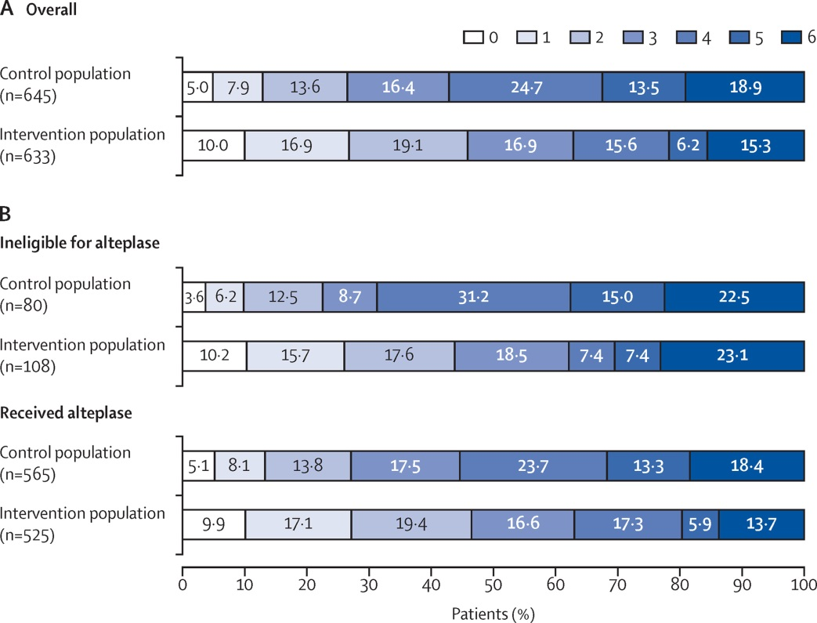
Mechanical thrombectomy trials
Multiple trials (MR-CLEAN, ESCAPE, SWIFT PRIME, EXTEND-IA, REVASCAT)
HERMES meta-analysis of above trials
Over 1200 patients
Functional independence at 90d (mRS 0-2) significantly increased with MT
Significantly reduced disability with MT
Benefit also seen if Alteplase not given
No difference in symptomatic haemorrhage
No difference in 90d mortality
NNT for favourable 90d outcome = 3 – 7.5

Slide 8
WHAT KIND OF STROKE?
Infarction (85%)
Atherothromboembolism 50%
Intracranial small vessel disease 25%
Embolism from heart 20%
Rarities 5%
Haemorrhage (15%)
Primary intracerebral haemorrhage 10%
Subarachnoid haemorrhage 5%

Slide 9
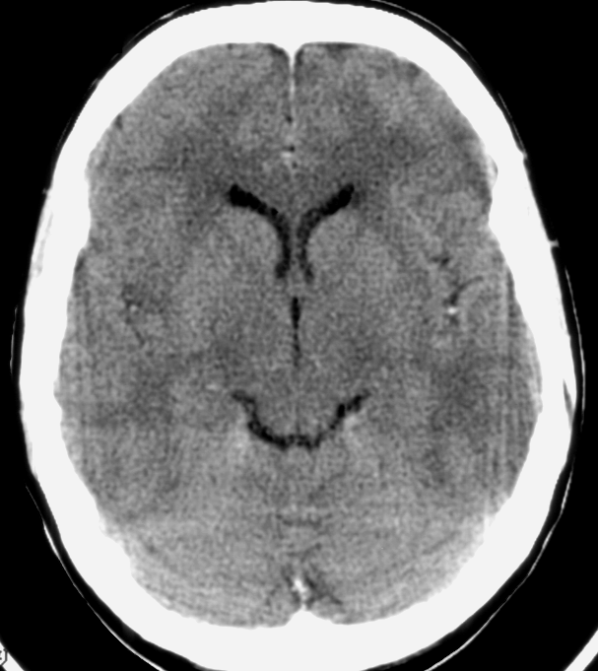
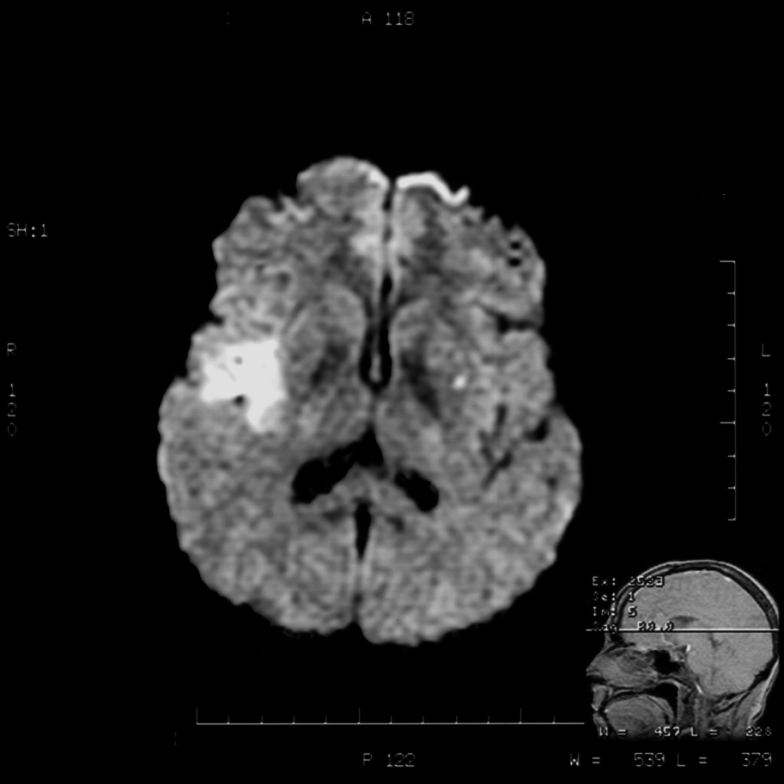
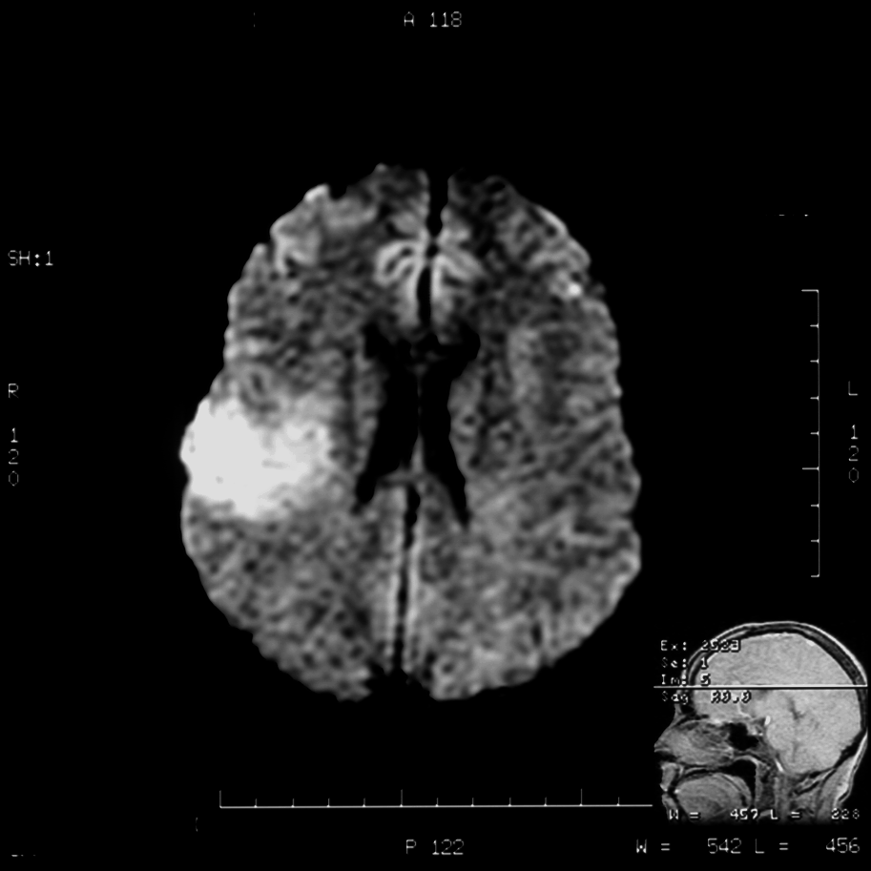
2hrs ago right hemiparesis: thrombolyse?
MRI DWI abnormal
-but DWI not widely available
CT Normal

Slide 10
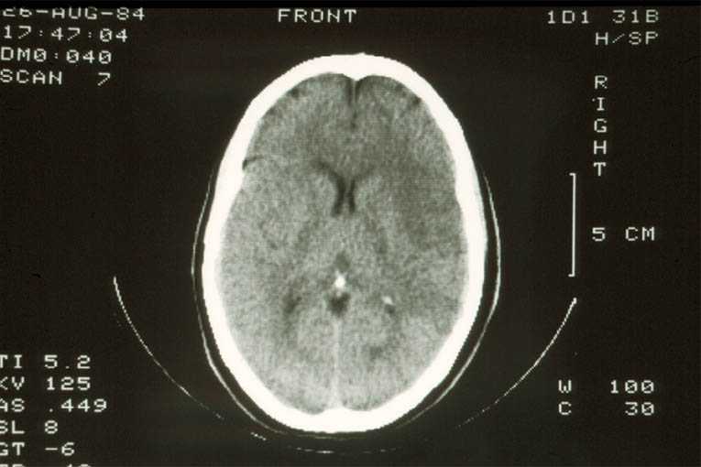
Early Infarction

Slide 11
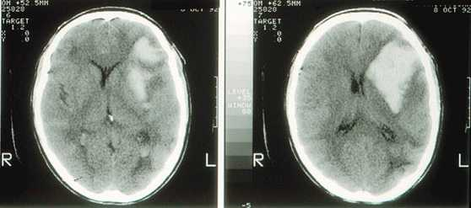
A haemorrhagic stroke
Notes:
This shows a n intracerebral haemorrhage in the deep structures of the left hemisphere. This is likely to be due to rupture of one of the small perforating branches of the middle cerebral artery. Hypertension is likely to have contributed to the disease of these blood vessels.

Slide 12
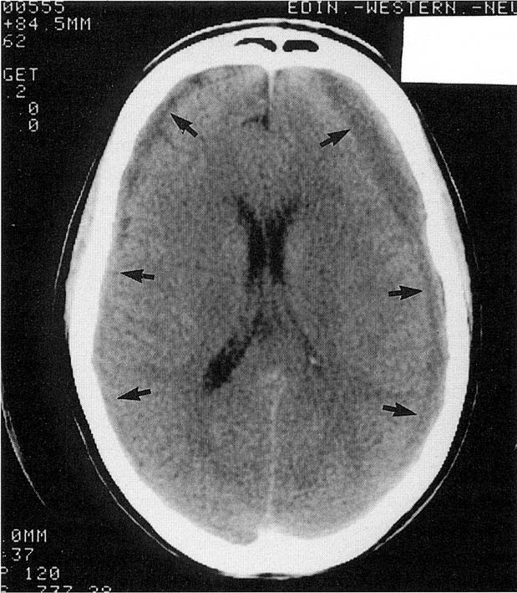
Non-stroke: bilateral subdural haematoma
Notes:
This scan shows low density areas (arrows) over the surface of the cerebral hemispheres. These are due to blood in the subdural space. More often the bleeding is on one side and can mimic a stroke although the symptoms usually come on more slowly. The blood can be removed surgically. Often such bleeding occurs after head injury and in patients taking anticoagulants

Slide 13
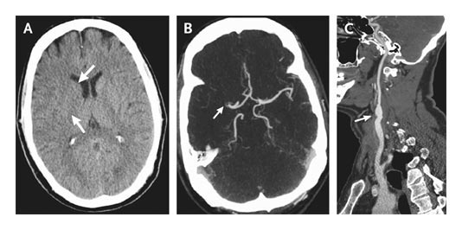

CT Scans Obtained 1 Hour 40 Minutes after the Onset of Symptoms Suggestive of Cortical Stroke in the Territory of the Right Middle Cerebral Artery
van der Worp H and van Gijn J. N Engl J Med 2007;357:572-579
Notes:
Figure 2. CT Scans Obtained 1 Hour 40 Minutes after the Onset of Symptoms Suggestive of Cortical Stroke in the Territory of the Right Middle Cerebral Artery. An unenhanced CT scan (Panel A) shows a slight loss of differentiation of gray and white matter in the basal ganglia (arrows). A CT angiographic image shows occlusion of the first segment of the right middle cerebral artery (Panel B, arrow) and atherosclerotic lesions in the carotid bifurcation (Panel C, arrow). The external carotid artery is not shown.

Slide 14
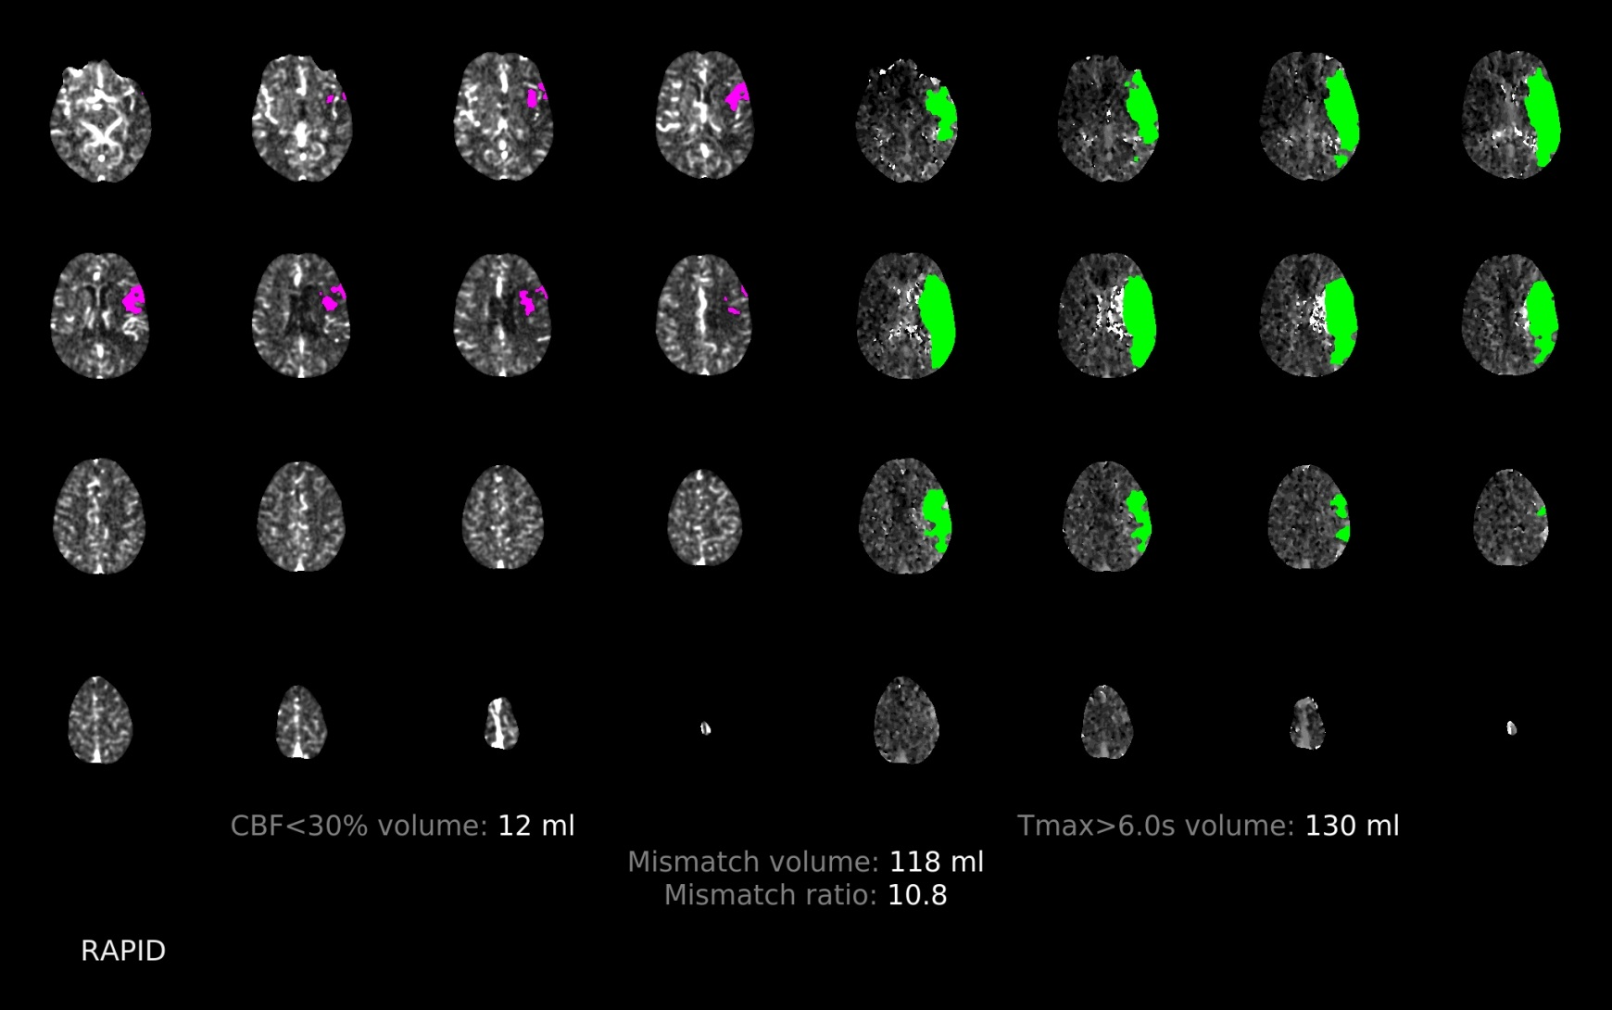
CT perfusion

Slide 15
What caused this… common causes
Infarct:
Hypertension
Diabetes mellitus
Cigarette smoking
Atrial Fibrillation
Carotid Stenosis
Cardiac Disease
Alcohol
?High Cholesterol
HAEMORRHAGE
Hypertension
Coagulation disorder
Aneurysym
Arterio-venous malformation (AVM)
Cigarette smoking
Amyloid angiopathy
Drug abuse

Slide 17
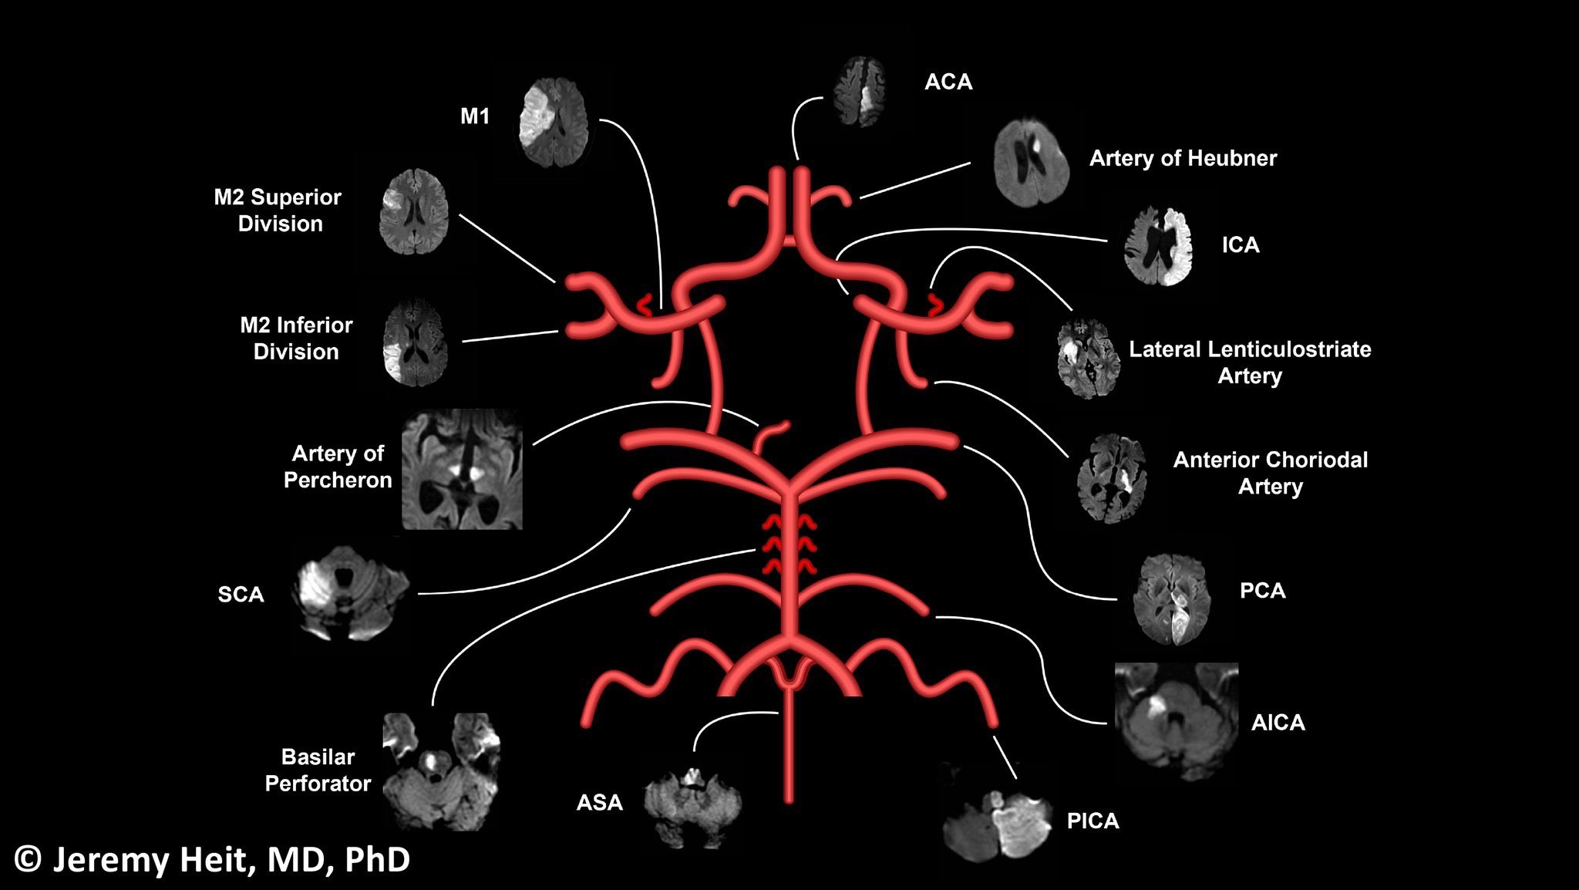

Slide 18
Oxford Classification of Stroke
Total Anterior Circulatory Infarct (TACS) | Partial Anterior Circulatory Infarct (PACS) | Lacunar Infarct (LACS) | Posterior Circulatory Infarct (POCS)
Carotid or Middle Cerebral Artery | Branch or Carotid MCA | Deep perforating Artery | Vertobrobasilar circulation
Hemiparesis Hemisensory loss Homonymous hemianopia HCD* | HCD Restricted hemiparesis/sensory loss +/- hemianopia | Hemiparesis/sensory loss Ataxic gait | Cerebellar signs Cranial Nerve Palsy Bilateral motor/sensory loss Conjugate eye movements Isolated hemianopia

Slide 19
WHAT PROBLEMS HAS IT CAUSED?
Motor loss (Hemiparesis)
Sensory loss
Slurred speech (Dysarthria)
Language problems (Dysphasia)
Swallowing (Dysphagia)
Unsteadiness (Ataxia)
Incontinence
Visual field defect (Hemianopia)
Visuo-spatial dysfunction
Neglect
Difficulty with complex tasks (Dyspraxia)
Memory & personality
Mood disturbance

Slide 20
Brain function
LEFT HEMISPHERE
(Dominant)
Right side power
Right side sensation
Right visual field
Language, calculation
Memory (verbal)
RIGHT HEMISPHERE
(Non-Dominant)
Left side power
Left side sensation
Left visual field
Visuo-spatial dysfunction
Neglect, dyspraxia,
sensory & visual inattention
Memory (non-verbal)

Slide 21
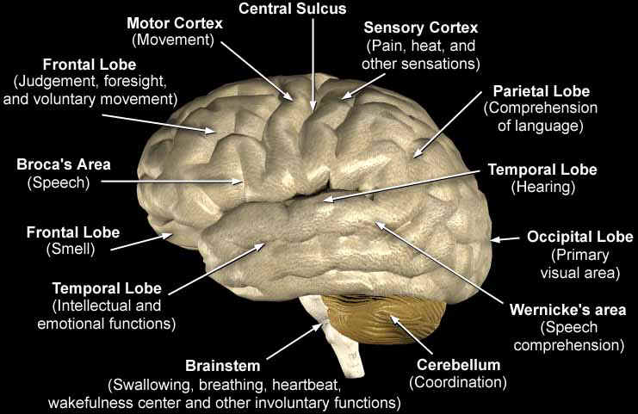
LATERAL VIEW OF THE BRAIN

Slide 22
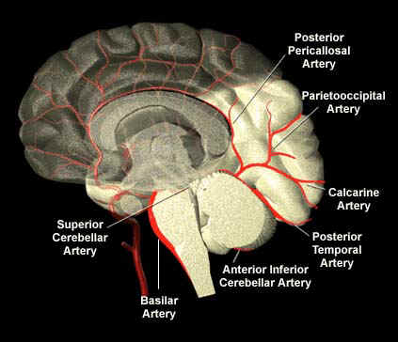
BLOOD SUPPLY OF BRAIN
POSTERIOR CIRCULATION
Vertebral & Basilar
Posterior cerebral
Relatively low mortality
high risk of recurrence

Slide 23
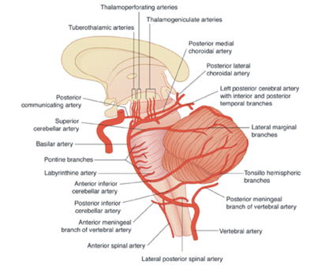
Vertebral and Basilar Arteries
Brainstem and cerebellum
Pathology
Infarction (85%)
haemorrhage (15%)

Slide 24
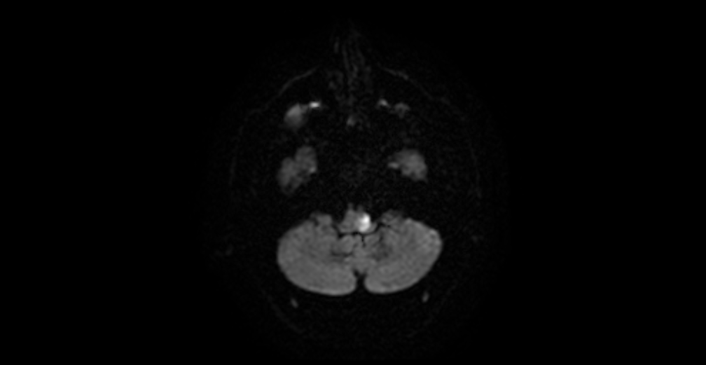
Brainstem Stroke ( left lateral medullary causing Wallenberg syndrome) MRI DWI

Slide 25
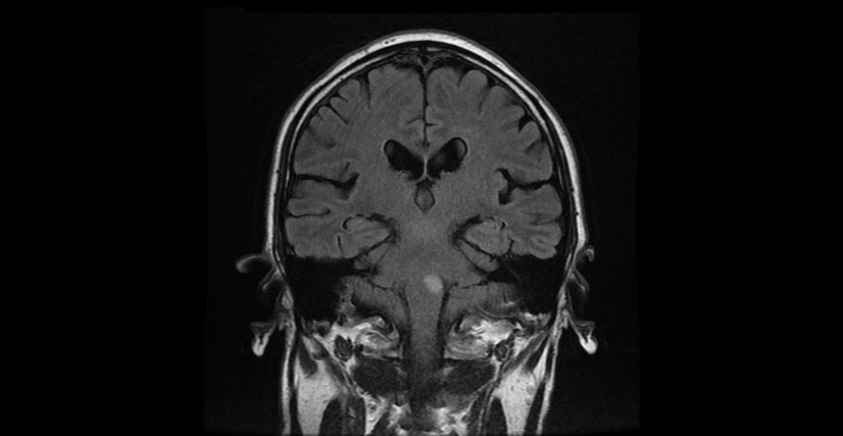
MRI T2 Flair (L lateral medullary stroke)

Slide 26
SYMPTOMS & SIGNS
Cerebellar strokes
Inco-ordination of limbs
Poor control of body
Unsteady walking -feet widely spread
Jerky movements of eyes (nystagmus)
Slurred speech (dysarthria)
Brainstem
similar to cerebellar but also:
Rotational vertigo (often with vomiting)
Double vision (diplopia)
Limb incoordination
Loss of pain and temp sensation
Hiccups
Bilateral weakness

Slide 27
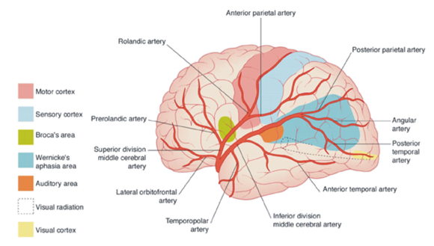
Middle Cerebral Artery

Slide 28
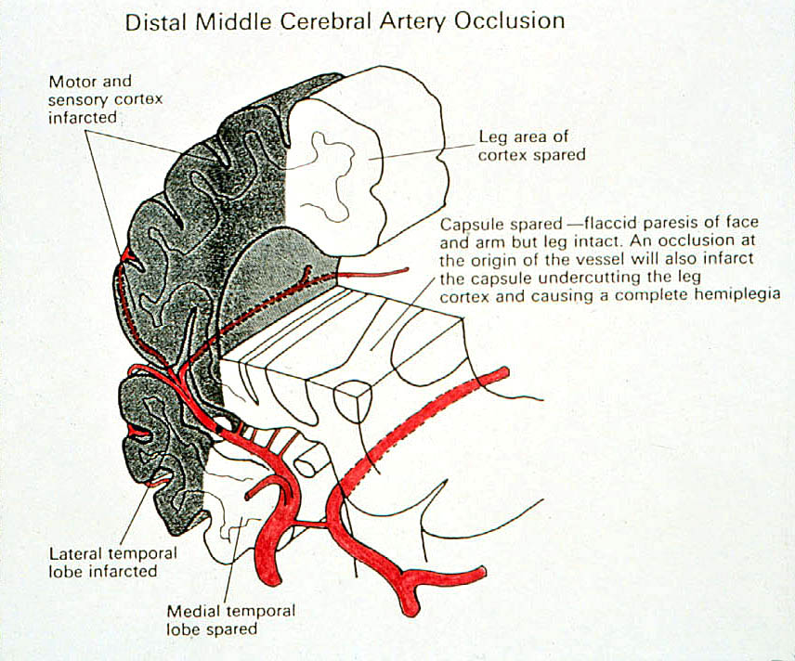
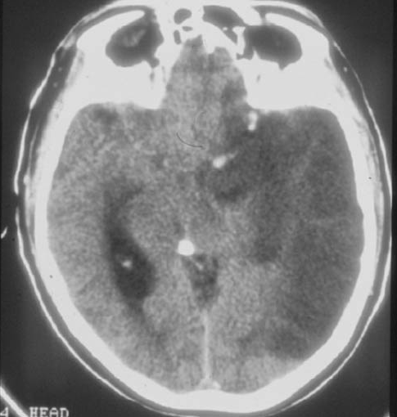
TACS 40% mortality at 1 month, 95% chance of dependence at 1 year 2/3rd embolic, in-situ thrombosis 1/3rd

Slide 29
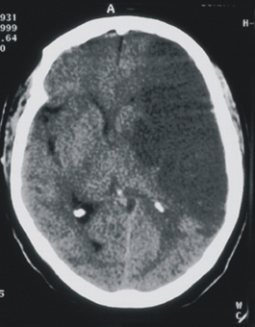
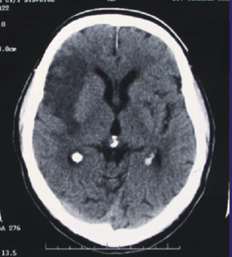
Total MCA infarction
Partial MCA infarction

Slide 30
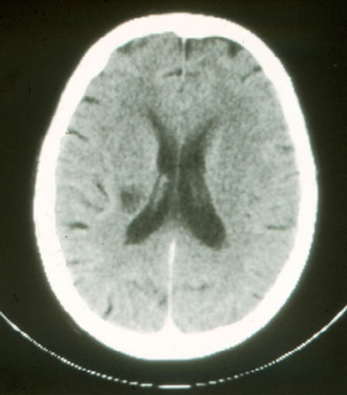
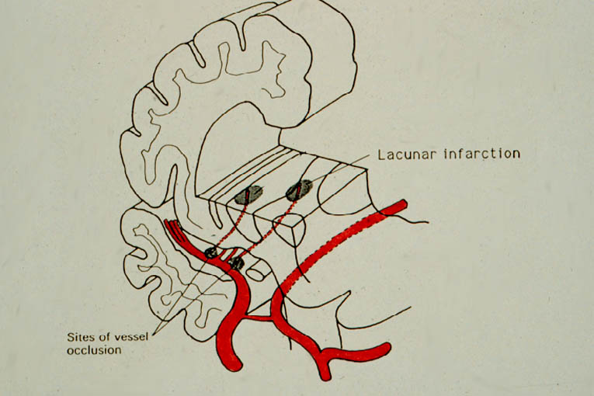
LACUNAR STROKE Low mortality, but relatively high proportion (30%) dependent at 1 year thrombotic occlusions of small deep end arteries
Common syndromes:
pure motor hemiparesis
hemisensory loss
sensorimotor stroke
ataxic hemiparesis
dysarthria clumsy hand syndrome

Slide 31
Most causes are arteriolosclerosis of deep vessels related to the usual vascular risk factors
Sporadic or hereditary Cerebral amyloid angiopathy
Inherited of genetic SVD; CADASIL, CARASIL, COL4A1, MELAS, Fabry’s disease etc
Inflammatory or immunological conditions: Sjogren’s, Wegner’s granulomatosis, Churg-Strauss, microscopic polyangiitis, Henoch-Shӧnleine Purpura, Cryoglobulonaemic vasculitis, SLE, Sneddon syndrome, cutaneous leukocytoclastic angiitis, primary angiitis, rheumatoid vasculitis, scleroderma, dermatomysositis
HIV related, post radiation angiopathy, non-amyloid micro-vessel degeneration in Alzheimer’s disease

Slide 32
Risk factors
Smoking
Obesity
Sleep apnoea
Hypertension
Heavy alcohol use
High cholesterol
Heart disease
Diabetes
Too much salt
Lack of exercise
Genetics
Inflammatory
Immunological

Slide 33
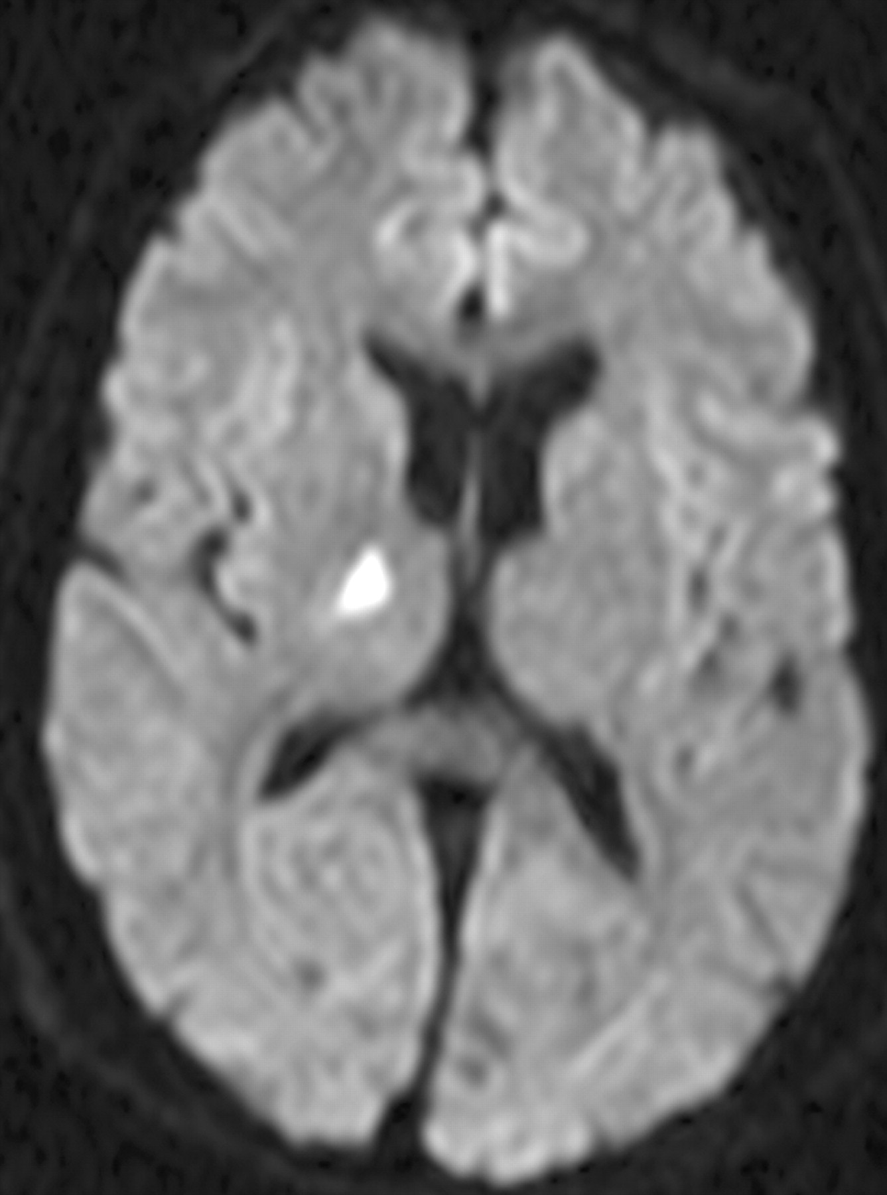
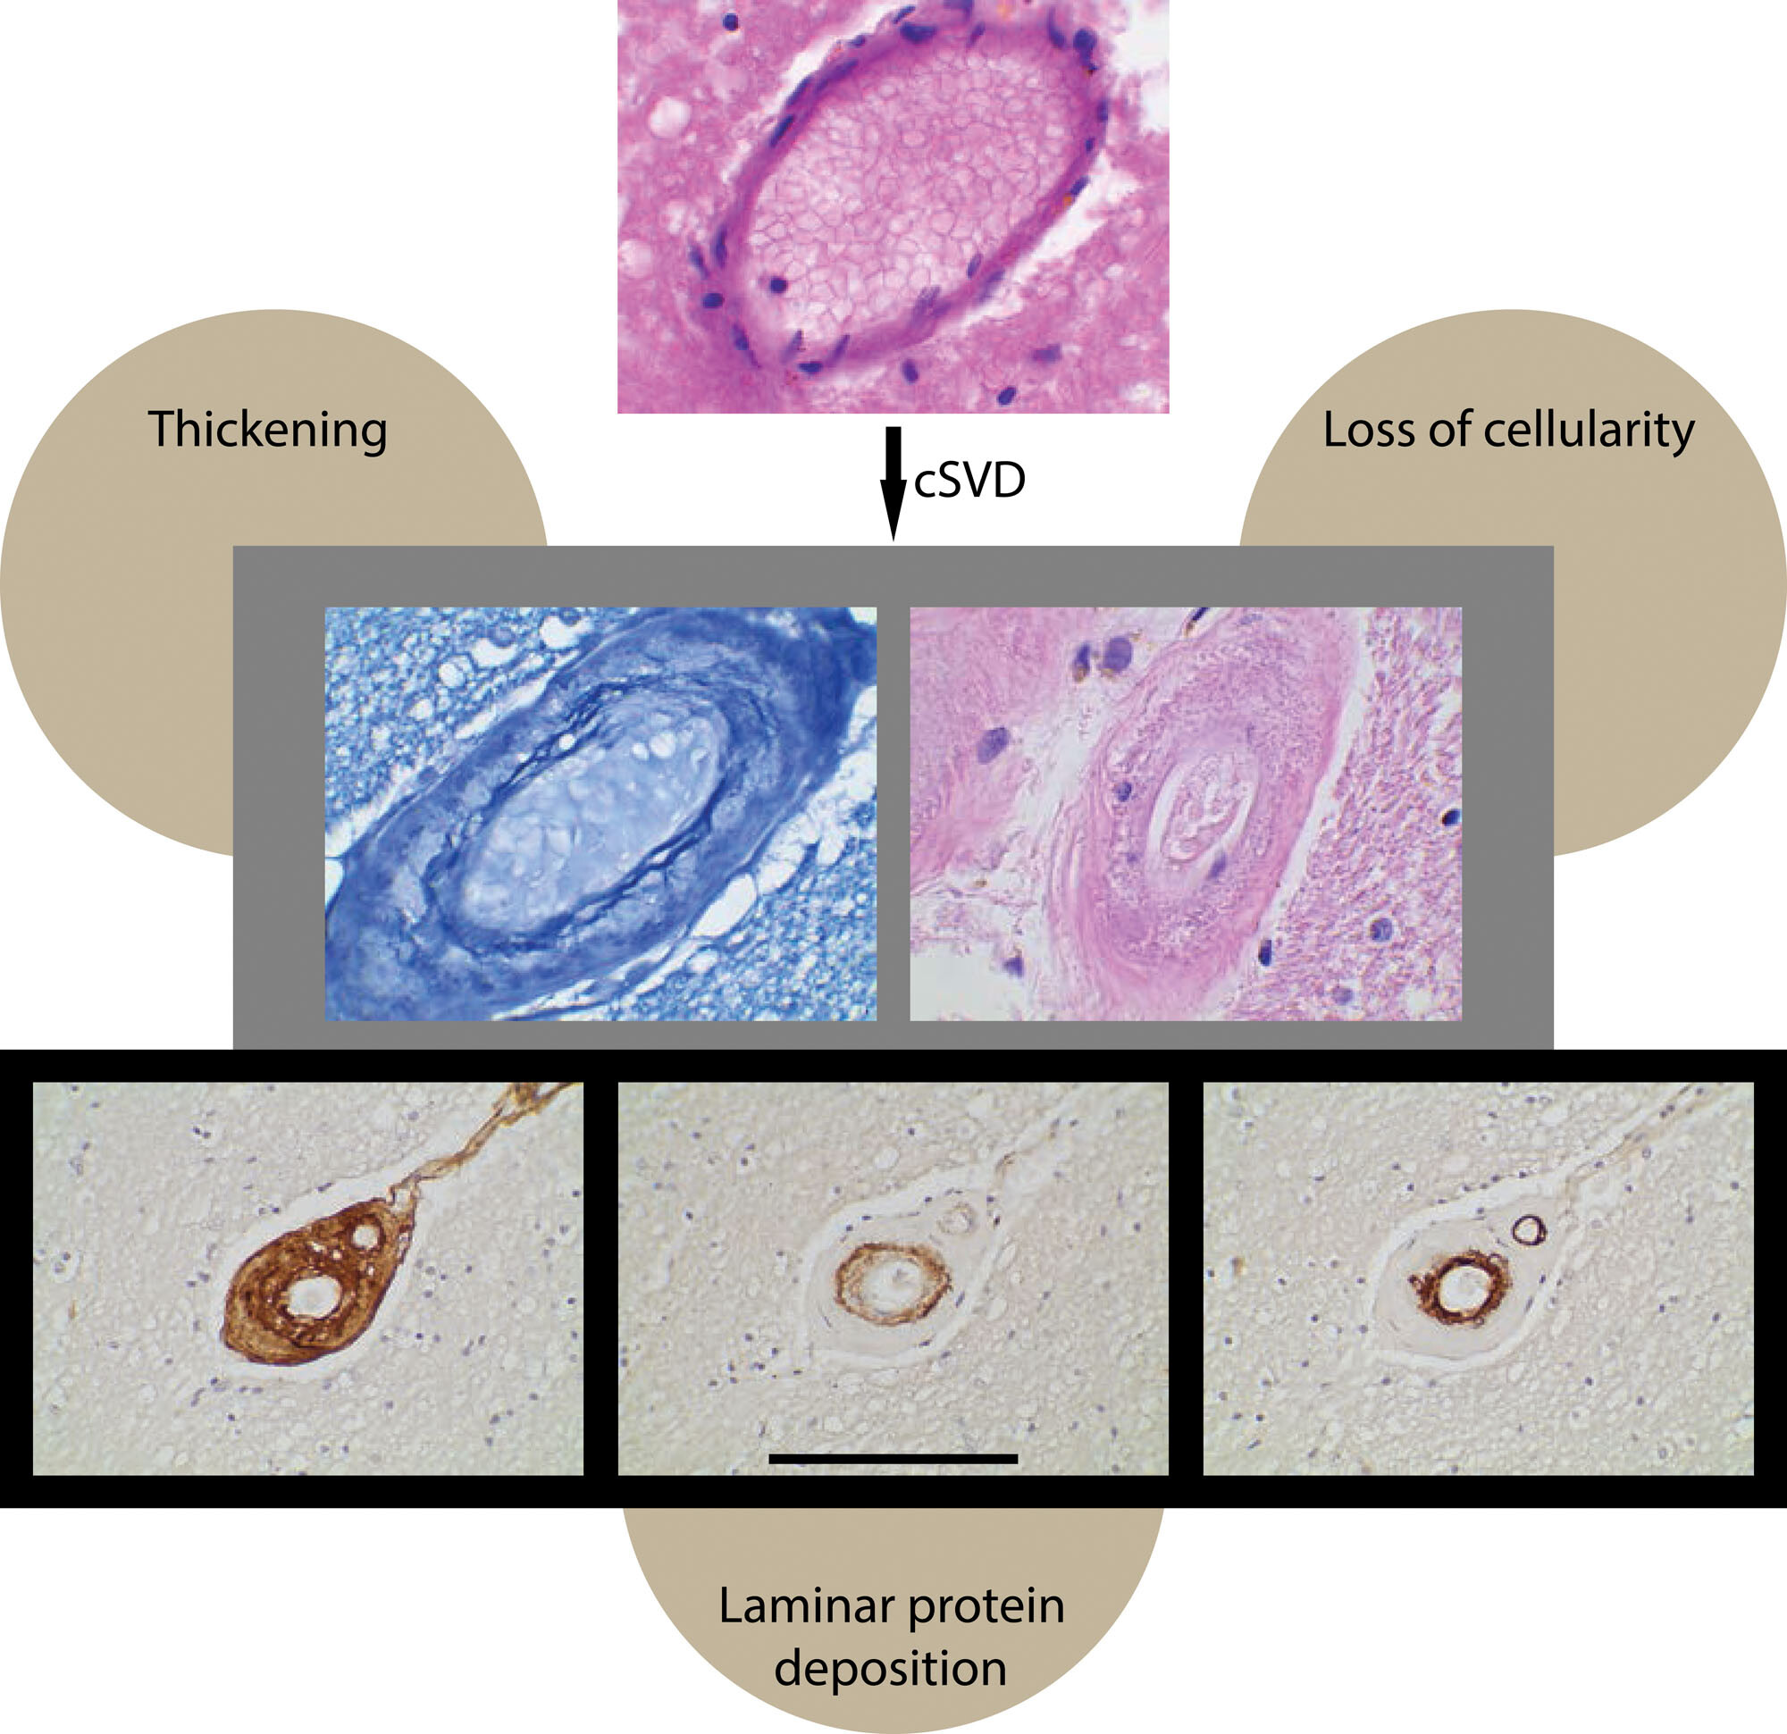
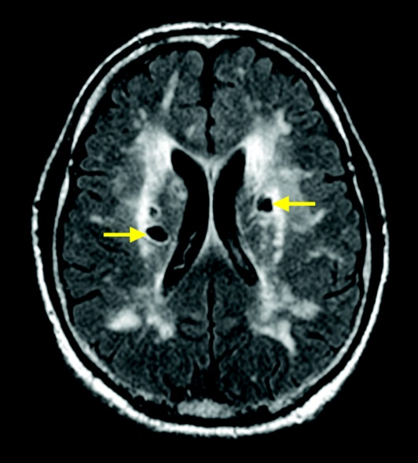

Cerebral small vessel disease and lacunar stroke
© 2023 American Heart Association, Inc.
Fanny M. Elahi. Stroke. Cerebral Small Vessel Disease–Related Dementia: More Questions Than Answers, Volume: 54, Issue: 3, Pages: 648-660, DOI: (10.1161/STROKEAHA.122.038265)

Slide 34
Cerebral small vessel disease (CSVD) denotes a range of clinical, imaging and pathological syndromes resulting from various causes affecting the small arteries, arterioles, capillaries and venules in the brain.
Cognitive disorder is one of the most common clinical features in CSVD.
CSVD is the most common cause of vascular cognitive impairment and contributes to up to 45% of dementias
The domain of cognitive impairment caused by CSVD may include the executive function, attention, working memory and psychomotor speed

Slide 35
Cerebral SVD is a leading cause of cognitive decline and functional loss in the elderly
Most aspects of secondary prevention are similar to other types of ischaemic strokes (e.g AF or other cardioembolic causes, thrombotic disorders)

Slide 36
Covert SVD: no symptoms
Stroke
Bleeding strokes
Cognitive problems: memory, thinking process, disorientation, struggle to follow things and process information
Apathy, low mood
Personality and mood changes
Mobility and balance problems: unsteadiness, poor balance falls

Slide 37
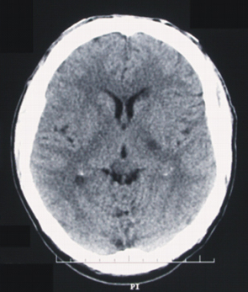
Lacunar strokes
Small deep lesions in either corona radiata, lentiform nucleus, internal capsule, thalamus or ventral pons
Pathology
Infarction (95-98%)
haemorrhage (2-5%)
Recurrence rate: low but steady over 12 months
Infarction: usually perforating artery microatheroma/lipohyalinosis
Arteritis (rare)
Embolism (rare)
Hamorrhage: any, but usually hypertensive small-vessel disease

Slide 38
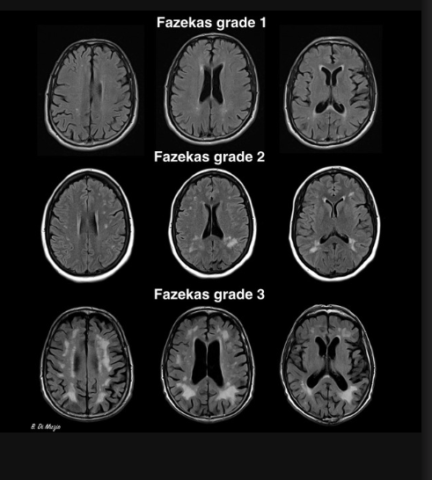
Fazekas scale
periventricular white matter (PVWM)
0 = absent
1 = “caps” or pencil-thin lining
2 = smooth “halo”
3 = irregular periventricular signal extending into the deep white matter
deep white matter (DWM)
0 = absent
1 = punctate foci
2 = beginning confluence
3 = large confluent areas

Slide 39
.
In a recent large systemic review and meta-analysis, individual neuroimaging markers of SVD (ie, WMH, lacunes and microbleeds) were associated with increased risk of mortality, showing the clinical significance of these markers
More importantly, the combined MRI markers of SVD may be more predictive of increased risk of mortality

Slide 40
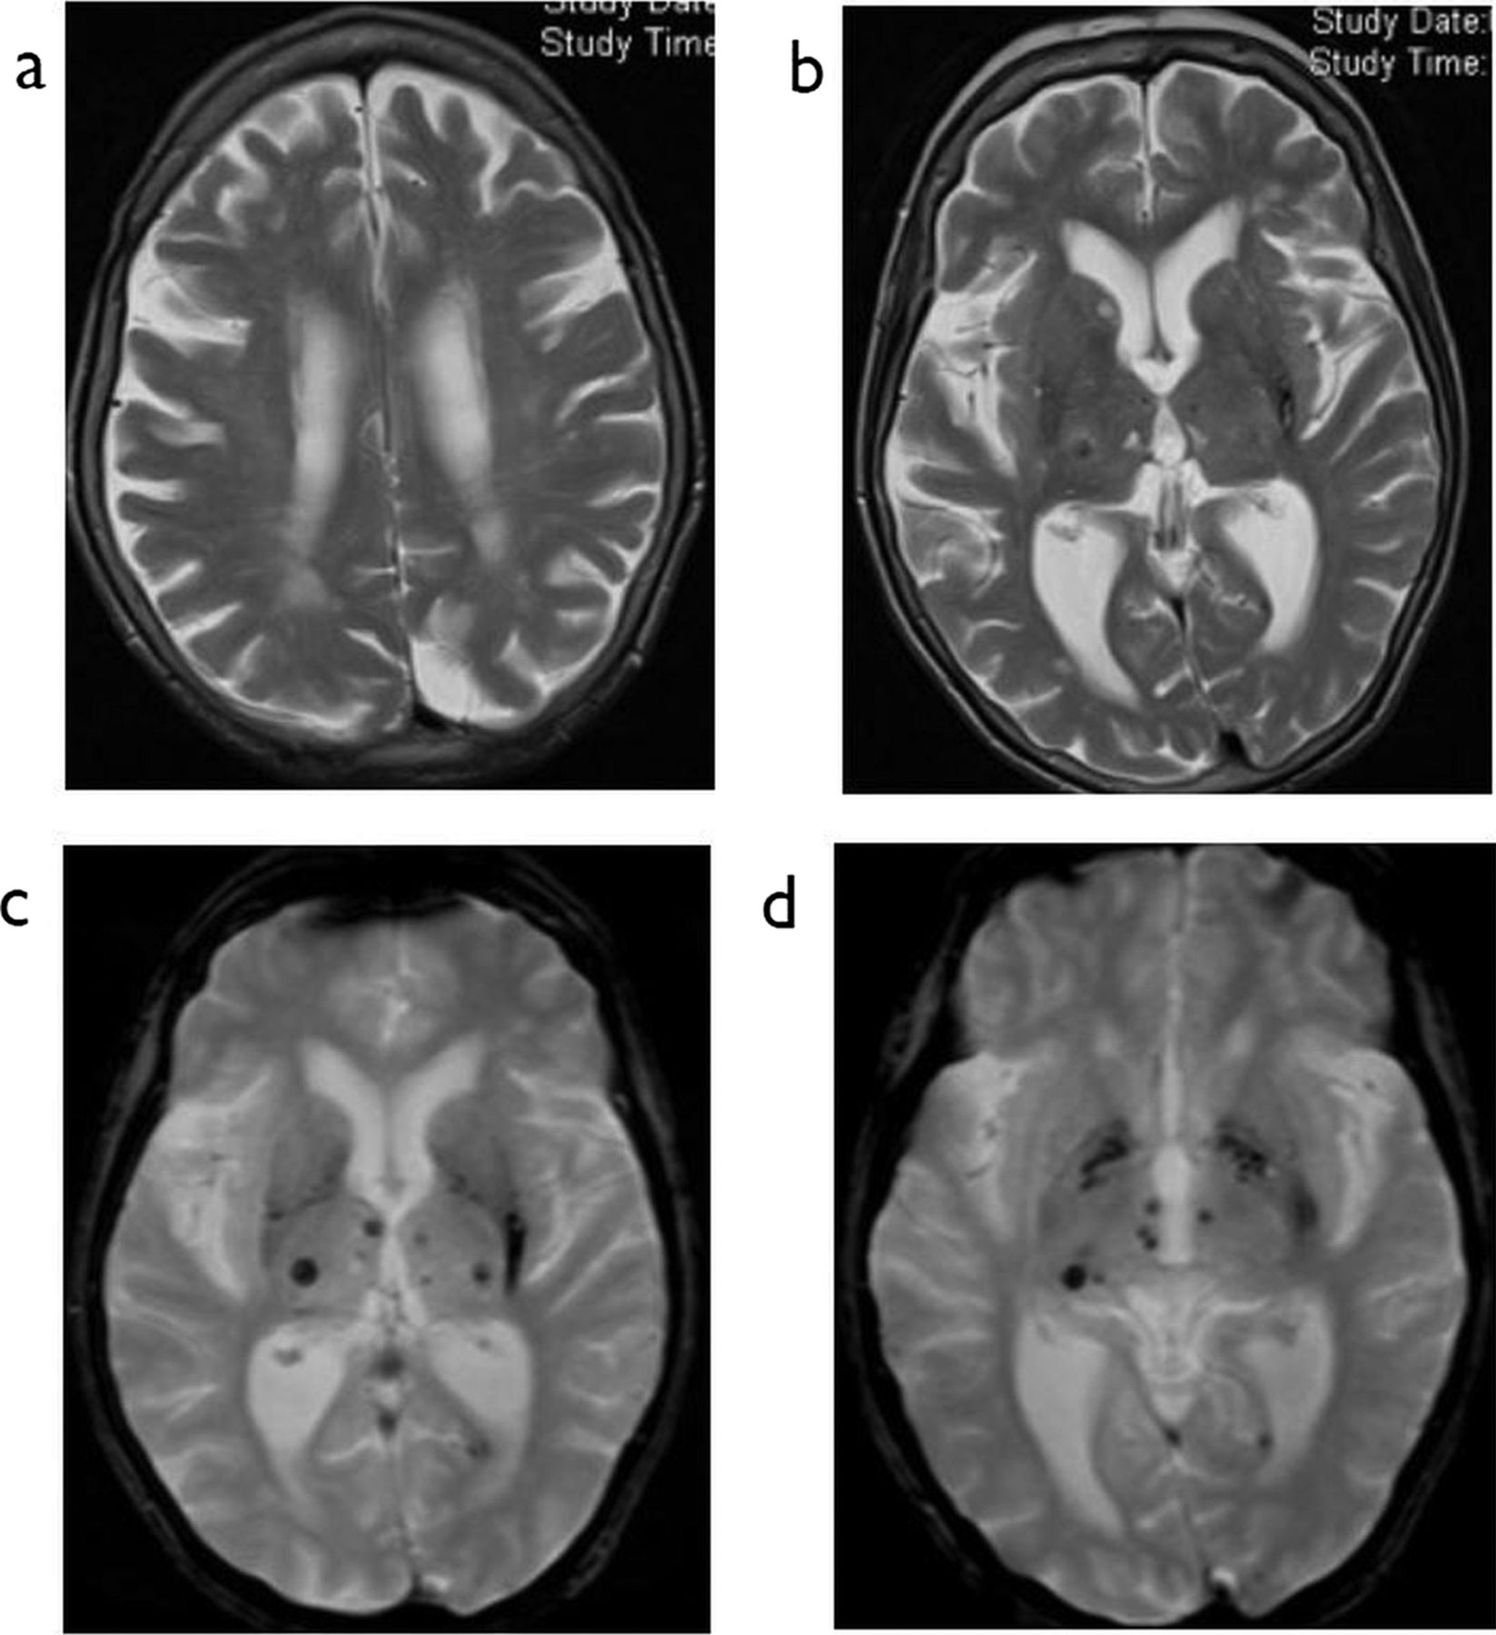

T2W axial (A and B) and T2W gradient echo axial MR images (C and D) demonstrate the typical microbleeds of hypertensive vascular disease with areas of haemosiderin in the thalami and basal ganglia.
Shelley Renowden Pract Neurol 2014;14:159-175
©2014 by BMJ Publishing Group Ltd
Notes:
T2W axial (A and B) and T2W gradient echo axial MR images (C and D) demonstrate the typical microbleeds of hypertensive vascular disease with areas of haemosiderin in the thalami and basal ganglia. There are small thalamic lacunar infarcts and patchy high signal in the periventricular white matter due to gliosis and occlusive small vessel disease.

Slide 41
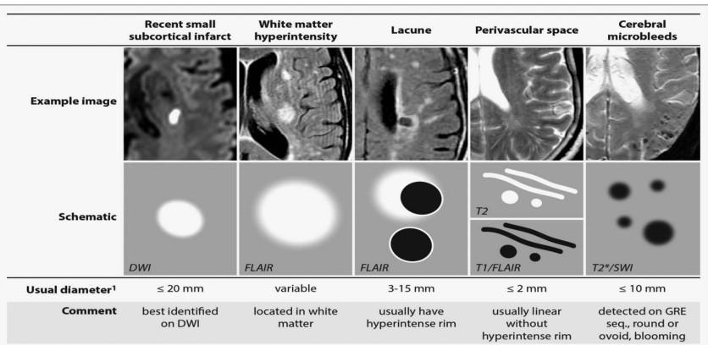
By Professor Wardlaw, Edinburgh, BMJ Open

Slide 42
Although many lacunes might have lacked acute symptoms, when present in larger numbers they are associated with dementia, cognitive impairment, gait disturbance and increased risk of stroke
In the general elderly population, the prevalence of lacunes ranges from 8% to 28% (mean age=50–75 years).

Slide 43
Was the ICH triggered by stress?
Case report by Lammie, Lindley, Keir and Wiggam (Stroke.2000;31:1426-1428)
84 yrs old man with a history of hypertension told of the death of his wife
immediately developed a severe left sided weakness.
BP 198/100 .
He became rapidly drowsy.

Slide 44
CT revealed right midbrain/thalamic haemorrhage
Repeat CT showed extension into the ventricles
Died 5 days later

Slide 45
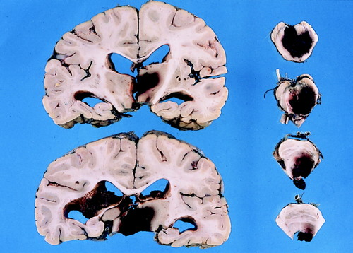
Copyright © 2000 by American Heart Association
G. Alistair Lammie. Stroke. Stress-Related Primary Intracerebral Hemorrhage , Volume: 31, Issue: 6, Pages: 1426-1428, DOI: (10.1161/01.STR.31.6.1426)

Slide 46
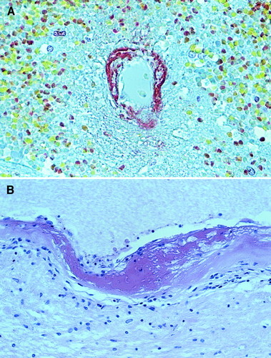
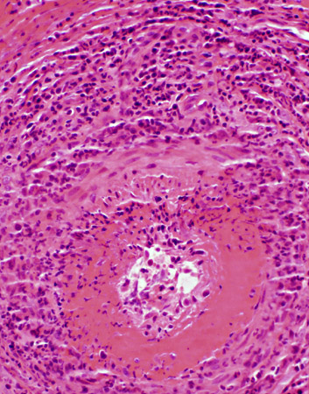
Autopsy findings
Right thalamic ICH
Multiple lacunar infarcts
Widespread concentric small-vessel wall thickening
Acute fibrinoid necrosis of small vessels with RBC extravasation adjacent to haematoma

Slide 47
Caplan’s theory
Acute rises in BP or cerebral blood flow may cause rupture of perforating cerebral vessels
Emotional or physical stress can cause such circulatory changes mediated in part by catecholamine secretion

Slide 48
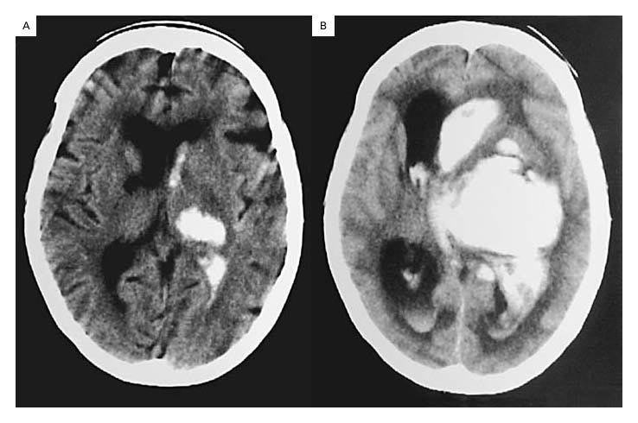
Expanding haematoma
CT of expansion
Offers a potential target for treatment

Slide 49
81 yrs old lady admitted with Facial droop and slurred speech
October 2024: Left corona radiata infarct
July 2025: Stroke review and HASU stay due to worsening Rt facial droop. NIHSS -9, MRI (July 2025): evolution of the left striatocapsular infarct
Type 2 Diabetes HbA1c 76 ( in July 2025)
Hypertension
Hypercholesterolaemia ( well controlled)

Slide 50
Cognitive assessment: ACE
Total score: 56/90
Attention: 12/18
Memory: 16/26
Fluency: 4/14
Language: 16/24
Visuospatial: 8/16
Difficulty with working memory tasks, including when asked to subtract 7 from 100
Both phonemic and semantic verbal fluency appear to be an area of difficulty.
Difficulty remembering a name and address over time, including difficulty recognising elements of this information, suggesting issues around both encoding and retention of information.

Slide 51
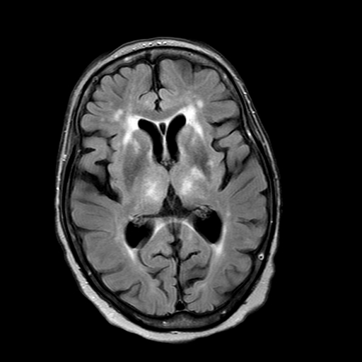
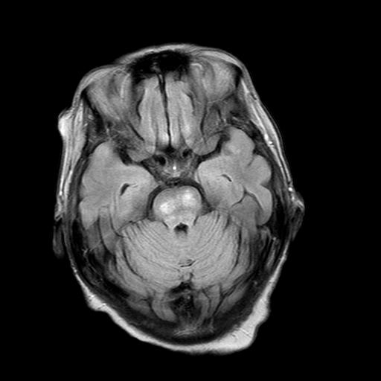
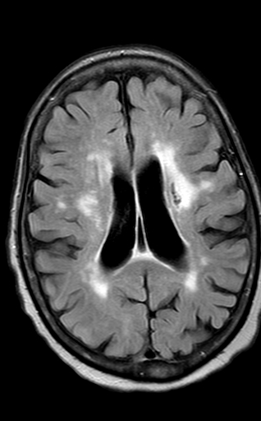
SVD and old infarct in L corona radiata

Slide 52
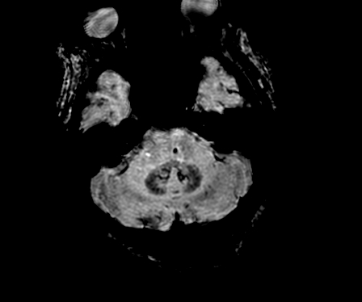
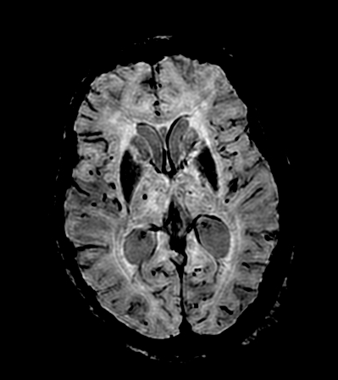
Hypertensive microbleeds

Slide 53
67 years old man
Right occipital intracerebral haemorrhage July 2024
Hypertension ( poorly controlled)
Type 2 Diabetes ( verry well controlled)
Prostate cancer ( in remission)
Intracranial CT angiogram, no evidence of aneurysms or AVM
Has never smoked, never drank alcohol
Taxi driver
His mother died of AD at the age of 89
Walks every day, active, BMI normal
LDL 2.44 TC 4.1
HbA1c 42
EGFR 89

Slide 54
Medications:
Candesartan 16 mg daily
Doxazosin 4 mg BD
Amlodipine 10 mg OD
Verapamil ( now stopped)
Metformin 500 mg OD
Atorvastatin 40 mg ON ( new)

Slide 55
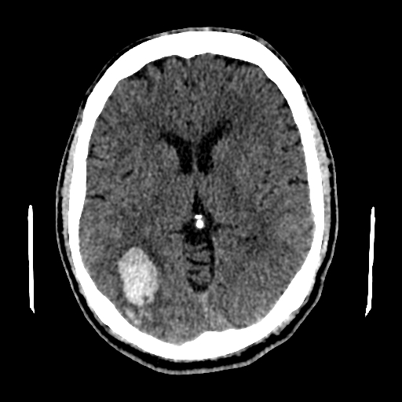
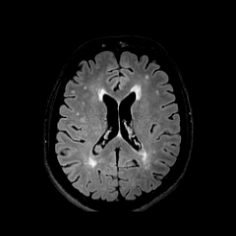
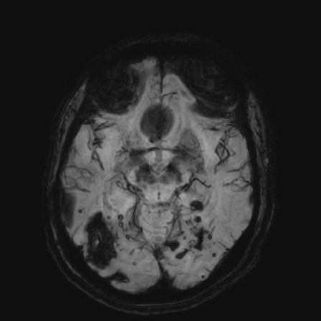

Slide 56
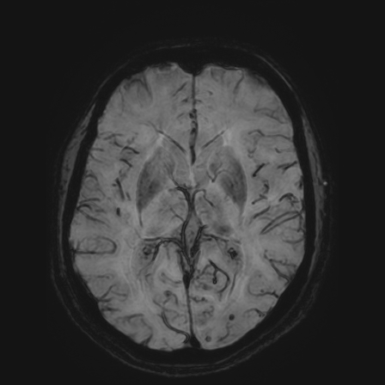
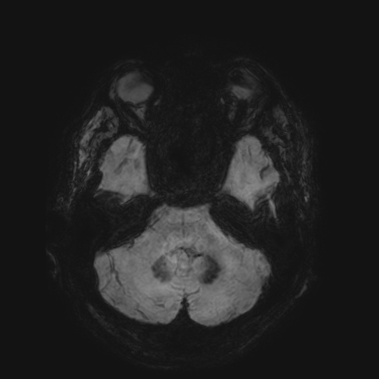
BG, Thalami , Pons and cerebellar hemispheres

Slide 57
Diagnosis and progress
ICH secondary to Hypertension
Small vessel disease secondary to Hypertension
Probable Cerebral amyloid angiopathy
Radiologically: no progress of lesions for the last 2.5 years
Now retired
Remains fully independent and active, walks every day, has a healthy diet
no hemianopia
No major cognitive decline but no interest in reading or learning new skills
Blood pressure since the ICH has been very well controlled at 110-120 systolic, HbA1c 40; LDL 1.70

Slide 58
Research
LACunar Intervention (LACI) Trial-3: Assessment of efficacy and safety of cilostazol and isosorbide mononitrate to prevent adverse outcomes in patients with cerebral small vessel disease (lacunar) ischaemic stroke

Slide 59
Cognitive impairment DSM-5 7-level ordinal cognitive score (derived from Telephone Interview for Cognitive Status, TICS; telephone Montreal Cognitive Assessmen; tMOCA, animal naming and other sources)
Dependency: modified Rankin Scale (mRS)
Recurrent stroke or TIA (TIA to be identified separately); LACI-3 Summary Protocol v1.3 20240614
MI
Depression (ZUNG)
Quality of life (EQ5D, EQVAS)
Stroke Impact Scale (SIS) – self reported cognitive, motor, mobility, mood, self-worth, QoL – analysed by individual components and a global SIS
Health Economic parameters – health care usage, social impacts;
Safety:
Death from all causes.
Major systemic or brain haemorrhage.
Symptoms potentially related to the trial drugs (reduced list of headache, palpitations, loose stools, falls, etc) as per LACI-2

Slide 60
Treatment
SPS3 trial showed that long-term dual antiplatelet treatment doubled the risk of bleeding without reducing the risk of stroke recurrence in patients with recent lacunar stroke
blood pressure lowering did not show significant reduction in recurrent lacunar stroke in the SPS3 trial, although it was consistent with a modest benefit
Post hoc analysis of a 2-year follow-up study from Hong Kong showed that statins might be able to delay WMH progression in patients with severe baseline WMH

Slide 61
Effect of Antihypertensive Medication on Cerebral Small Vessel Disease: A Systematic Review and Meta-Analysis Tessa van Middelaar, MD, Tanja E. Argillander, MD, Floris H.B.M. Schreuder, MD, Jaap Deinum, PhD, Edo Richard, PhD, and Catharina J.M. Klijn Stroke Volume 49, Number 6 https://doi.org/10.1161/STROKEAHA.118.021160
AHM is effective in slowing the progression of WMH.
The optimal timing of treatment to prevent WMH progression is unknown.
From a prevention perspective, the ideal timing of AHM would probably be early in the course of hypertension
No effect on brain atrophy
WMH seems to progress exponentially and with slow progression rates; in the early stages, it may be difficult to prove effectiveness of AHM within a reasonable time frame.

Slide 62
Look after your thinking skills (Age UK)
Keep fit
Don’t smoke
Have regular check-ups : Blood pressure, high cholesterol, diabetes checks
Eat a healthy diet: high in fruits, vegetable, nuts, olive oil, beans and cereals; moderate fish , dairy products and wine; limited in poultry, red meat ( Mediterranean diet is linked to healthier brain health)
Maintain a healthy weight
Look after your sleep: aim for 7-8 hours a day mainly at night
Learn another language ( linked with better thinking skills later in life)
Stay connected with family and friends ( may help maintain thinking skills and reduces cognitive decline)

Slide 63
Research trials
DNA Lacunar 2 | Genetic study using GWAS approach in lacunar stroke syndrome patients
LACI-3 | cilostazol and isosorbide mononitrate to prevent adverse outcomes in patients with cerebral small vessel disease (lacunar) ischaemic stroke

Slide 64
68 years old man
Presenting with sudden onset anarthria, dysphagia, facial diplegia and tongue paralysis
PMHx
Left insula and left precentral gyrus infarcts June 2023
Wheelchair user due to back pain since at least 2018
IHD - 2 stents
Myocardial infarction - 2005
Hypertension
Patient very frustrated as cannot articulate words. He can communicate by writing ( quite messy an illegible). Unable to swallow at all and initially refusing NG feeding. Hypersalivation and cannot close his mouth as facial diplegia. Increasingly frustrated

Slide 65
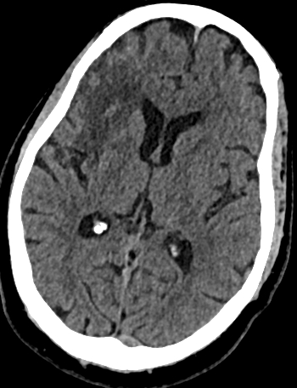
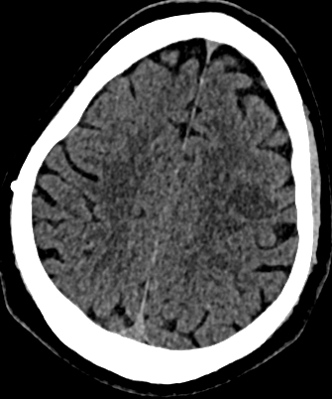
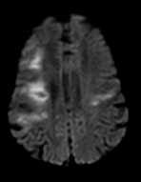
New Left posterior frontal infarct. Old Right MCA territory infarction (relatively large). This is involving the right frontal parietal and insular lobes.

Slide 66
Foix-Chavany-Marie syndrome (FCMS) is a cortical-subcortical pseudobulbar palsy characterized by automatic voluntary dissociation of facio-masticatory-pharyngo-glosso-laryngeal movements. FCMS is typically caused by vascular insults on the bilateral anterior opercular or adjacent subcortical areas.
Acute onset of FCMS secondary to a unilateral lesion is extremely rare
The anterior operculum contains the voluntary motor fibers for the 5th, 7th, 9th, 10th, and 12th cranial nerves, which then travel to the cranial nerve nuclei via the corticobulbar tract.
Previous case reports have described how a new unilateral lesion in combination with older lesions can result in FCMS

Slide 67
Acute left posterior frontal infarct on background of right fronto-insular infarct 29/5/25 Foix–Chavany–Marie syndrome
Mood/ Behaviours-
Patient has presented with challenging behaviours intermittently throughout admission.
Refusing care from certain staff members
Paranoid delusions regarding ward staff
Intermittent agitation resulting in destruction of hospital property and aggression to others occur when patient is acutely distressed (when feels persecuted, not-listened to, or when requests are repeatedly denied)
Lack of insight
Impulsive behaviour
Aggressive behaviour on few occasions against particular members of staff
pre-morbid personality was known have paranoid tendencies and he has a general mistrust of the health service which is likely to become exaggerated post-stroke

Slide 68
Language -
Non verbal
Writes responses, but the quality of this is dependent on stress
Mild expressive and receptive impairments
Significant CCD characterised by impulsivity, reduced planning, prioritisation, content organisation
Cognition-
Patient presents predominantly with executive dysfunction, namely difficulties with planning, organisation, response inhibition and behavioural impulsivity.
Impairments impacted by heightened emotion.
Difficulties with time manage, organise himself, demonstrate awareness of others and regulate himself within this environment which results in requiring high levels of support and assistance to modulate and support this set up in order to keep the patient safe and successful in this set up.

Slide 69
Initially had Trazodone for nearly 1 month, then Risperidone for 1 week
Then Olanzapine 2.5mg at noon + 5mg ON from 19th September until discharge to specialist rehab in Dec Promethazine 25mg BD PRN
Lorazepam IM PRN
1:1 with MHSW to mitigate risk of aggression to others
focus on distraction and stimulating activities while maintaining clear communication.
Restrictive measures are likely to increase frustration and therefore the risk of aggression towards others
Starts to calm down
Accepts PEG insertion after showing video
Has capacity to consent for PEG
Starts engaging better with therapy
Engages especially with musical activities
Transferred to rehab specialist unit for stroke/neurology patients with behavioural problems 6 months after admission

Slide 70
Research
MIDAS-2 | Modafinil 200 mg OD Vs placebo for 2 months in post-stroke fatigue after 3 months of stroke.
EASE | Sertraline 50mg OD vs placebo for 6 months in recent stroke and post-stroke emotionalism

Slide 71


St George’s Hospital Guidelines
Adult aged 18-65
Adult >65
ECG and haematological monitoring are also strongly recommended, especially when higher doses are used. ECG monitoring is formally recommended for all patients who receive I/M haloperidol.

Slide 72


Slide 73
Post stroke psychiatric disorders
Depression up to 28%, can occur at 1-18 months : Left frontal, Basal ganglia
SSRIs or SNRIs avoid early start if possible: CBT first ; SE profile; interaction with Clopidogrel
Anxiety 20-24%: right hemisphere, right limbic system
SSRIs, SNRIs,
Psychosis 4.86% (delusions and hallucinations): right hemisphere (temporal, parietal)
Haloperidol, Quetiapine, Olanzepine, Risperidone, benzodiazepines
PTSD
CBT; SSRI, SNRI, TCA
Mania ( very rare) right hemisphere, right front lobe, right temporal lobe
Valproate, carbamazepine, oxcarbazepine, atypical antipsychotics
Emotional lability: bilateral-cortico bulbar pathway, brainstem strokes
?antidepressants such as Fluoxetine
Fatigue 25-85% subcortical, infratentorial
Modafanil?
Apathy/abulia 34.6% (with depression in 40%) : frontal lobes especially medial frontal, thalami, caudate
Personality disorders and aggression, irritability 12-53% , disinhibition 6-76% : frontal lobe (orbito-frontal cortex)
Fluoxetine, citalopram, Lithium

Slide 74
Acute confusional state
Arterial infarct
Haemorrhage
Thalamus: pramedian and thalamopolar arteries
Posterior cerebral artery ( bilateral infarcts)
Anterior cerebral artery ( bilateral infarcts)
Middle cerebral artery: deep ( caudate nucleus, genu of the internal capsule) and superficial ( particularly right) territories
Frontal
Thalamus

Slide 75
Complication and comorbidities
Metabolic disorders
Infections and fever
Pain
Cardiopulmonary disorders
Etanol and drugs intoxication and withdrawal
Epilepsy, subdural haematoma, brain injury
Pre-existing dementia

Slide 76
Neuropsychiatric symptoms following stroke occur in at least 30% of stroke survivors and are a major predictor of poor outcome
Neuropsychiatric symptoms are often underdiagnosed and undertreated after stroke ( little research )
psychosis is often excluded from treatment guidelines for poststroke psychiatric management

Slide 77
Poststroke psychosis: a systematic review Stangeland H, Orgeta V, Bell V Poststroke psychosis: a systematic review Journal of Neurology, Neurosurgery & Psychiatry 2018;89:879-885. http://orcid.org/0000-0001-8616-4847
Abstract
A preregistered systematic review of poststroke psychosis examining clinical characteristics, prevalence, diagnostic procedures, lesion location, treatments, risk factors and outcome. Neuropsychiatric outcomes following stroke are common and severely impact quality of life.
No previous reviews have focused on poststroke psychosis despite clear clinical need.
CINAHL, MEDLINE and PsychINFO were searched for studies on poststroke psychosis published between 1975 and 2016. Reviewers independently selected studies for inclusion, extracted data and rated study quality.
Out of 2442 references, 76 met inclusion criteria.
Average age for poststroke psychosis was 66.6 years with slightly more males than females affected.
Delayed onset was common.
Neurological presentation was typical for stroke, but a significant minority had otherwise ‘silent strokes’.
The most common psychosis was delusional disorder, followed by schizophrenia-like psychosis and mood disorder with psychotic features.
Estimated delusion prevalence was 4.67% (95% CI 2.30% to 7.79%) and hallucinations 5.05% (95% CI 1.84% to 9.65%). Twelve-year incidence was 6.7%. No systematic treatment studies were found. Case studies frequently report symptom remission after antipsychotics, but serious concerns about under-representation of poor outcome remain.

Slide 78
Poststroke psychosis: a systematic review Stangeland H, Orgeta V, Bell V Journal of Neurology, Neurosurgery & Psychiatry 2018;89:879-885. http://orcid.org/0000-0001-8616-4847
A total of 106 (40.2%) patients were reported to have lesions in the right hemisphere
19 (7.2%) patients were reported to have lesions in the left hemisphere
9 (3.4%) patients were reported to have bilateral lesions.
The regions that were most often affected included the right frontal, temporal and parietal regions, as well as the right caudate nucleus.
The right frontal region was affected in 30 (11.4%) patients
The right temporal region was affected in 26 (9.8%) patients
The right parietal region was affected in 40 (15.2%) patients
The right caudate nucleus was affected in 14 (5.3%) patients
The most common affected artery was the right middle cerebral artery, which was reported to be affected in 22 (8.3%) patients
Psychosis considerably adds to illness burden of stroke
Delayed onset suggests a window for early intervention.
Studies on the safety and efficacy of antipsychotics in this population are urgently needed.

Slide 79
poststroke psychosis affects approximately 1 in 20 patients with stroke in the post-acute stage, and one longer-term study⁸ suggests that this may increase to approximately 7% over subsequent years
The typical onset of poststroke psychosis may be several months after stroke suggesting a window for early detection and intervention

Slide 80
Haloperidol and risperidone are reported as the most frequently prescribed, followed by quetiapine and olanzapine.
Side effects include dyskinesias and weight gain, and some, especially risperidone, stroke
no clinical trial has evaluated clinical effectiveness, safety or adverse effects
patients with poststroke psychosis have an increased 10-year mortality risk

Slide 81
Atypical Antipsychotics and Risk of Cerebrovascular Accidents Nathan Herrmann, M.D., F.R.C.P.C., Muhammad Mamdani, Pharm.D., M.A., M.P.H., and Krista L. Lanctôt, Ph.D.Authors Info & Affiliations Publication: American Journal of Psychiatry Volume 161, Number 6 https://doi.org/10.1176/appi.ajp.161.6.1113
OBJECTIVE: Randomized controlled trials have suggested that at least one atypical antipsychotic may be associated with an increased risk of stroke in older people with dementia. This study examined the association between atypical antipsychotic use and stroke in the elderly.
METHOD: The authors conducted a retrospective population-based cohort study of patients over the age of 66 by linking administrative health care databases. Three cohorts—users of typical antipsychotics, risperidone, and olanzapine—were identified and compared.
RESULTS: Subjects treated with typical antipsychotics (N=1,015) were compared with those given risperidone (N=6,964) and olanzapine (N=3,421). Model-based estimates adjusted for covariates hypothesized to be associated with stroke risk revealed relative risk estimates of 1.1 (95% CI=0.5–2.3) for olanzapine and 1.4 (95% CI=0.7–2.8) for risperidone.
CONCLUSIONS: Olanzapine and risperidone use were not associated with a statistically significant increased risk of stroke compared with typical antipsychotic use.

Slide 82
Delirium
Difficult to diagnose
Sudden change in cognition or behaviour
Fluctuating course
Impaired arousal or attention
Sleep disruption or reversal
Delusions or hallucinations
Extreme or labile emotions
Motor restlessness
Autonomic changes such as postural hypotension or incontinence
Causation to due physical illness, injury, drug or drug withdrawal not explained by dementia or another neurological process

Slide 83
Peduncular hallucinosis of Lhermitte
Complex, often colourful, dream like visual hallucinations particularly in the evening and at sleep onset
Caused by strokes in the ponto-mesencephalic or mesencephalic tegmentum and in the paramedian thalamus
Associated with insomnia
Resolves spontaneously

Slide 84
Apathy and abulia
Can mimic/overlap with depression or dementia
lack of spontaneous verbal and motor initiative
increased latency to respond to stimuli
Difficulty sustaining attention and persisting with tasks
Impaired problem solving
Decreased attentional capacity
Moderate impairment on memory tasks even with cues but with normal recognition
Anterior and medial thalamic lesions
Inferior genu of the internal capsule
Anterior infarcts ( with memory deficit)
Dorsomedial infarcts ( with drowsiness, memory and vertical gaze disturbance)

Slide 85
References
Debette S , Schilling S , Duperron M-G , et al
Clinical significance of magnetic resonance imaging markers of vascular brain injury: a systematic review and meta-analysis. JAMA Neurol 2019;76:81–94
Rensma SP , van Sloten TT , Launer LJ , et al Cerebral small vessel disease and risk of incident stroke, dementia and depression, and all-cause mortality: a systematic review and meta-analysis. Neurosci Biobehav Rev 2018;90:164–73
Saha, Gautam; Chakraborty, Kaustav1; Pattojoshi, Amrit2. Management of Psychiatric Disorders in Patients with Stroke and Traumatic Brain Injury. Indian Journal of Psychiatry 64(Suppl 2):p S344-S354, March 2022. | DOI: 10.4103/indianjpsychiatry.indianjpsychiatry_34_22
Stangeland H, Orgeta V, Bell V Poststroke psychosis: a systematic review Journal of Neurology, Neurosurgery & Psychiatry 2018;89:879-885
Age (UK)
National Stroke guidelines UK
The Stroke Association
Caplan’s Stroke: A Clinical Approach Fifth Edition ( Louis Caplan)
Stroke Care: A Practical Manual Third Edition ( Rowan H Harwood et al)
St George’s University Hospitals NHS Foundation Trust guidelines
St George’s Stroke unit cases

Slide 86

Thank you any questions?

