Slide 1
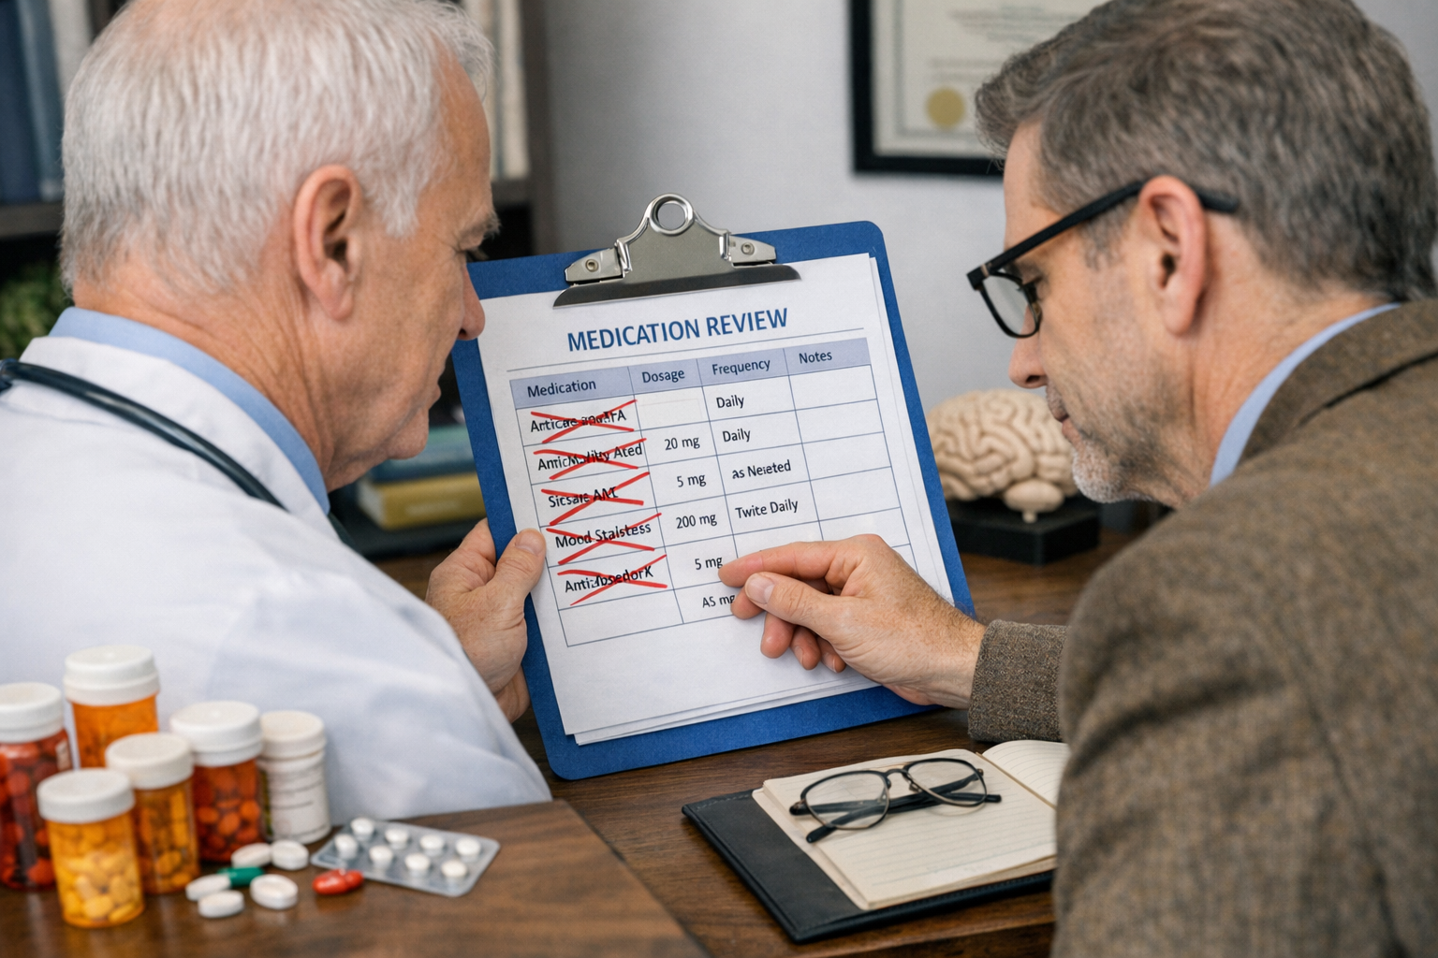
Polypharmacy and Deprescribing
Dr Iain Wilkinson
Clinical Director Frailty – SaSH
Vice President Education and Training – British Geriatrics Society
TPD – KSS Deanery

Slide 2



Declarations of interest

Slide 3

How does it feel…
To start a medication?
To continue a medication?
To stop a medication?

Slide 4
The next 45 or so mins
Why does polypharmacy happen and the main issues / problems
Why older people are more affected
Some case examples
Tips and tools to reduce polypharmacy

Slide 5

Right now…
Notes:
Right now…
- 3 million + people in the UK with long term health conditions managed by polypharmacy
Some people looking at their tablets laid out working out what to take when
Getting a prescription but not taking their tablets
Someone confused by the number of their medications and not taking them correctly
Is being admitted to hospital as a direct consequence of their medications

Slide 6
Medications dispensed in UK
Data adapted from: The Pharmaceutical Journal, PJ October 2025, Vol 315, No 8002;315(8002)

Slide 7
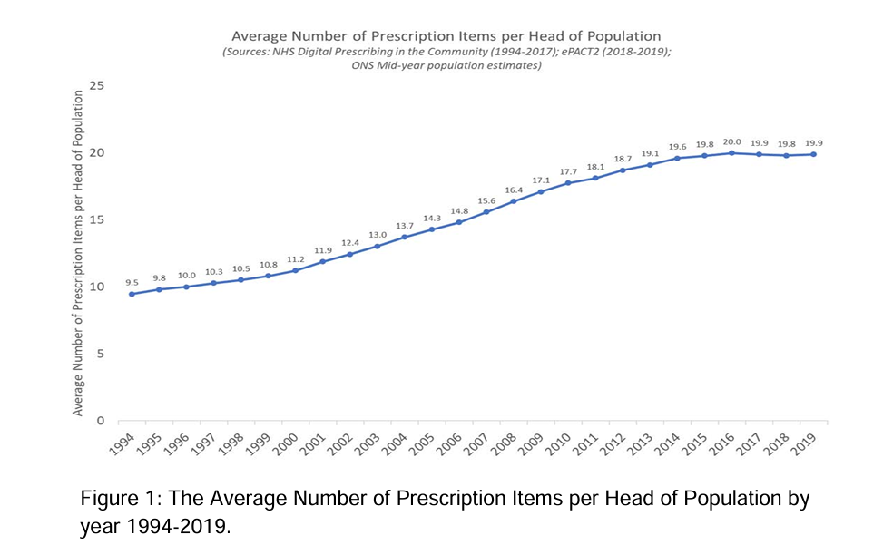

Slide 8
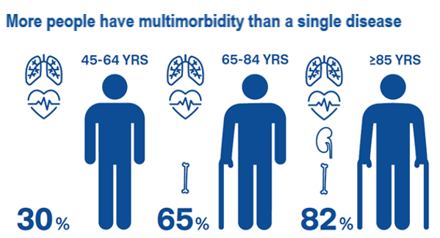

Multimorbidity is on the rise
60% of adults aged over 65 are expected to be living with multiple health conditions (multi-morbidity) by 2035.
17% will living with four or more diseases
2x the number in 2015.
1/3 of these people would have a mental health condition like dementia or depression.
https://evidence.nihr.ac.uk/alert/multi-morbidity-predicted-to-increase-in-the-uk-over-the-next-20-years/

Slide 9
Multimorbidity is on the rise
The greatest prevalence increase is for cancer which had doubled from 12.6% in 2015.
From: https://evidence.nihr.ac.uk/alert/multi-morbidity-predicted-to-increase-in-the-uk-over-the-next-20-years/
Notes:
With these come medications

Slide 10
OA, HTN and Respiratory disease
2
OA – Many non-pharmacological treatments, Paracetamol +/- NSAIDs or opioids
HTN- Multiple at lower dose more effective than higher doses* Most need >2
Respiratory disease – medications often combined in COPD (3 in one inhaler)
3
3
* https://pmc.ncbi.nlm.nih.gov/articles/PMC10658721/

Slide 11
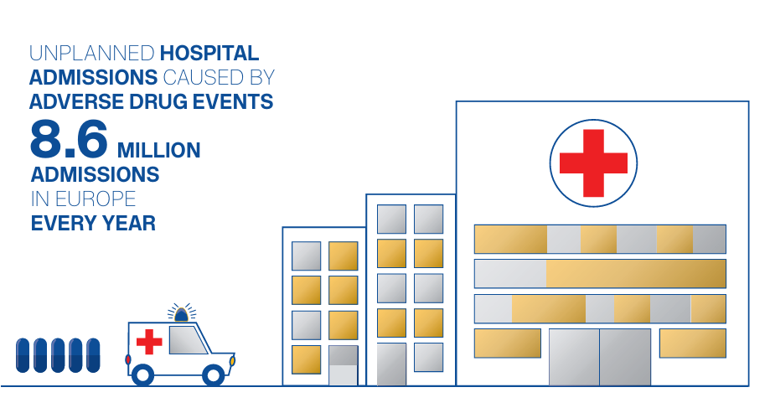
Hospital admissions
If a person is taking ten or more medicines they are 3x more likely to be admitted to hospital
Adverse drug reactions are responsible for 6.5% of hospital admissions
4% of total bed days!
(c. 1.4 million bed days)

Slide 12
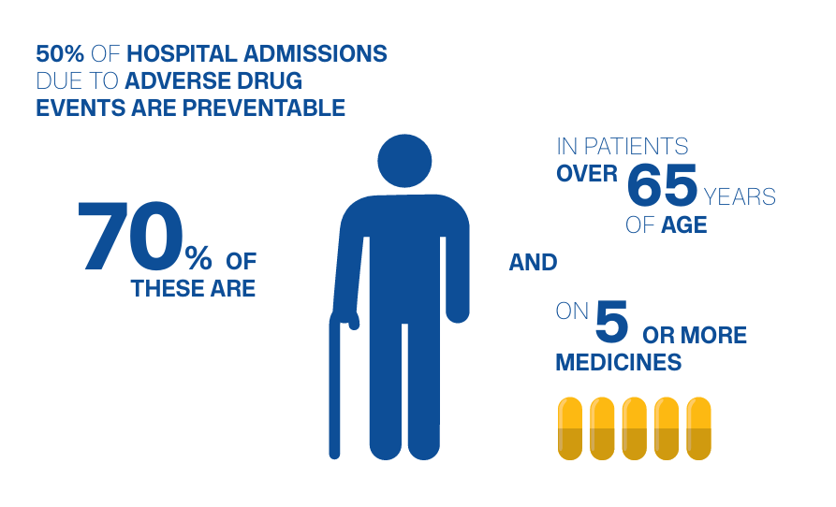
But… its age dependant

Slide 13
Example of avoidable admission
Mr H 82 yrs seen in ED following a fall at home > Frailty SDEC
Went to run out of the front door to stop his grandson running away
Tripped and fell > small head injury
Actually, also fell earlier in the day and 2 weeks ago
PMH:
Migraine – diagnosed around 10 years ago
Tremor – Clinically not PD
Amyloid angiopathy
Partial seizures – Rx started 6 months ago and increased 1 month ago
HTN
Confusion – awaiting memory clinic
CT head showed small ICH
Medications:
Amitriptyline
Apixaban
Lamotrigine
Paracetamol
Candesartan

Slide 14

Case synthesis
Worsening confusion since taking Lamotragine
Getting mixed up with his tablets
? Taking too many – won’t let his wife help
Falls probably due to the amitryptyline

Slide 15
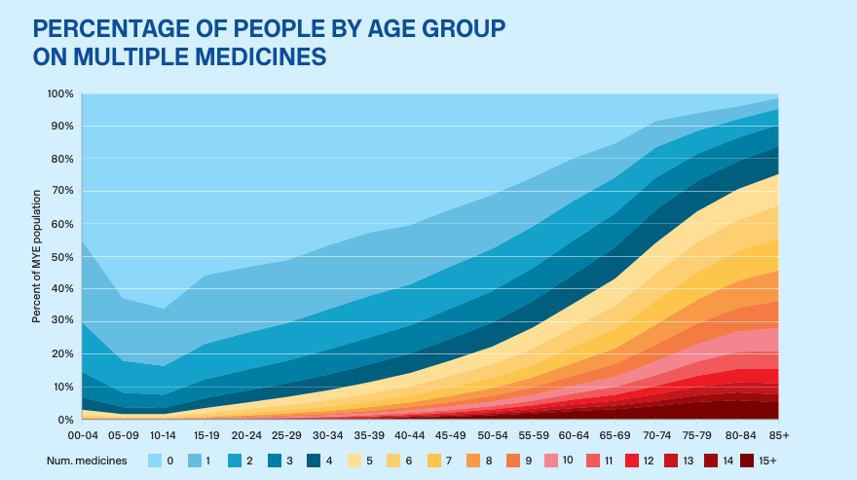
A problem of older age
Notes:
A pr

Slide 16
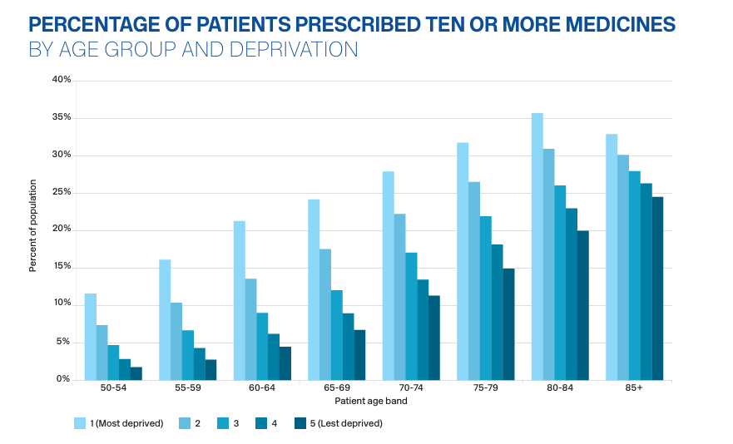
Links to deprivation

Slide 17
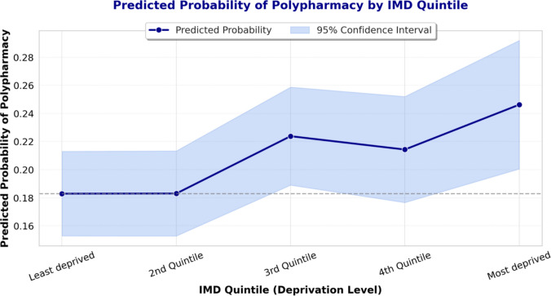
https://pmc.ncbi.nlm.nih.gov/articles/PMC12823709/

Slide 18
Why?
Research indicates that deprived populations often face barriers to non-pharmacological interventions (eg physiotherapy or dietary counselling)>>> a greater reliance on medications
When adjusted for GP visit frequency - more frequent healthcare interactions in deprived areas resulted in additional prescriptions
https://pmc.ncbi.nlm.nih.gov/articles/PMC12823709/

Slide 19
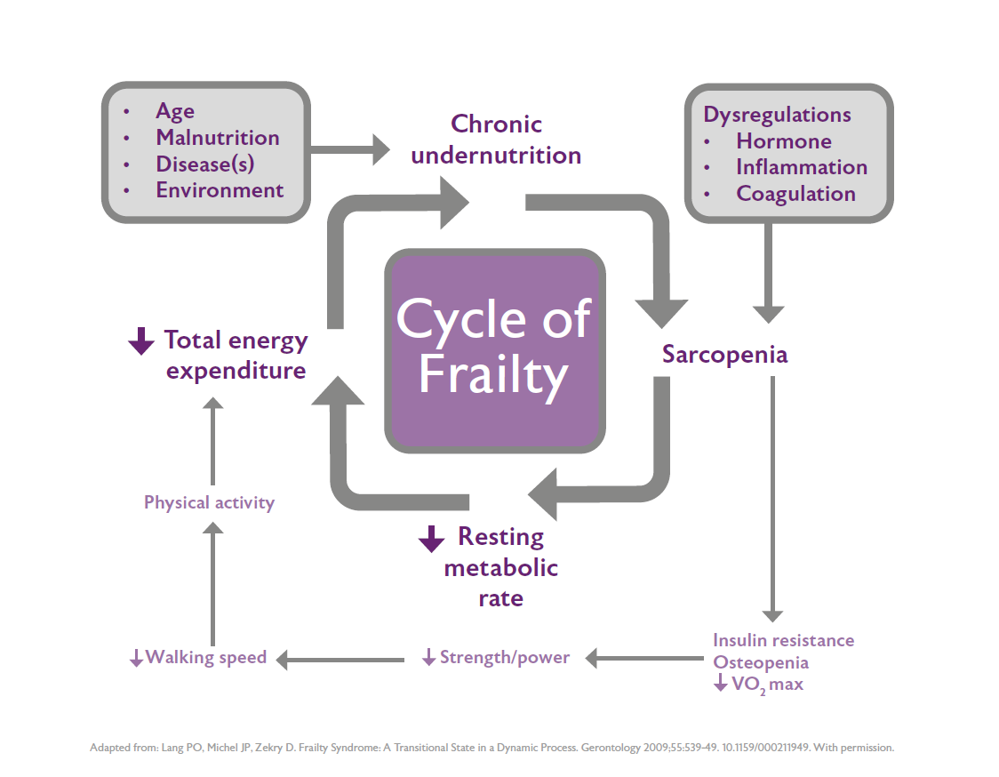
Frailty
Frailty is a distinct, age-related medical state characterized by a decline in physiological reserves across multiple body systems.
It increases an individual’s vulnerability to stressors (like infection or injury), leading to a higher risk of adverse outcomes, including functional decline, hospitalization, and mortality.
It is not merely aging or disability, but a state of reduced resilience.

Slide 20
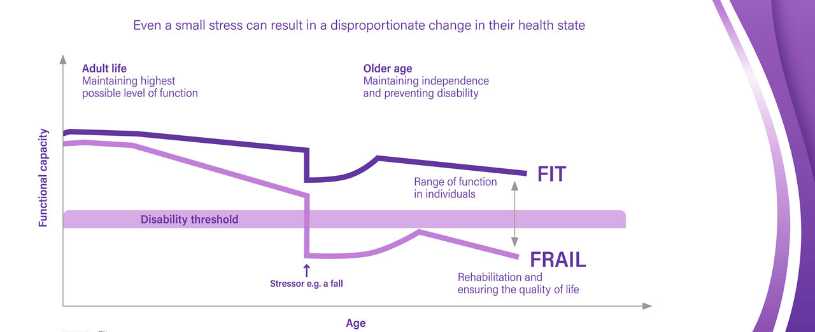

Slide 21
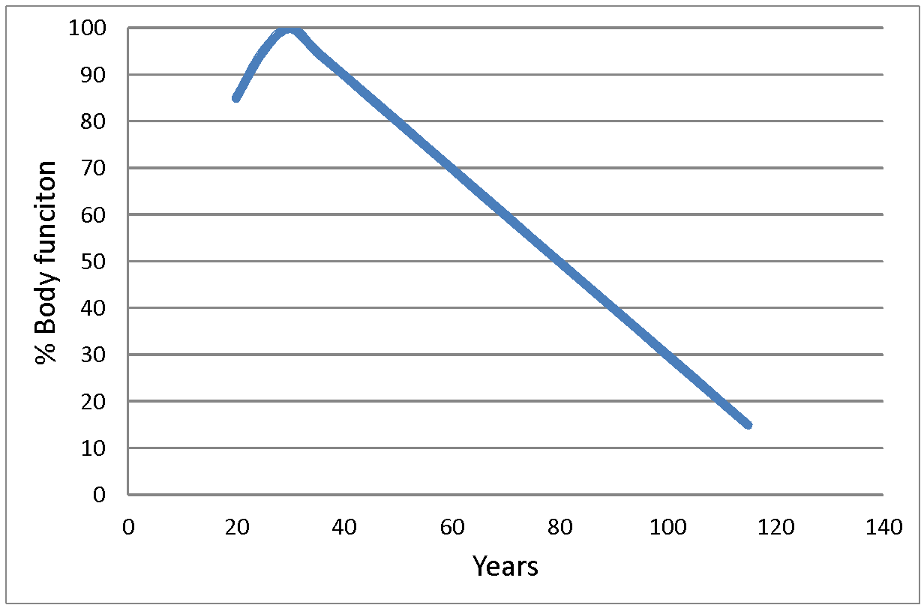
AGEING… Is the accumulation of changes in an organism or object over time. Ageing in humans is multidimensional.
Line of dependency

Slide 22
Progression
Robust
Pre frail
Frail
Progression is associated with greater morbidity, functional decline, and mortality in wide-ranging contexts.
J Gerontol A Biol Sci Med Sci, 2019, Vol. 74, No. 8, 1265–1270
Notes:
Progression is associated with greater morbidity, functional decline, and mortality in wide-ranging contexts.

Slide 23
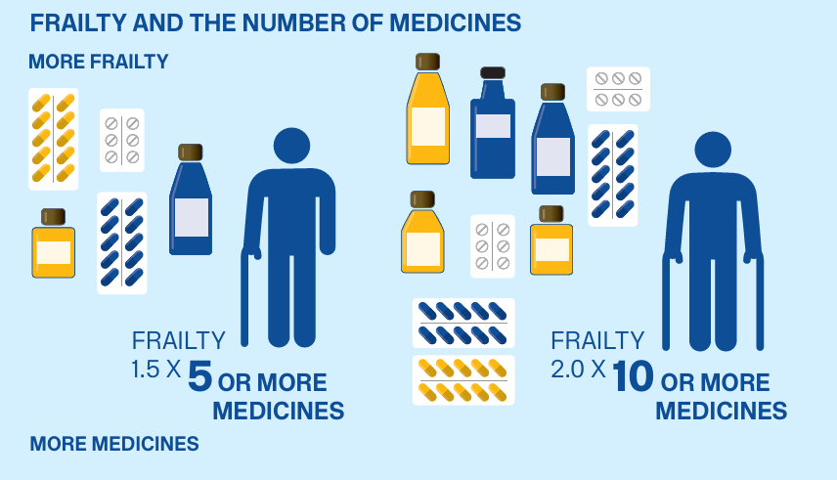
Frailty effects

Slide 24
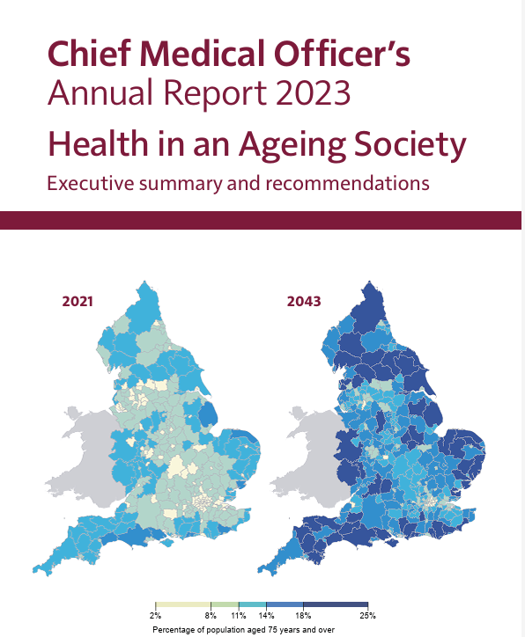
Ill health and disability in older age is not inevitable
Urban areas are not where the growth in older people is occurring; more peripheral areas are where the increase in need will be seen
Delaying disease onset enables adults to live for a much shorter proportion of life with significant disability
Multimorbidity is increasing; medical science and the medical profession must respond
Frailty overlaps with, but is not the same as, multimorbidity
Improving quality of life in older age sometimes means less medicine, not more
Research often excludes older adults; they should be the main focus of much of our research
Focus where the need is greatest

Slide 25

Adding in mental health…
Mental health components are common
Present in
34.1% of people with four or more conditions
This pattern is expected to change little by 2035.
Life expectancy is predicted to increase by 3.6 years for men and 2.9 years for women by 2035.
Reduction in years lived with no or only one health condition
Increase in years lived with multi-morbidity.
4.1% of people with two or more conditions
https://evidence.nihr.ac.uk/alert/multi-morbidity-predicted-to-increase-in-the-uk-over-the-next-20-years/

Slide 26
Why does polypharmacy happen?
Single-condition clinical guidelines
Lack of alternatives to prescribing a medicine
Need for on-going review and deprescribing to be built into the process of prescribing
Inability to access comprehensive patient records
Lack of digital interoperability
Time
Cultural – we have a healthcare culture that favours medicines over alternatives
Patient voice

Slide 27
Case example of guidelines
HTN [NG 136]
Calcium channel blocker - Amlodipine
If not controlled - Bendroflumethiazide added
COPD [NG 115]
LABA / LAMA – Symbicort
Osteoarthritis [NG 226]
NSAID - Naproxen
PPI - Omeprazole
Heart failure (EF mildly reduced) [NG106]
ACE inhibitor - Ramipril
Beta-blocker - Bisoprolol
Mineralocorticoid receptor antagonist (MRA) - Spironolactone
Sodium-glucose cotransporter-2 - SGLT2 inhibitor – Dapagliflozin
Furosemide
Diabetes [NG 28]
Metformin
Sitagliptin (as there is heart failure)

Slide 28
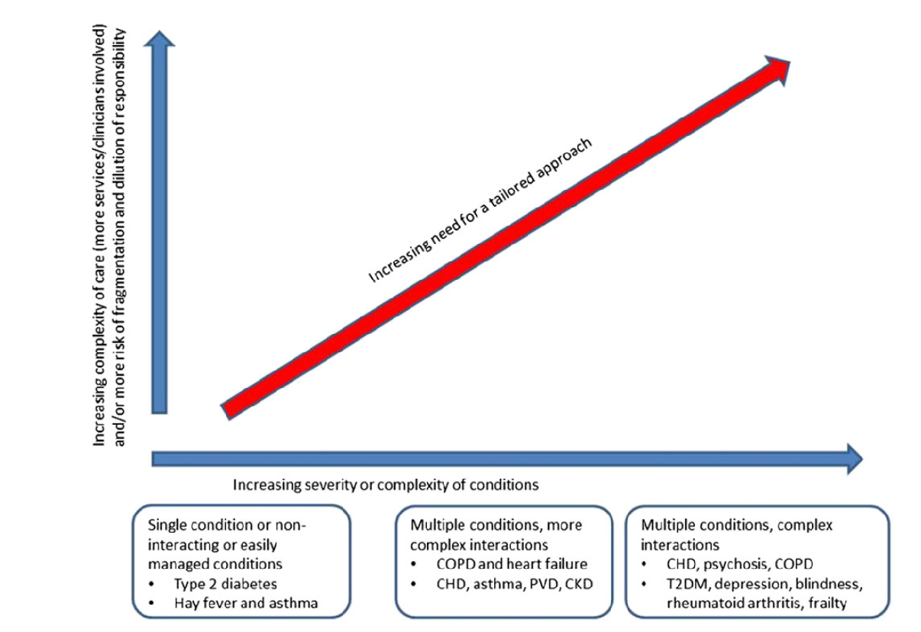
Multimorbidity

Slide 29
Progression?
Single disease
Multimorbidity
Functional impairment
(? Disability)
Frailty
Single organ / risk factor approach
Patient becoming frail / having multimorbidity
Management of ‘multi-morbidity’ approach
Age and Ageing 2017; 0: 1–7

Slide 30
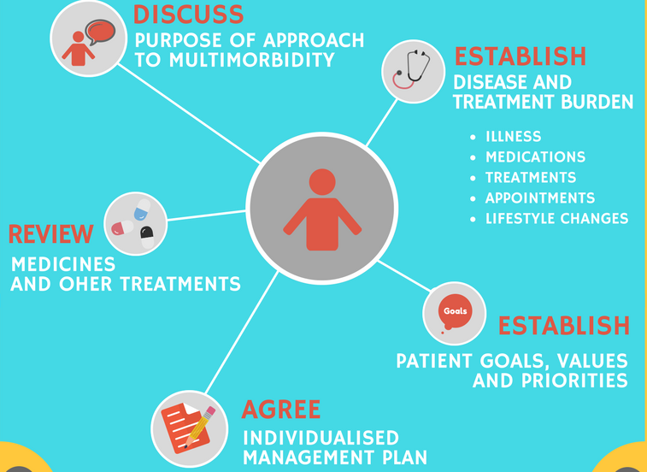

Multimorbidity guidelines [NG56]
MDTea Podcast episode https://thehearingaidpodcasts.org.uk/series-3-1-multimorbidity/

Slide 31
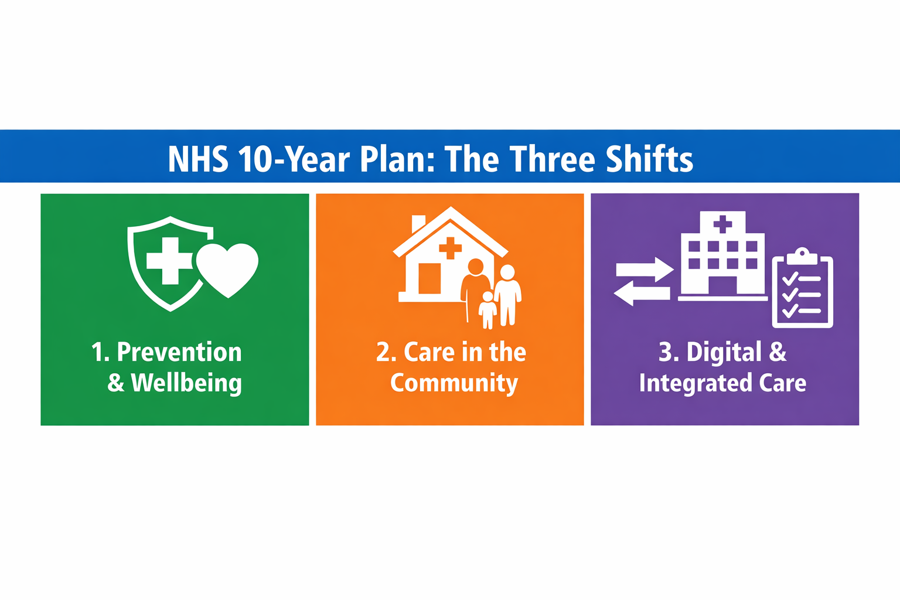
The 10 year plan…
Sickness to prevention
More population health management
Will lead onto greater focus on disease prevention
Less individualised medicine if we are not careful

Slide 32

The future
A population that is ageing
01
More years living with multimorbidity
02
An increased focus on preventative medicine (and thus risk factor management)
03
Polypharmacy increase
Polypharmacy

Slide 33

Why is polypharmacy dangerous in older people?
Older people are more sensitive to the adverse effects of polypharmacy due to some physiological changes which occur with ageing.

Slide 34
Research into medications
Older people are often underrepresented
When they are included often they are ‘healthy’ older people
Frailty, multimorbidity, cognitive impairment, care home residents often an exclusion criteria

Slide 35
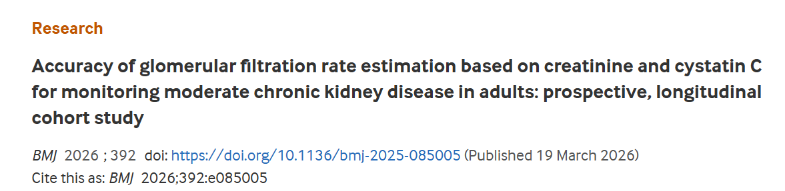
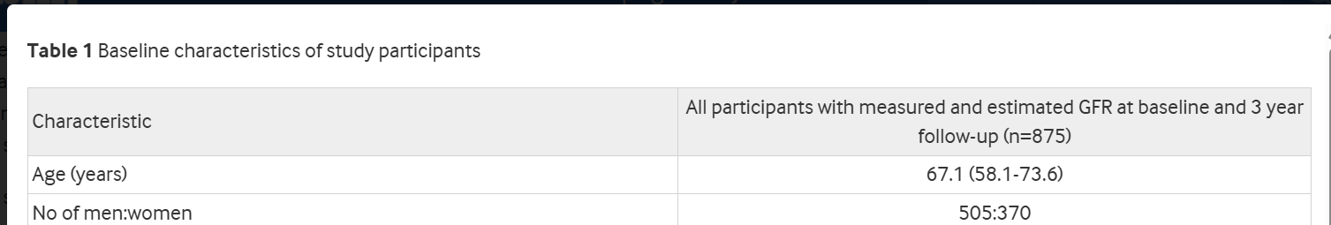
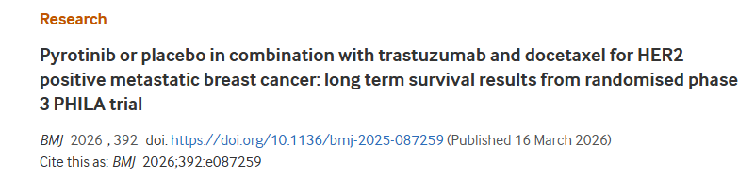
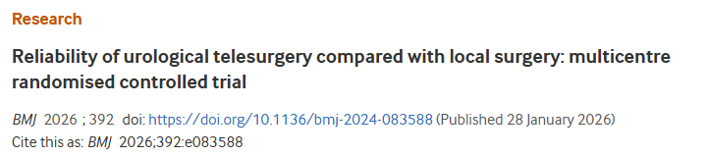
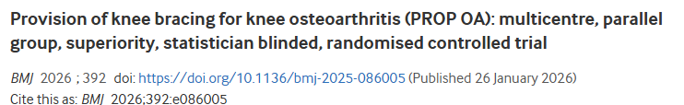
Participants aged 18 to 75 years
The median age of patients was 61.0 (interquartile range 57.5-68.0) years in the telesurgery group and 65.0 (56.5-70.0) years in the local surgery group.
Mean age 64
Notes:
In study 3 tool development 1 study had mean age 73

Slide 36
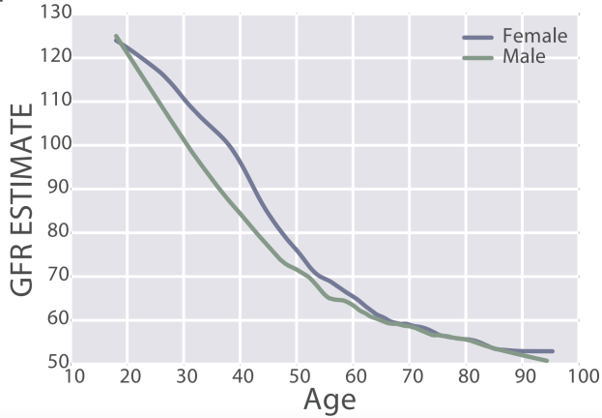
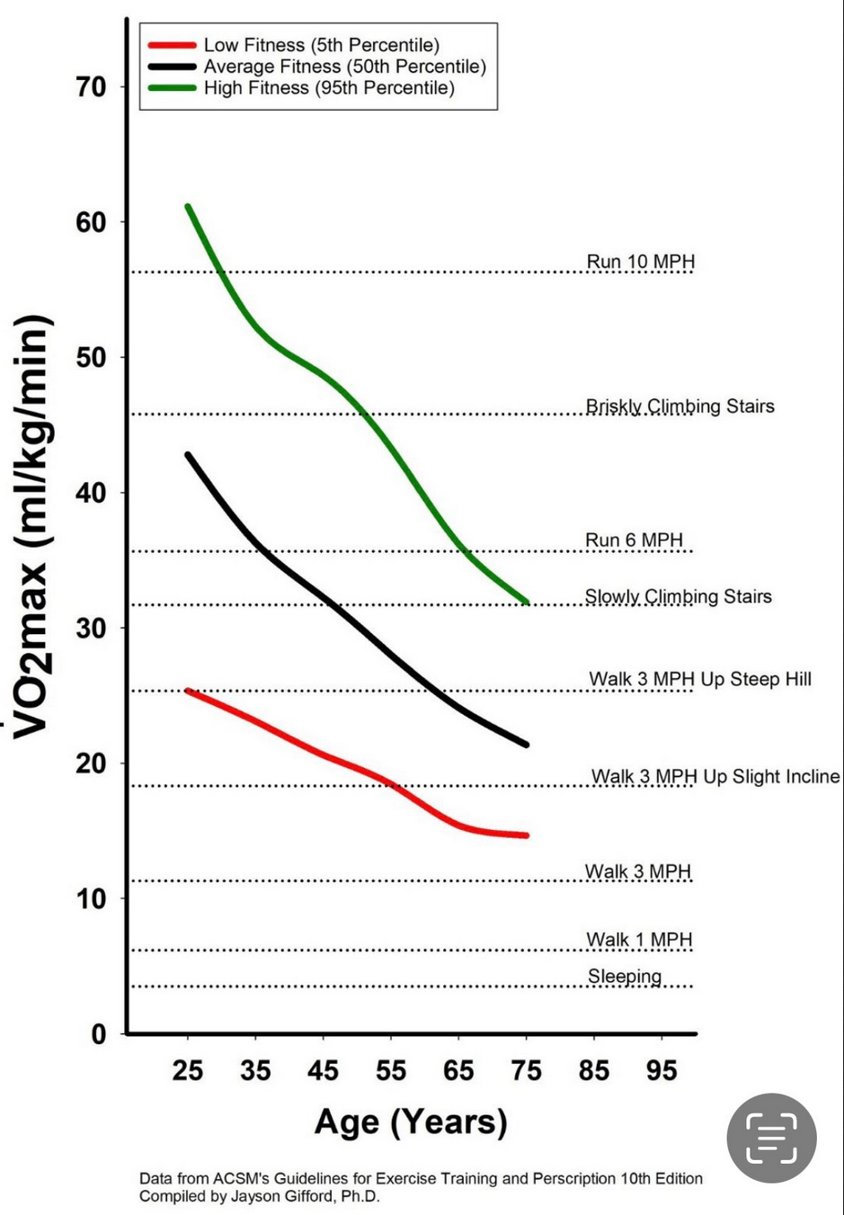
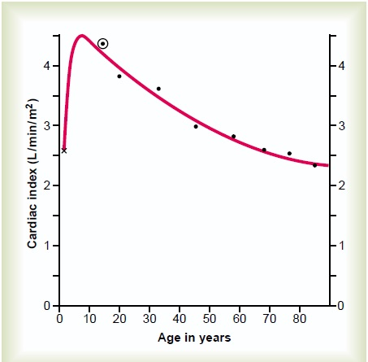
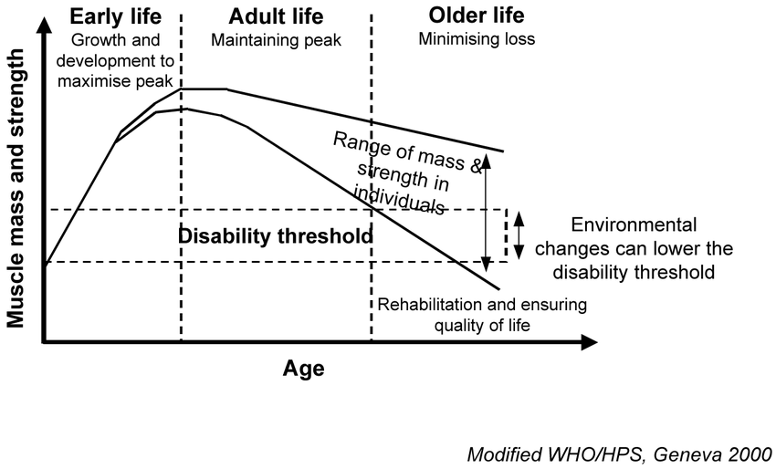
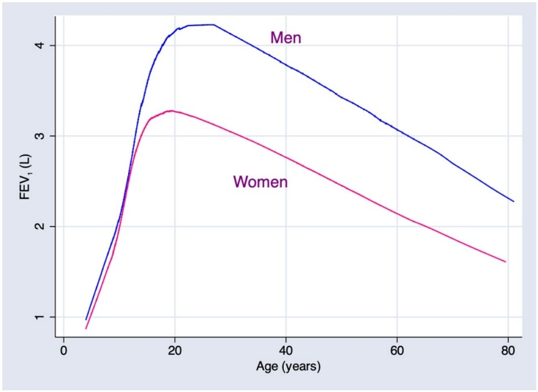

Slide 37
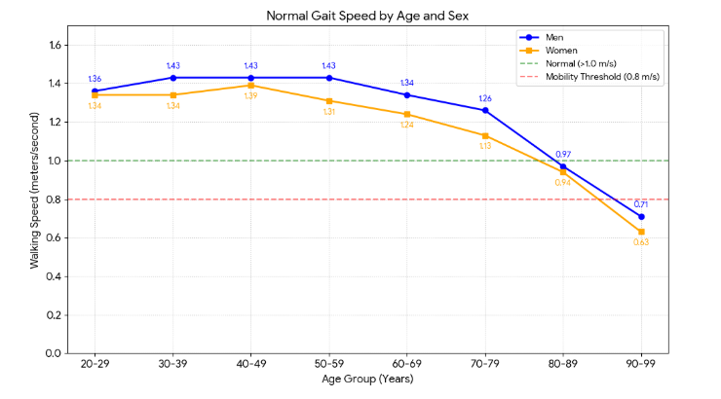

Slide 38
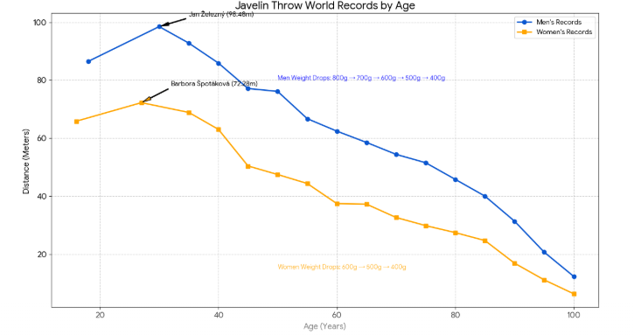
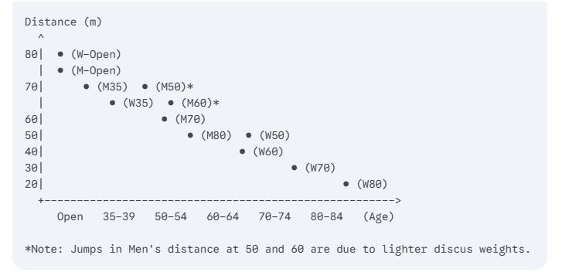
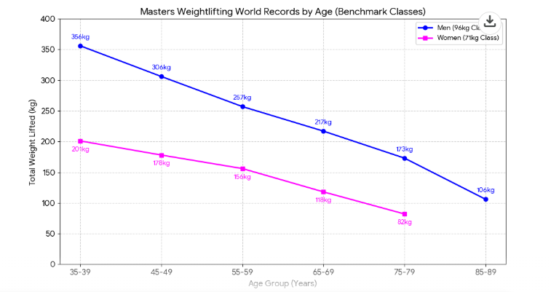
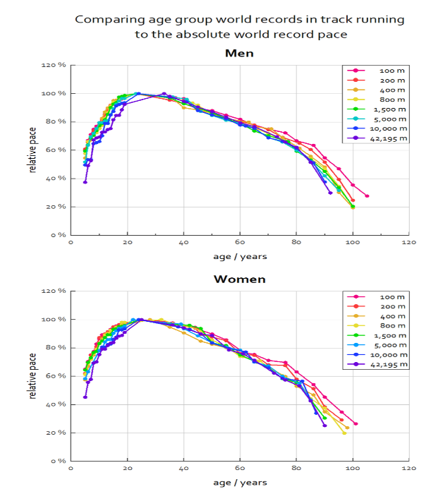

Slide 39

Absorption
Increased Gastric pH (sometimes due to medications such as proton pump inhibitors) due to atrophic gastritis.
Decrease in gastric emptying
Worsened by GLP-1 agonists (exenatide etc)

Slide 40
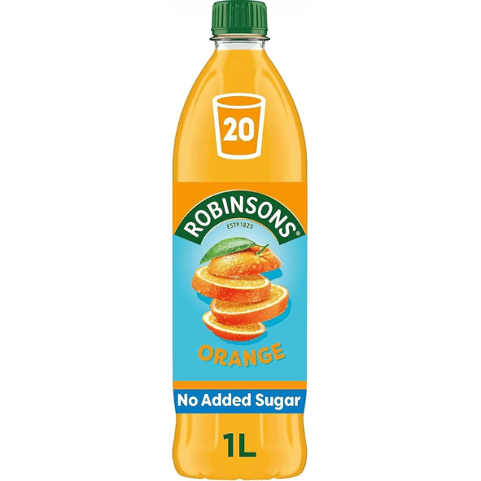
Distribution
Probably the main physiological change that occurs with ageing that leads to adverse drug reactions.
Increase in body fat and decrease in body water (as a proportion of total body weight).
Volume of distribution of fat soluble drugs increases
Medications accumulate due to increased elimination half life
Can still have an effect a long time after the medication has been stopped
Eg. benzodiazepines
Volume of distribution of water soluble drugs is decreased > water soluble drugs need a reduced loading dose
e.g. digoxin
Altered permeability of the blood brain barrier so the brain of an older adult can be exposed to higher levels of medication causing cognitive adverse effects
Also worsened in neurodegeneration

Slide 41
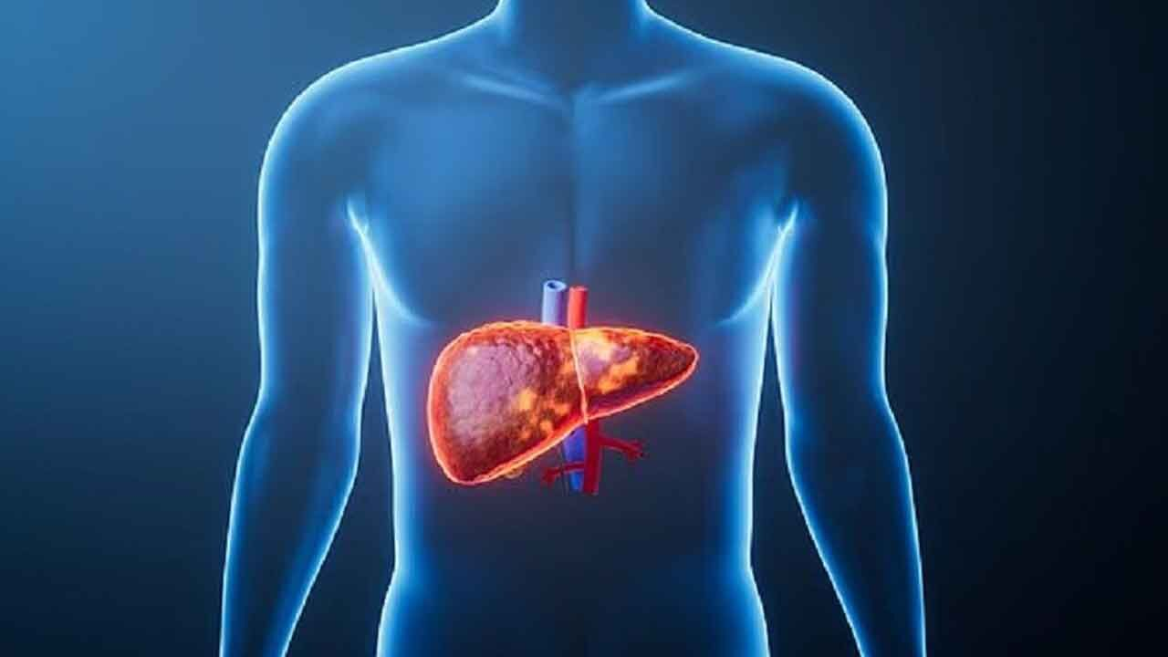
Metabolism
Reduced hepatic blood flow can reduce clearance of medications that have high hepatic excretion ratio
e.g. Amitryptiline.
The number of medications makes it more likely that they are taking an inducer or inhibitor of Cytochrome P450 > increasing the chance of drug-drug interactions.

Slide 42
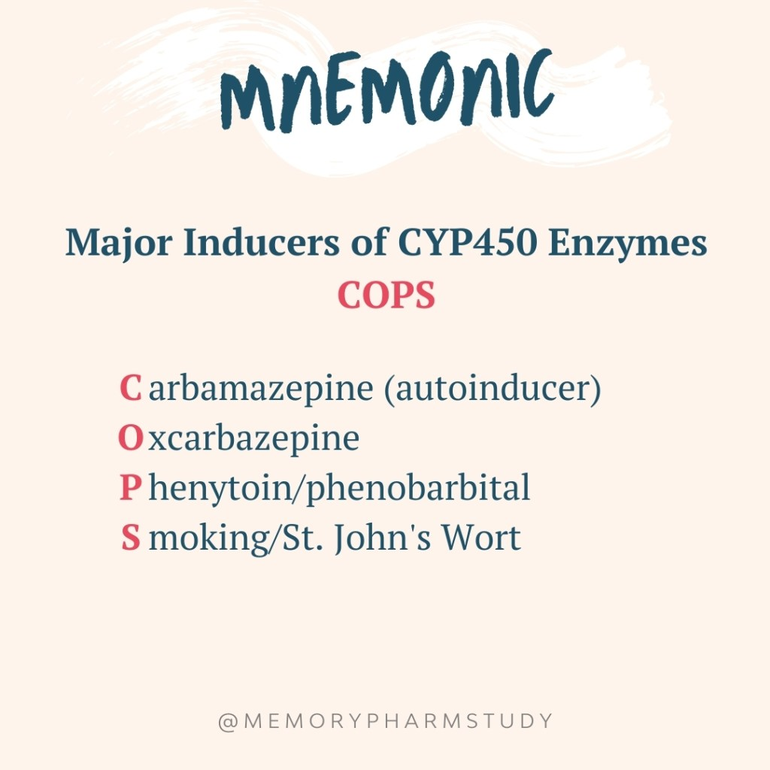
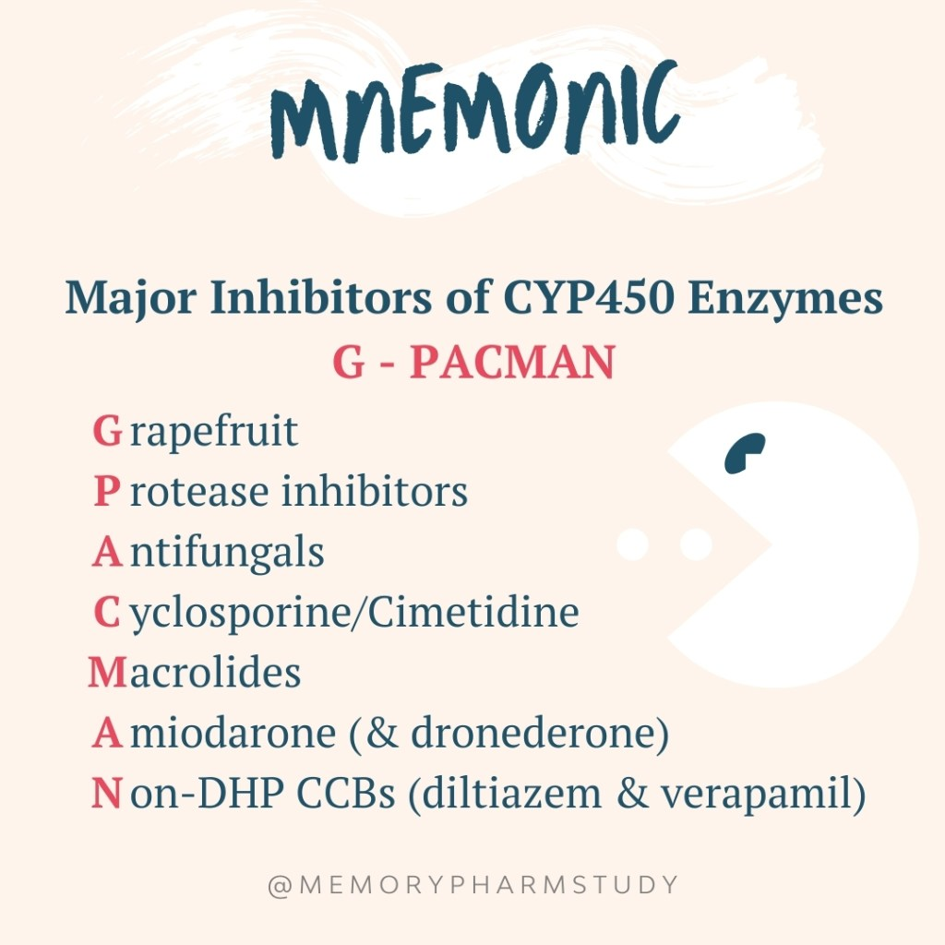
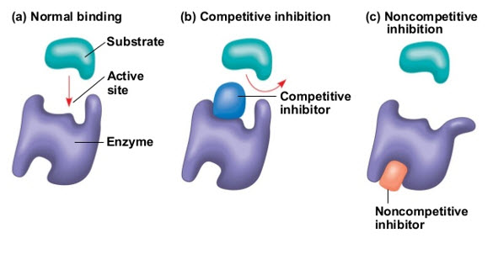
Cytochrome p450

Slide 43

Elimination/Kidneys
As people age there is a reduction in renal mass and renal blood flow. eGFR decreases by 0.5% a year after age 20.
Affects clearance of water soluble drugs such as diuretics, digoxin and NSAIDs.

Slide 44
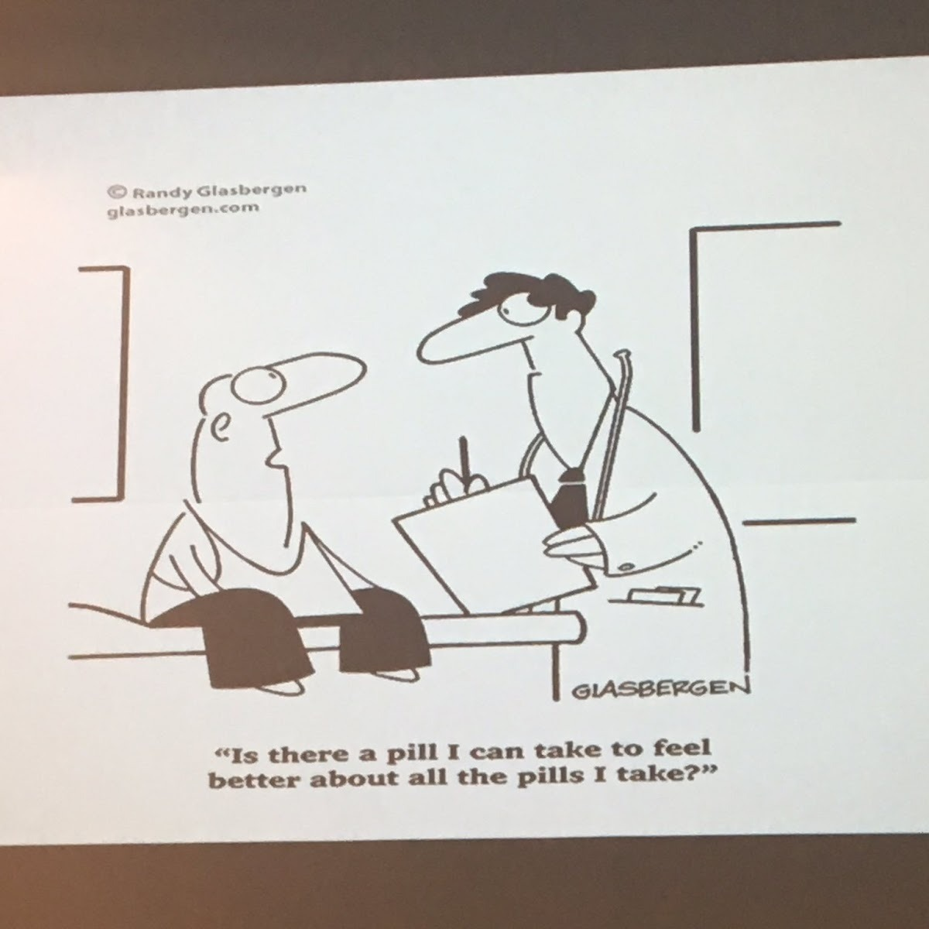

Appropriate vs non-appropriate polypharmacy

Slide 45

Appropriate vs inappropriate polypharmacy
Mrs F 85 yrs
Lives part time with partner by coast and part time in her home
Family close to her home
Quite co-dependant
PMH:
HTN, Hypothyroid, Hypercholesterolaemia, CKD(3)
Admitted following a fall at home
With ambulance BP 255/139
On ward BP c. 180/100

Slide 46
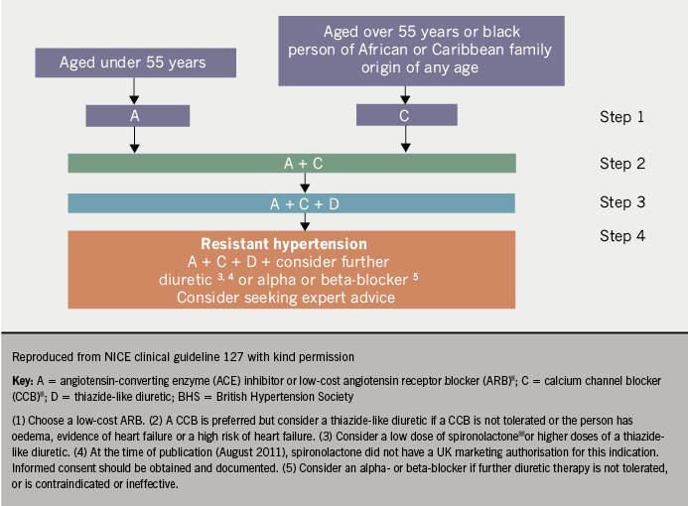
Medications - Appropriate vs inappropriate polypharmacy
Levothyroxine
Duloxetine 40mg BD
Atorvastatin 10mg
Macrogol
Paracetamol
Atenolol 50mg OD
Losartan 100mg OD*
Doxazocin 8mg BD*
Amlodipine 2.5mg
Beclomethasone/Formeterol inhaler
10

Slide 47
A mix
?
Appropriate
Needs multiple Rxs for HTN
ARB for CKD
Mild COPD Mx correct
Low dose statin
? Inappropriate
Not on diuretic
Still on Atenolol
But… It’s got to be right for the individual patient. Guidelines are there to guide
Notes:
Medications now inappropriate

Slide 48
Appropriate vs inappropriate polypharmacy
Mr S is 83 diagnosed with PD 6 years ago
PMH: RLS, HTN, IHD (Stents in 2001 and 2005), COPD and hypothyroidism
Mobilises around his house
Motor:
Some freezing episodes indoors, wheelchair outside, stick, minimal tremor, falls ++
Non Motor:
Hypersomnolence ++ (Failed on modafinil),
Speech quiet and hard to hear,
Constipation
Postural hypotension

Slide 49

Medications
Pramipexole IR 350 TDS (and 180 PRN*)
Safinamide
CoCareldopa 100/25 x2 QDS
Lethothyroxine
Trelegy Ellipta
Bisoprolol
Clopidogrel
Bumetanide
Quinine
Rosuvastatin
Betahistine
14
Notes:
How many medications is that?

Slide 50
A mix
?
Appropriate
PD treatment, some of the IHD treatment, COPD Rx, thyroxine
? Inappropriate
Betahistine, statin, quinine
Then…possible impulse control disorder
Now Pramipezole less appropriate
Notes:
Medications now inappropriate

Slide 51
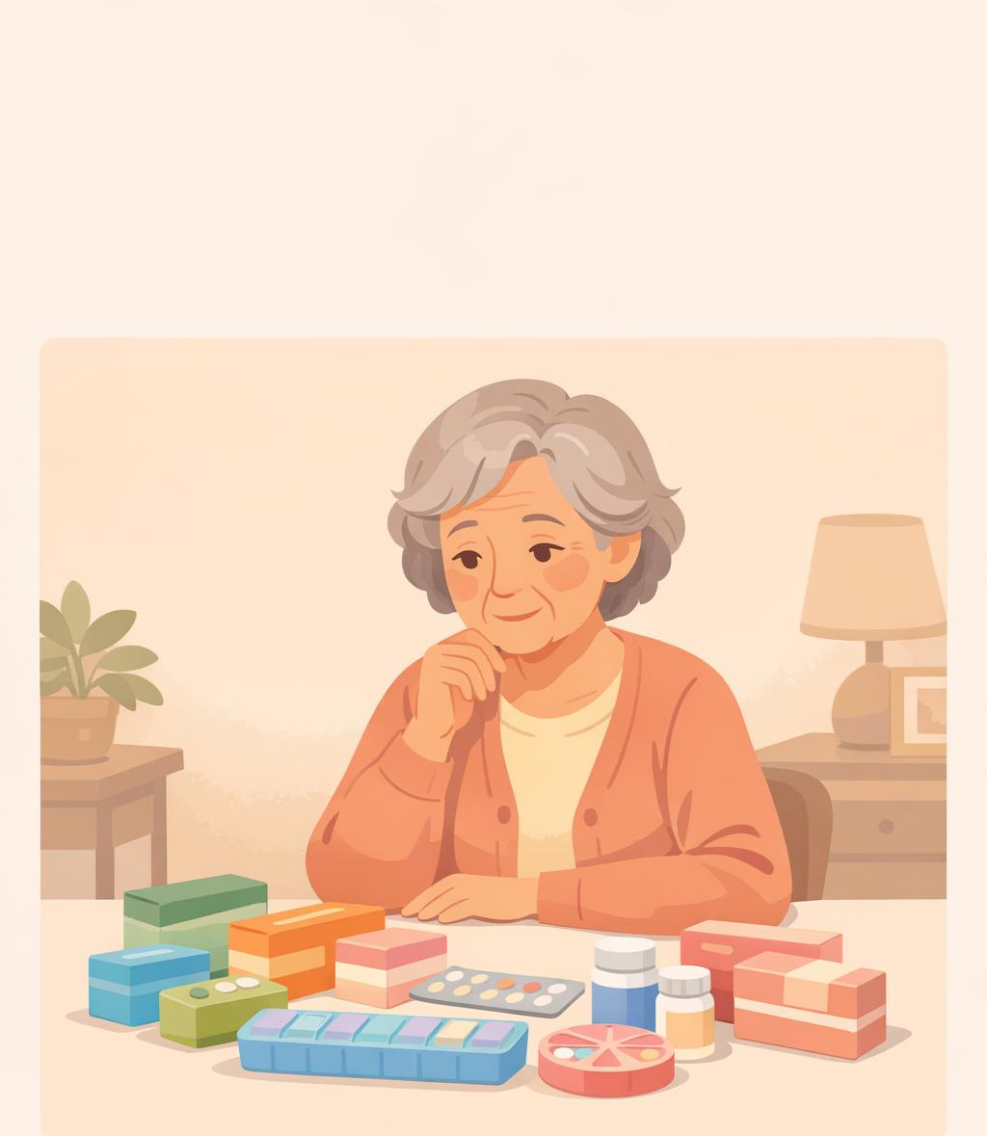
Case 2
Mrs P
Admitted to hospital with a fall
Medications:
Solifenacin – OAB
Atenolol and Ramipril – HTN
Donepezil – AD
Citalopram – Low mood
Aspirin – CVD risk
Omeprazole – As on aspirin

Slide 52

Appropriate vs inappropriate
Always a balance
Key is the thought and the principle of medication reconciliation and review
What are they actually taking and is that right still?

Slide 53
Medication reconcilliation
Ascertain all drugs patient is currently taking and reasons for each one
Need patient (or family member) to bring all drugs (prescribed, complementary and alternative medications and OTC meds)
Clarify how/when/if patient is taking medication
Ask the patient if they have missed any doses recently
Ask about medicine-taking habits
Do not apportion blame
Use the pharmacist to help!
perform med reconciliation (may involve contacting patient’s pharmacy, employing pill counts, etc)

Slide 54

Prescribing cascade
Where a medication has been started to treat the side effect of another medication
Amlodipine – causing LL oedema
Furosemide – To treat the oedema
Macrogol – to treat the constipation
Ramipril – to manage the ‘CKD’
Allopurinol - to treat the gout exacerbations
Codeine – for the pain
Senna as the Macrogol ‘isn’t working’

Slide 55
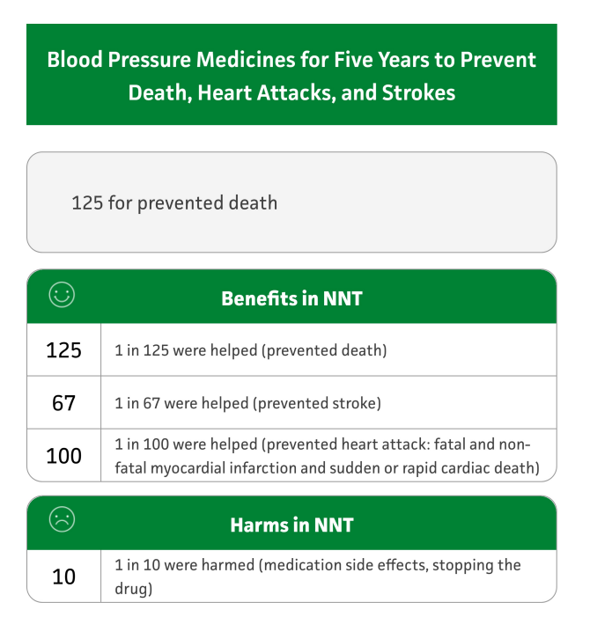
NNT

Slide 56

Anticholinergic burden
20-50% of older people prescribed at least one medicine with anti-cholinergic activity.
Dry mouth and eyes, constipation, urinary retention, blurred vision, tachycardia
Sedation, confusion, hallucinations, decline in cognitive and physical function
23% of people with dementias are prescribed AC drugs.
https://www.acbcalc.com/

Slide 57
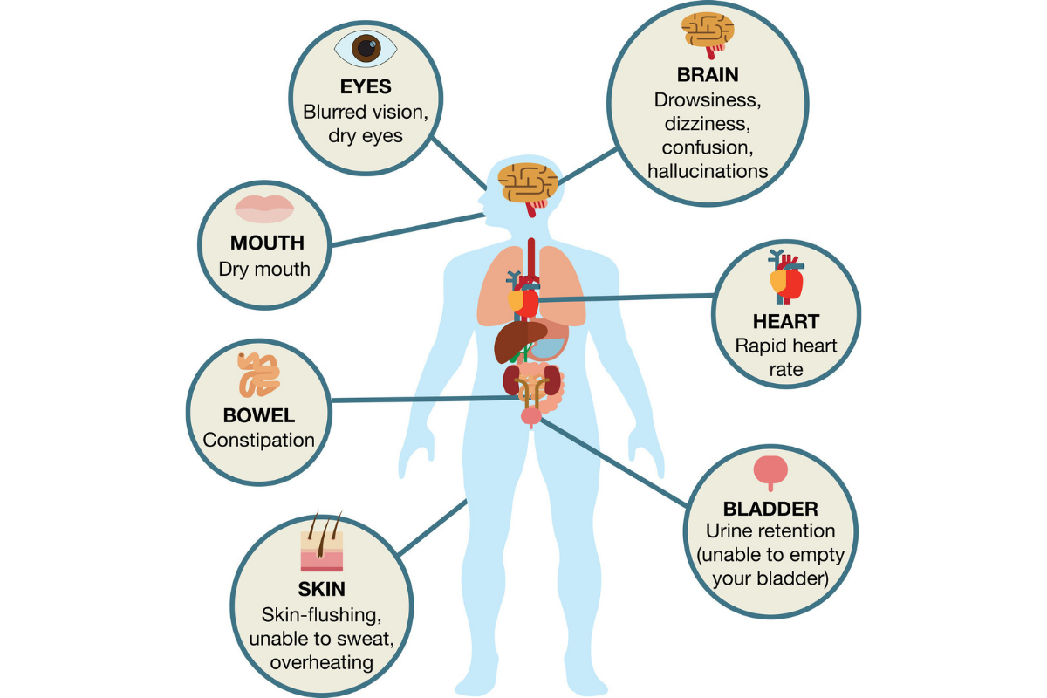

Slide 58
Reasons to stop a medication – appropriate deprescribing
The condition has now gone (i.e. an infection)
The medication has done its job (i.e. Bisphosphonates)
The medication has a better alternative (i.e. Atenolol for HTN)
The medication is causing harm (i.e. Aspirin in a GI bleed)
The patient isn’t taking the medication
The patient doesn’t want it
The way the patient is taking it may cause harm (i.e. in dementia and confusion)
The side effects outweigh the benefits (i.e. Tamsulosin in BPH and postural hypotension falls)

Slide 59

Barriers to deprescribing
Concern from clinicians to discontinue medications started by another provider
Time expenditure
Fear of drug-withdrawal side effects
Lack of resources
Resistance from patients or family members
Fear of losing patient-provider relationship
Fear of loosing focus on the acute issue
Concerns about follow up ability and accountability
Lack of continuity
This Photo by Unknown Author is licensed under CC BY-SA

Slide 60

Some useful tools

Slide 61
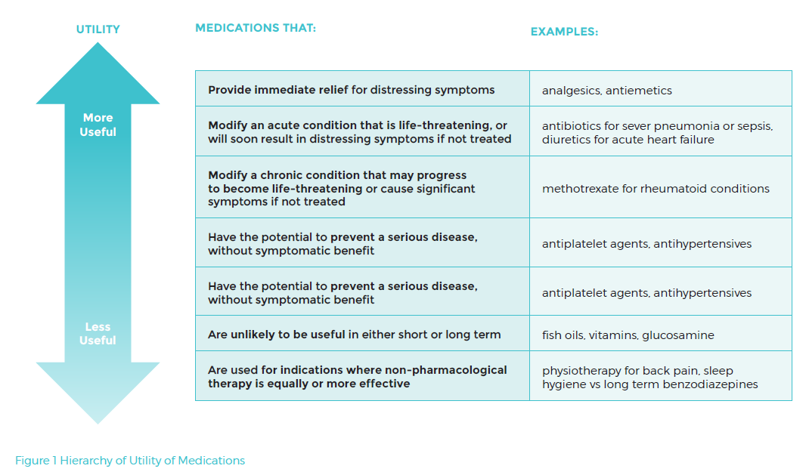
http://www.cpsedu.com.au/posts/view/47/2016-Deprescribing-Resources

Slide 62

NO TEARS
Has the diagnosis changed? Was long term treatment intended? Is the dose correct?
Open Questions
Solicit the patient's opinion and concordance
Simplification and switches
Simplify the regimen and implement cost effective switches
Risk reduction or prevention
Adverse Events
Tests and monitoring
Evidence and guidelines
Are further tests needed?
Is there a better approach to this illness now? e.g. new guidelines
Consider iatrogenic problems (Side effects, drug interactions)
Identify the individual patients risks
Need and indication
Lewis T. BMJ 2004; 329: 434
Notes:
A useful prompt to aid efficient medication review and maximise the potential of the 10 minute consultation

Slide 63
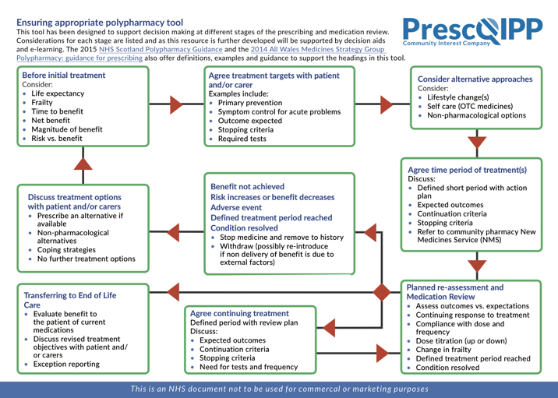

Slide 64
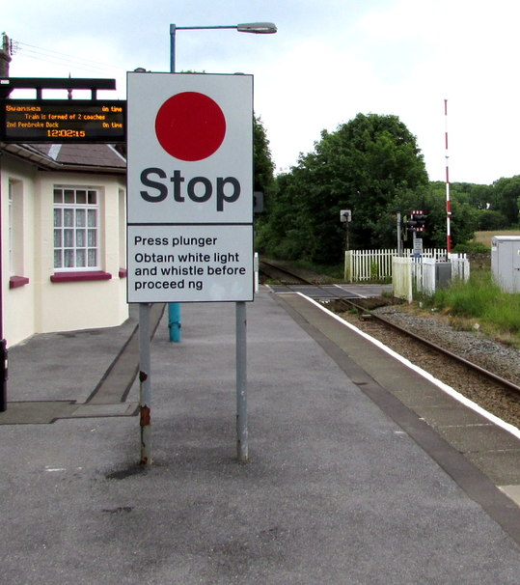
START / STOPP
Examples of STOPP Criteria (To Stop)
Cardiovascular: Loop diuretics for dependent ankle oedema only (no signs of heart failure).
CNS: Long-term opiates in patients with dementia.
Gastrointestinal: Diphenoxylate, loperamide, or codeine phosphate for severe gastroenteritis.
Falls: First-generation antihistamines, long-term opioids, or benzodiazepines in patients with a history of falls.
Examples of START Criteria (To Start)
Cardiovascular: Statins or antiplatelet therapy for patients with documented atherosclerotic disease.
Metabolic: Metformin for Type 2 diabetes mellitus, if not contraindicated.
Respiratory: Regular inhaled agonist or anticholinergic for mild-to-moderate asthma or COPD.
Eur Geriatr Med. 2023 Aug;14(4):633

Slide 65
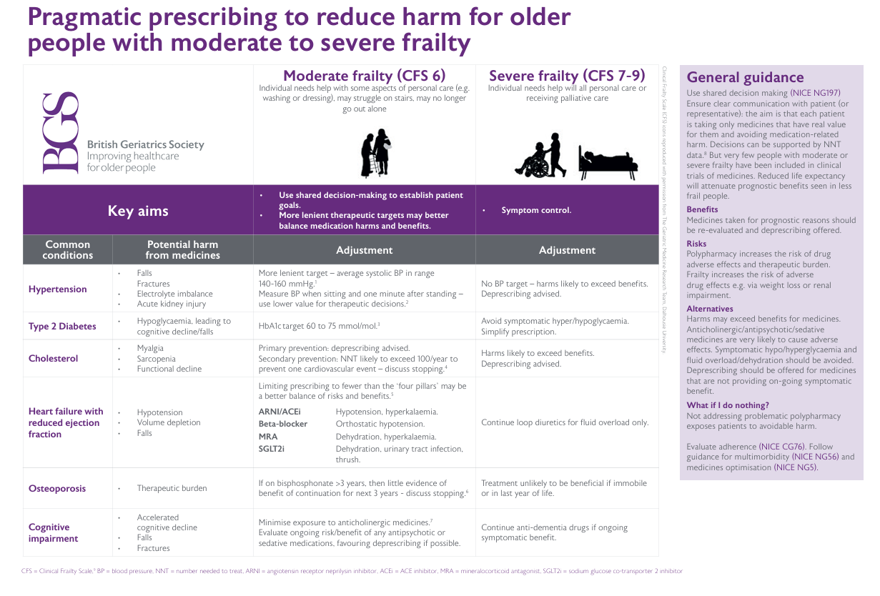
How not to start inappropriate medications

Slide 66

Tips
‘We’ often won’t change ‘your’ medications so its all about partnership working
Think – am I the right person to talk about deprescribing
You might just be the person that opens the box
Find who is the continuity for this patient
What is the ‘risk’? – think about consent!
Use the tools when starting and stopping medications
But… the principles of what to treat when are probably better!

Slide 67
Summary
Polypharmacy is very common as we get older
Medications interact with each other and with the patient
Older people are more at risk of harm from medications
Think about the medications in some detail and prompt a deprescribing conversation
There are multiple tools to help stop medications and BGS guidance to reduce the starting of medication

Slide 68

Question time

