Slide 1

Renal Medicine for Old Age Psychiatry 2026
Dr Jen Joslin
Consultant Nephrologist
King’s College Hospital NHS Foundation Trust
Notes:
Thank you to the organisers for inviting me to speak today.
My credentials and interests that are particularly relevant to this conference, are that aside from working directly opposite a large psychiatric hospital and thereforw seeing a lot of patients with severe psychiatric illness, I have lots of experience working in ‘Advanced Kidney Care’ - our clinic for people approaching the need for renal replacement therapy, which obviously skews to patients of an older age.

Slide 2
Declaration of interests
Nil

Slide 3
Objectives
Chronic Kidney Disease with co-morbidities
Prescribing in kidney disease
Dialysis – considerations for the elderly population

Slide 4
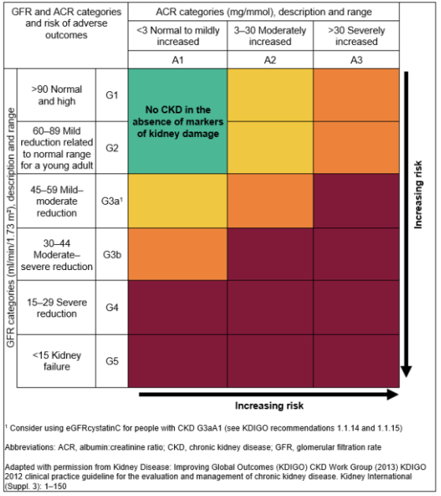
Chronic Kidney Disease with co-morbidities
Chronic kidney disease =
  Abnormalities in kidney function or structure that persist for > 3 months

Slide 5
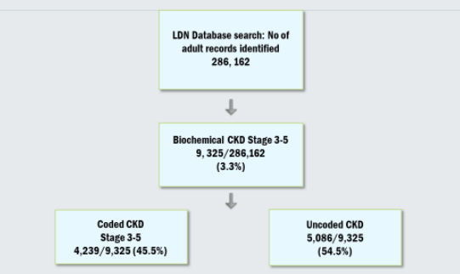
How big is the CKD problem?
Estimated 9% globally
1.9 million people diagnosed with CKD in UK
But often hidden:
UK:
est. 6% CKD G3-G5
Molokhia M, Okoli GN, Redmond P, Asgari E, Shaw C, Schofield P, Ashworth M, Durbaba S, Nitsch D. Uncoded chronic kidney disease in primary care: a cross-sectional study of inequalities and cardiovascular disease risk management. Br J Gen Pract. 2020 Oct 29;70(700):e785-e792. doi: 10.3399/bjgp20X713105. PMID: 33077509; PMCID: PMC7575408.

Slide 6
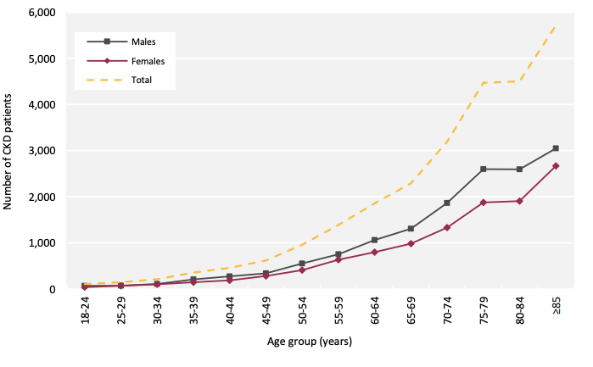
Risk factors for CKD
Context:
~ 5m people age >75 in England
Number of people starting RRT (UK, 2023): 8560
Age
In people over 75 years (England, 2021 / 2022):
Prevalence of CKD G1-G5 48%
Prevalence of CKD G3-G5 36%
Prevalent CKD G4/5
(Incomplete data)
UK Renal Registry Annual Report, data to end 2023

Slide 7
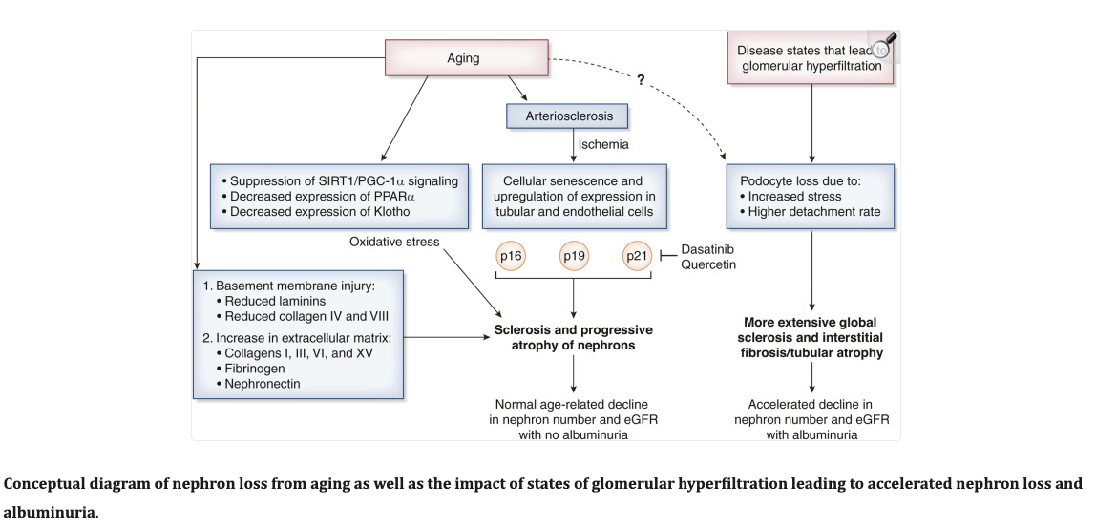
Nephron loss is part of ageing
Denic, Aleksandar¹; Glassock, Richard J.²; Rule, Andrew D.¹. The Kidney in Normal Aging: A Comparison with Chronic Kidney Disease. CJASN 17(1):p 137-139, January 2022. | DOI: 10.2215/CJN.10580821

Slide 8
Risk factors for CKD
Diabetes
Hypertension
Inherited conditions
Obstructed uropathy
Glomerular diseases
Multisystem diseases
Acute Kidney Injury
Nephrotoxic medication
CKD rarely happens in isolation

Slide 9
Management of CKD with or without co-morbidities
Cardiovascular risk management is the cornerstone
Optimise blood pressure
Optimise high cholesterol
Optimise glycaemic control
Avoid e.g. NSAIDs
Lifestyle:
  Weight loss
  Low salt diet
  Exercise
  Smoking cessation

Slide 10
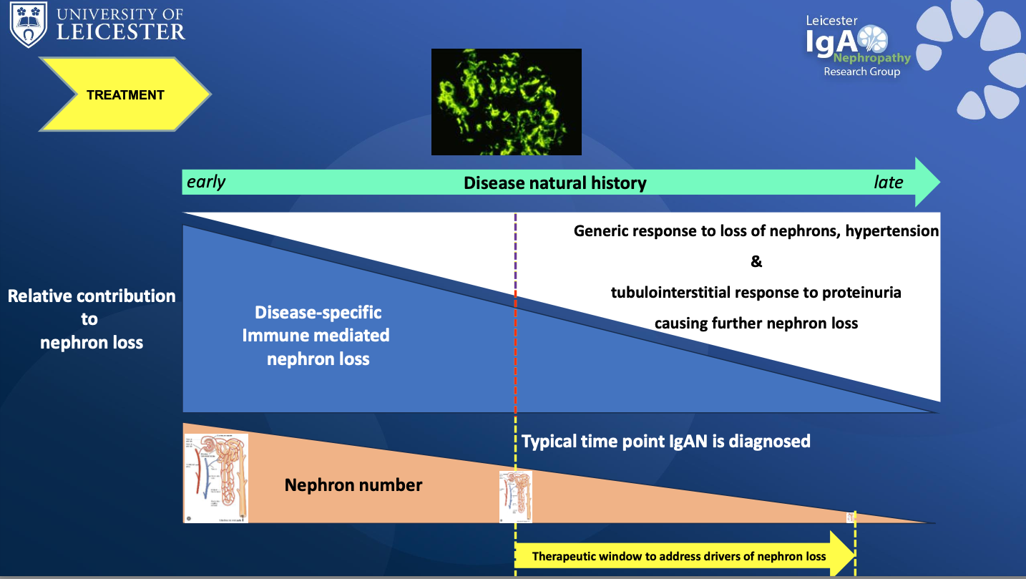
Prof Jonathan Barratt

Slide 11
Most people with CKD are not under Nephrology
Refer adults with CKD for specialist assessment (taking into account their wishes and comorbidities) if they have any of the following:
a 5-year risk of needing renal replacement therapy of greater than 5% (measured using the 4-variable Kidney Failure Risk Equation)
an ACR of 70 mg/mmol or more, unless known to be caused by diabetes and already appropriately treated
an ACR of more than 30 mg/mmol (ACR category A3), together with haematuria
a sustained decrease in eGFR of 25% or more and a change in eGFR category within 12 months
a sustained decrease in eGFR of 15 ml/min/1.73 m² or more per year
hypertension that remains poorly controlled (above the person's individual target) despite the use of at least 4 antihypertensive medicines at therapeutic doses (see also NICE's guideline on hypertension in adults)
known or suspected rare or genetic causes of CKD
suspected renal artery stenosis.
Rapid progression
Nephrotic / nephritic
Unclear cause
NICE NG203, 2021

Slide 12
Kidney Failure Risk Equation
Age, eGFR, sex, uACR
  Generates 2y and 5y risk of ‘kidney failure’ for patients with CKD G3-5
  Kidneyfailurerisk.co.uk
Age | eGFR (ml/min/1.73m²) | sex | uACR (mg/mmol) | 2y KFRE (%) | 5y KFRE (%)
34 | 35 | M | 165 | 8.7 | 27.7
74 | 35 | M | 165 | 3.7 | 12.6
84 | 35 | M | 165 | 3.1 | 10.2
80 | 28 | F | 20 | 2.1 | 7.5

Slide 13
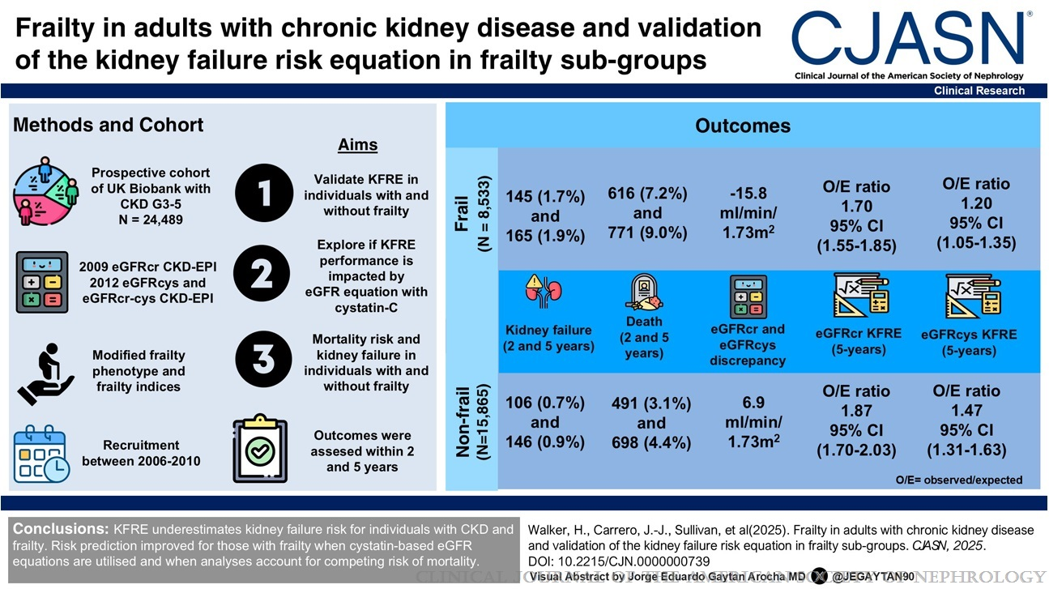

Frailty in Adults with CKD and Validation of the Kidney Failure Risk Equation in Frailty Subgroups
Walker, Heather; Carrero, Juan-Jesus; Sullivan, Michael K.; Field, Ryan; Lees, Jennifer S.; Hanlon, Peter; Faucon, Anne-Laure; Fu, Edouard L.; Beridze, Giorgi; Jani, Bhautesh Dinesh; Gallacher, Katie; Mark, Patrick B.
Clinical Journal of the American Society of Nephrology20(8):1051-1062, August 2025.
doi: 10.2215/CJN.0000000739
KFRE underestimates risk in frailty?
Does not take into account active disease process

Slide 14
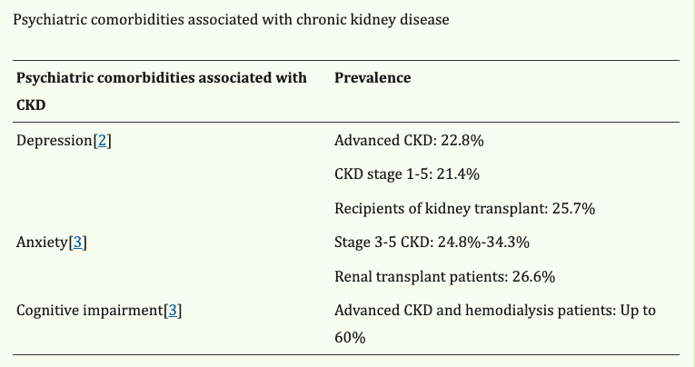
CKD and mental health I
Dalal PK, Kar SK, Agarwal SK. Management of Psychiatric Disorders in Patients with Chronic Kidney Diseases. Indian J Psychiatry. 2022 Mar;64(Suppl 2):S394-S401. doi: 10.4103/indianjpsychiatry.indianjpsychiatry_1016_21. Epub 2022 Mar 23. PMID: 35602366; PMCID: PMC9122172.
Systematic review suggests depression associated with increased risk of death among patients with CKD (RR 1.59, 95% CI 1.35-1.87)
Palmer SC, Vecchio M, Craig JC, Tonelli M, Johnson DW, Nicolucci A, Pellegrini F, Saglimbene V, Logroscino G, Hedayati SS, Strippoli GF. Association between depression and death in people with CKD: a meta-analysis of cohort studies. Am J Kidney Dis. 2013 Sep;62(3):493-505. doi: 10.1053/j.ajkd.2013.02.369. Epub 2013 Apr 25. PMID: 23623139.

Slide 15
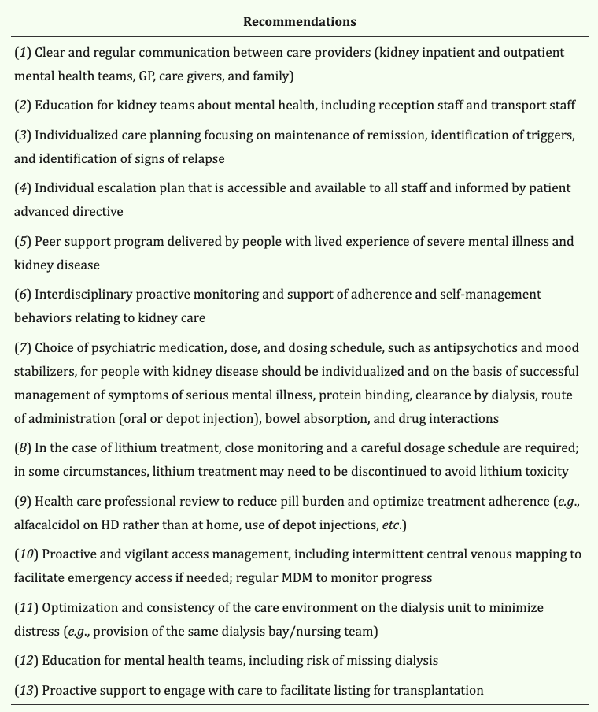
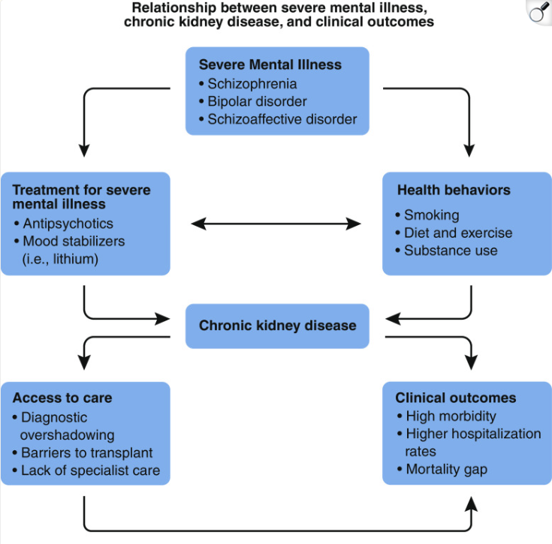
CKD and mental health – severe mental illness
Cogley C, Carswell C, Bramham K, Chilcot J. Chronic Kidney Disease and Severe Mental Illness: Addressing Disparities in Access to Health Care and Health Outcomes. Clin J Am Soc Nephrol. 2022 Sep;17(9):1413-1417. doi: 10.2215/CJN.15691221. Epub 2022 Mar 31. PMID: 35361628; PMCID: PMC9625106.

Slide 16
Summary – CKD with co-morbidities
CKD very common in old-age
Most CKD care is not under Nephrology; overwhelming majority of people with CKD will die without ESKD
Nephrology input needed if rapid progression, active urine
Consider if a diagnosis of CKD G3a without proteinuria is really significant
Very unusual to not have co-morbidities
  Common concomitant mental illness
Cardiovascular risk management is essential
Aside from rare cases, biggest impact on patients likely to be around medication consideration

Slide 17
Prescribing in kidney disease
Renal-specific medication
‘nephrotoxics’
Prescribing in CKD

Slide 18
Mrs FJ
General Nephrology Clinic, 72yo, eGFR 28:
  Type 2 diabetes mellitus (15 years, with retinopathy), hypertension (10 years), hypothyroidism, osteoarthritis, generalized anxiety disorder
Presentation consistent with gradual progression of chronic kidney disease secondary to diabetes / hypertension
Renal specific ‘treatment’: limited
Mainstay of treatment = management of risk factors, try and slow down progression
However new medication options over recent years

Slide 19
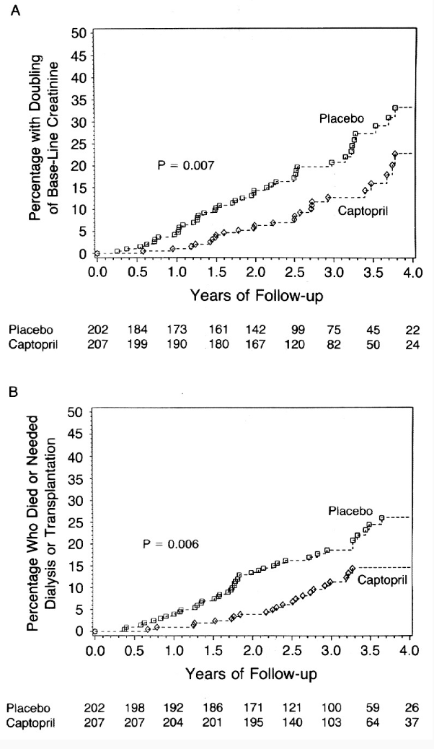
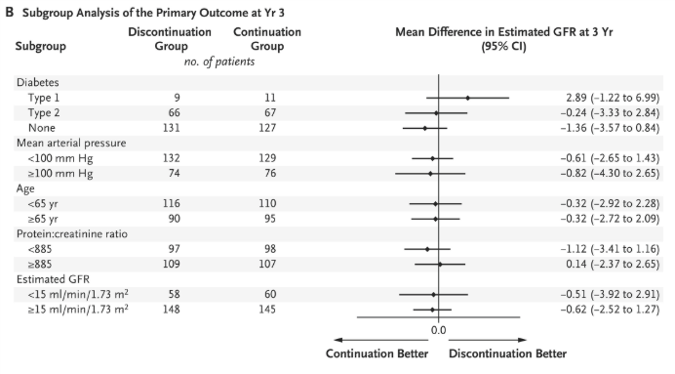
1. Renin-angiotensin system blockade – for most (uACR > 3mg/mmol if diabetes, >30mg/mmol if no diabetes)
Blood pressure management
Proteinuria reduction
Kidney disease with and without diabetes
Continue in advanced CKD
Caution: hyperkalaemia, ‘sick-day rules’
The Effect of Angiotensin-Converting-Enzyme Inhibition on Diabetic Nephropathy, 1993
DOI: 10.1056/NEJM199311113292004
STOP-ACE trial: DOI: 10.1056/NEJMoa2210639

Slide 20
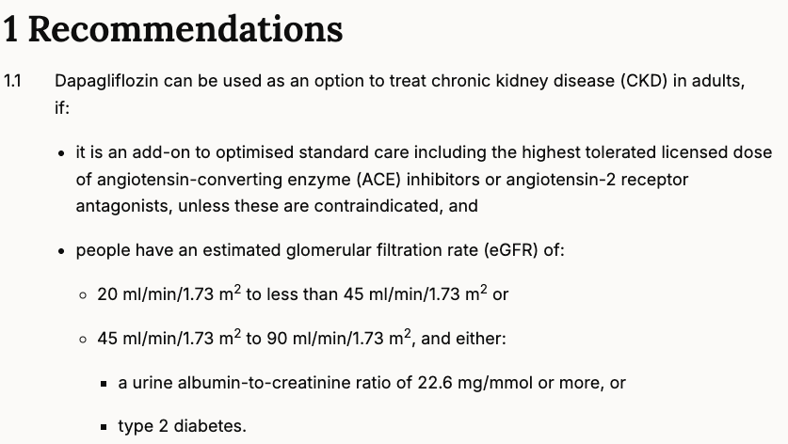
SGLT2 inhibitors – for many
NICE TA1075, 2025

Slide 21
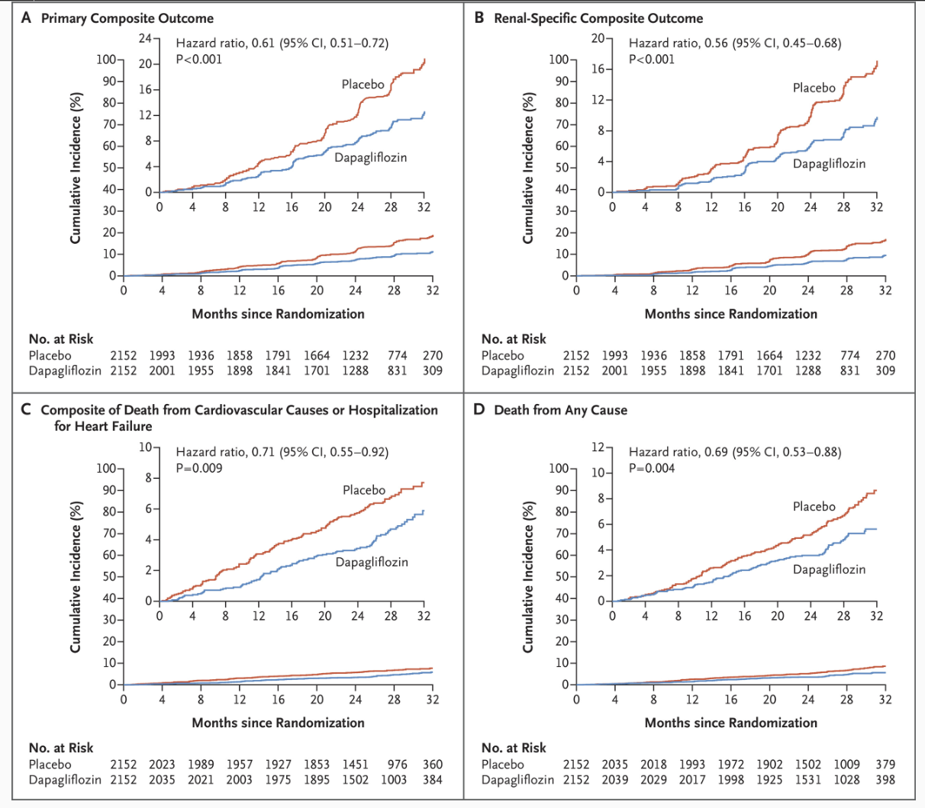
Renal specific composite outcome:
Composite of a sustained decline in the estimated GFR of at least 50%, end-stage kidney disease, or death from renal causes (Panel B)
DAPA-CKD DOI: 10.1056/NEJMoa2024816

Slide 22
SGLT2 inhibitors
Not suitable in Type 1 diabetes
Trials did not include participants with lupus nephritis, ADPKD, or vasculitis
Caution: DKA, complicated urinary tract infections, genital infections (including Fournier’s gangrene)
‘sick-day rules’ to avoid dehydration
Renal excretion of lithium may be increased by empagliflozin – need to monitor levels

Slide 23
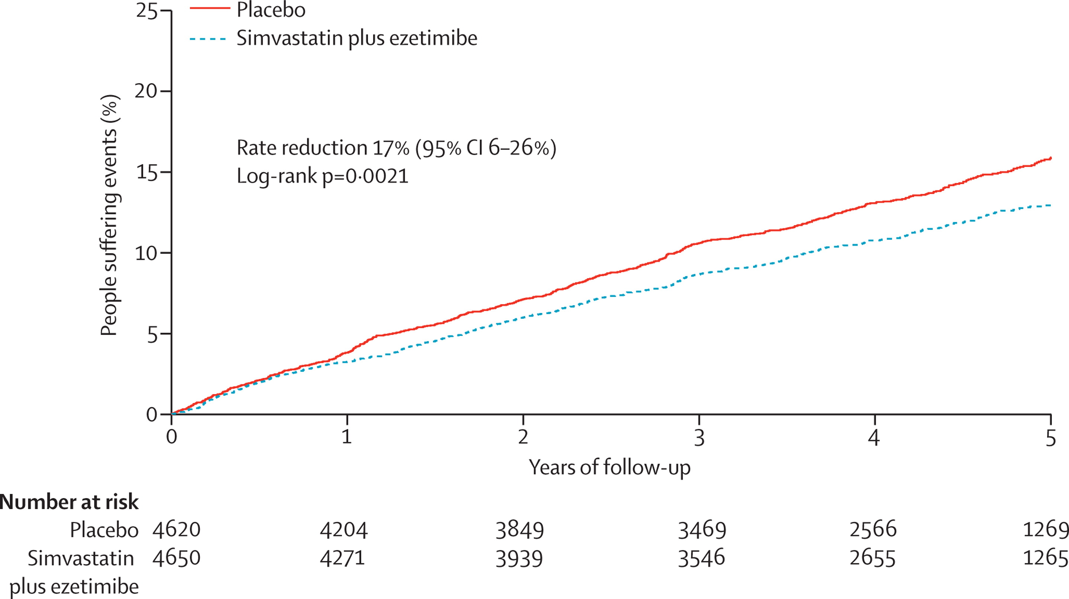
Statin – for pretty much all
Baigent C, Landray M, Reith C et al.
The effects of lowering LDL cholesterol with simvastatin plus ezetimibe in patients with chronic kidney disease (Study of Heart and Renal Protection): a randomised placebo-controlled trial
The Lancet, 2011; 377, 2181-219

Slide 24
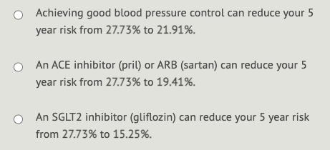
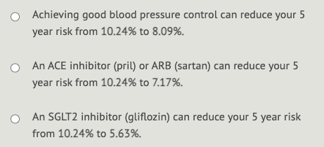
Medication does make a difference
Age | eGFR (ml/min/1.73m²) | sex | uACR (mg/mmol) | 2y KFRE (%) | 5y KFRE (%)
34 | 35 | M | 165 | 8.7 | 27.7
74 | 35 | M | 165 | 3.7 | 12.6
84 | 35 | M | 165 | 3.0 | 10.2
80 | 28 | F | 20 | 2.1 | 7.5

Slide 25
Pretty much all other renal-specific medication is specialist initiated / prescribed
Finerenone in Type 2 diabetes
Sparsentan in IgA Nephropathy
Sodium Zirconium or patiromer to help manage hyperkalaemia
Immunusuppression (SLE, vasculitis, podocytopathies, GN)
Tolvaptan (ADPKD)
Treatment for myeloma, HIV, hepatitis…

Slide 26
'Nephrotoxics’
Avoid non-steroidal anti-inflammatory medication where possible
RAAS inhibitors and SGLT2 inhibitors are not per se nephrotoxic, but should be held when dehydrated (risk AKI)
  However do need to be restarted promptly when well
Many medication can be associated with kidney damage (commonly AKI, interstitial nephritis, RTA):
  Antibiotics – aminoglycosides, penicillins, vancomycin
  Proton pump inhibitors
  Calcineurin inhibitors
  Some chemotherapy agents (including checkpoint inhibitors)
  Tenofovir
  Lithium

Slide 27
Lithium
AKI can occur in acute toxicity
Nephrogenic diabetes insipidus common
  20-87%
  >3L day dilute urine
  Usually reversible in early phase on stopping lithium
  Can treat with amiloride
Chronic kidney disease rare
  Prevalence uncertain, perhaps around 1% of long-term lithium users
  Chronic tubulointerstitial fibrosis
  Slowly progressive (>20 years)
  Unclear ‘tipping point’
  Risk factors as per common CKD risk factors
    ? Lithium levels / duration / NDI
    ? Benefit of stopping lithium

Slide 28
Prescribing considerations in CKD
Some medications unsuitable at lower creatinine clearance
Consider if drug is renally excreted – dose adjustments
Effect on tubular reabsorption of creatinine?
If on RRT, consider dialysis elimination and timing of doses
Renal Drug Handbook
Specialist Renal Pharmacists

Slide 29
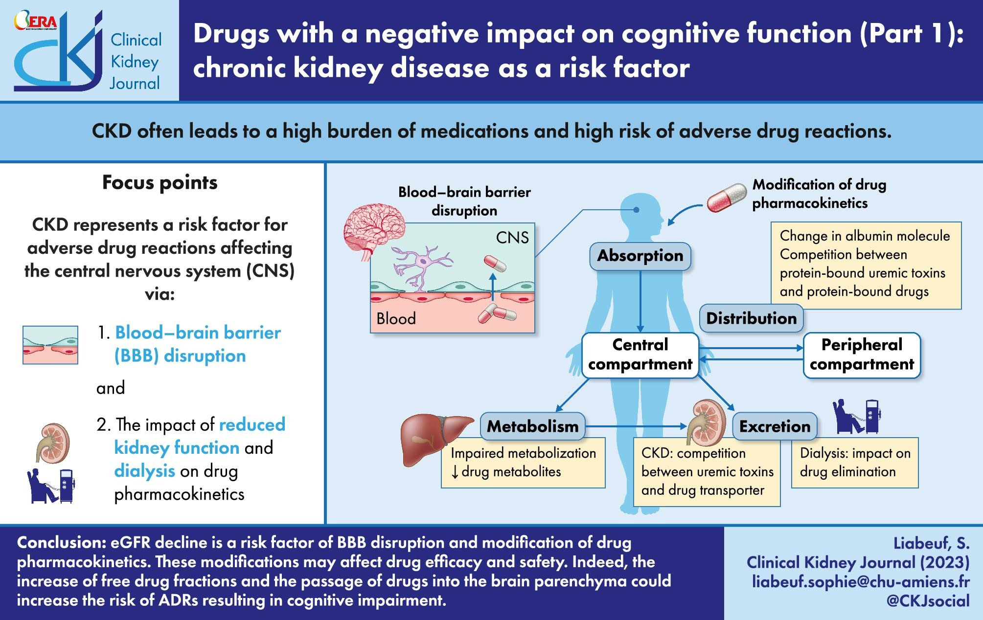

Slide 30
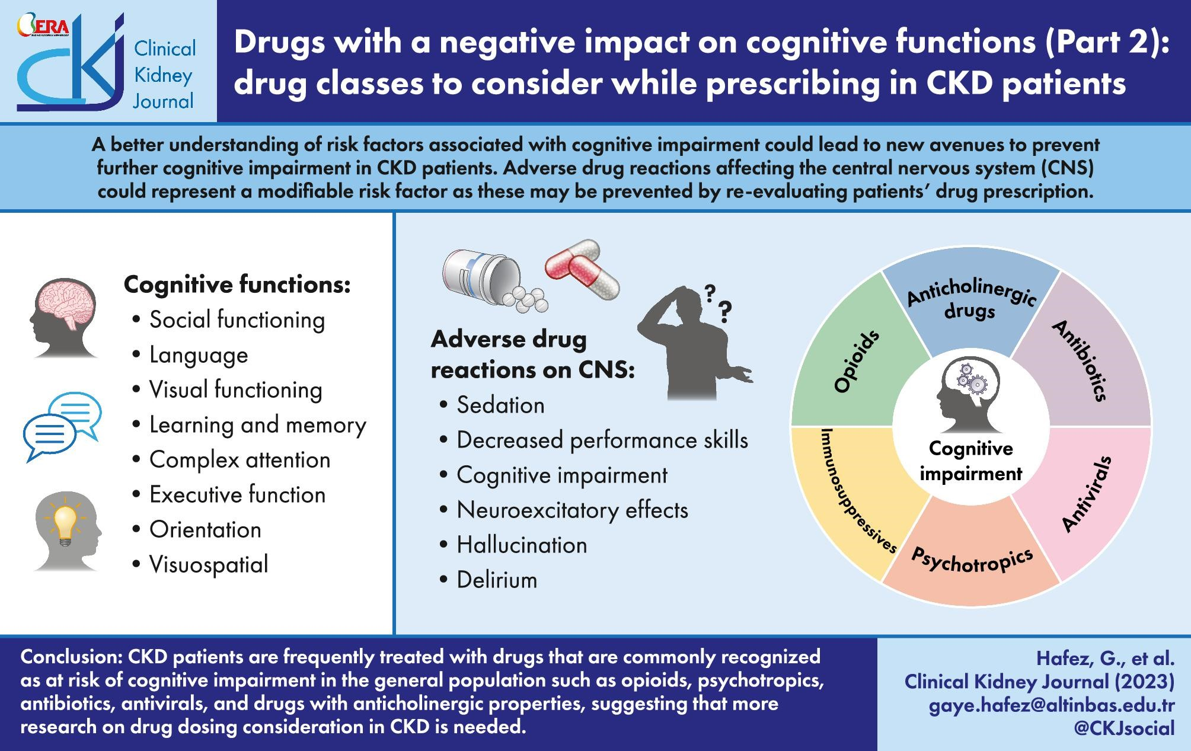

Slide 31
Prescribing in CKD conclusions
RAAS inhibition, SGLT2 inhibition, lipid-lowering therapy advised for most
‘sick day rules’
Avoid NSAIDs
Consider effect of medications on CKD and prescribing modifications
CKD medication burden may contribute to cognitive decline

Slide 32
Renal replacement therapy – considerations for the elderly population
Haemodialysis
  Usually in-centre, 3x / week, 4 hours at a time
  Plus transport time…
Peritoneal dialysis
  Home-based
  ‘continuous’ (several exchanges across the day) or ‘automated’ (typically overnight)
  May be assisted
Both require procedures, lots of hospital visits, high likelihood of complications / admissions
Neither is ‘medically’ better
Transplant

Slide 33
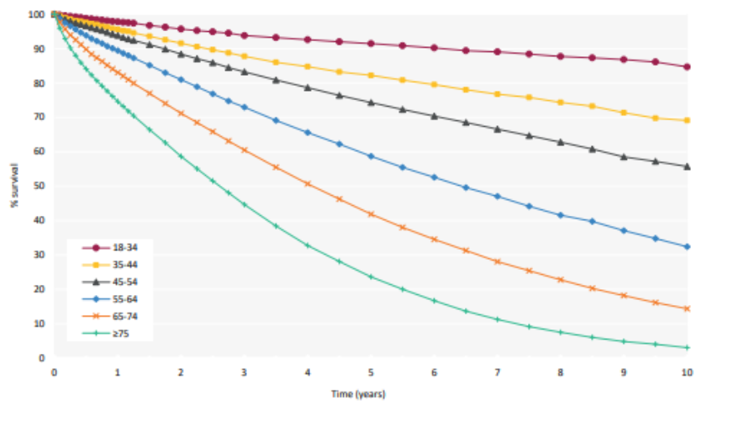
UK Renal Registry Annual Report, data to end 2023

Slide 34
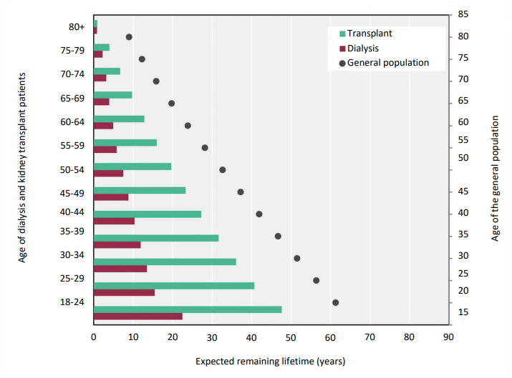
UK Renal Registry Annual Report, data to end 2023

Slide 35
Case: Mrs FJ
79yo
ESKD secondary to diabetes / HTN (now both well controlled)
Other PMHx: hypothyroidism, osteoarthritis, generalized anxiety disorder (sertraline)
Started haemodialysis via tunnelled line 2023
Initial attempt at arterio-venous fistula was unsuccessful
Lives with daughter and family, independently mobile
At the time of dialysis initiation: memory not perfect but not particularly concerning, full capacity to make decisions around dialysis

Slide 36
Mrs FJ 2026:
Dialysis has generally been medically unproblematic
However:
  Memory has increasingly deteriorated, formally diagnosed with Alzheimer’s Disease in 2025 during a long admission following a fall and fractured neck of femur
  Intermittently agitated on dialysis
    Fistula would now be unsafe
  More often than not agitated immediately after dialysis
  Paranoid, erratic behaviour at home (including violence)
  Unable to stick to fluid restriction and increasingly fluid overloaded

Slide 37
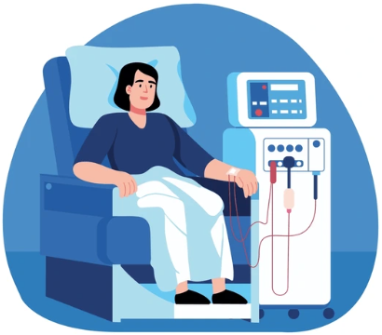
Inflammation
Hypertension
Diabetes
Vascular disease
Smoking
Intradialytic hypotension
Uremic toxins
Oxidative stress
Cognitive decline

Slide 38
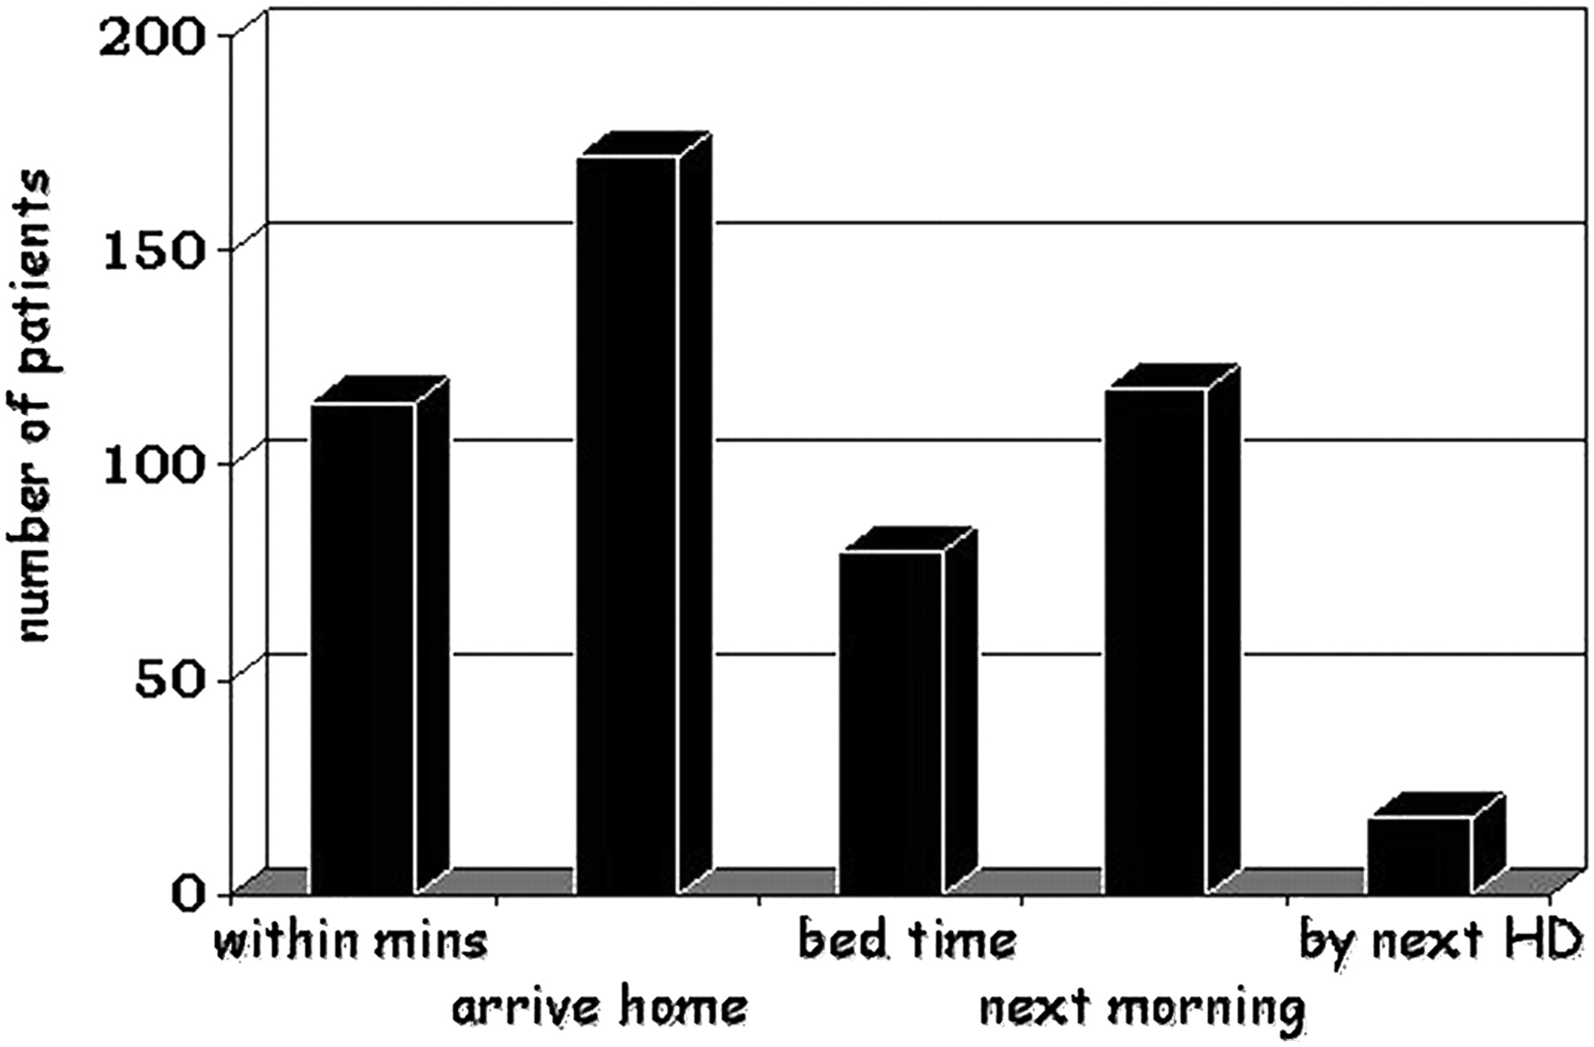

Fig. 2. Time to recovery following a HD session.
Notes:
Fig. 2. Time to recovery following a HD session.
Unless provided in the caption above, the following copyright applies to the content of this slide: © The Author 2011. Published by Oxford University Press on behalf of ERA-EDTA. All rights reserved. For Permissions, please e-mail: journals.permissions@oup.com

Slide 39
So what do we do for Mrs FJ?
Now lacks capacity to make complex decisions around ongoing dialysis
However: when did have capacity made a clear choice for haemodialysis
She does know that if she stops dialysis she will die
At present we can deliver safe haemodialysis
CMHT involved, small dose lorazepam on arrival at home after HD session
Ongoing discussions and best-interests considerations

Slide 40
Peritoneal dialysis
Smaller body of evidence for cognitive decline with peritoneal dialysis
Cognitive impairment on PD associated with increased risk of hospitalization (especially for PD peritonitis), and lower modality survival rate
Assisted APD useful in elderly where available
Otherwise PD suitability depends upon active engagement

Slide 41
Transplant – considerations for the elderly population
Mental illness is not necessarily a contraindication
  Up to a point
  Medication compliance is essential for good outcomes
  Studies suggest comparable outcomes in severe mental illness in carefully selected patient cohorts
Age is not necessarily contraindication
  Up to a point
  Graft survival and overall survival worse in >70s
  Dementia is a significant relative contraindication
  Consideration of deceased organ allocation system

Slide 42





Dialysis
~ eGFR<20
General Nephrology
Advanced Kidney Care
Transplant
Supportive Care
Disease modification treatment
Disease progression slowing treatment

Slide 43
Supportive Care in Advanced CKD
Active patient-centred approach for management of advanced CKD, avoiding dialysis
  Includes symptom management, continued management of risk factors to slow progression, MDT care, psychological and social support, advanced care planning
Unclear survival benefit of dialysis in elderly / multi-morbid patients
Needs careful discussions with patients and families

Slide 44
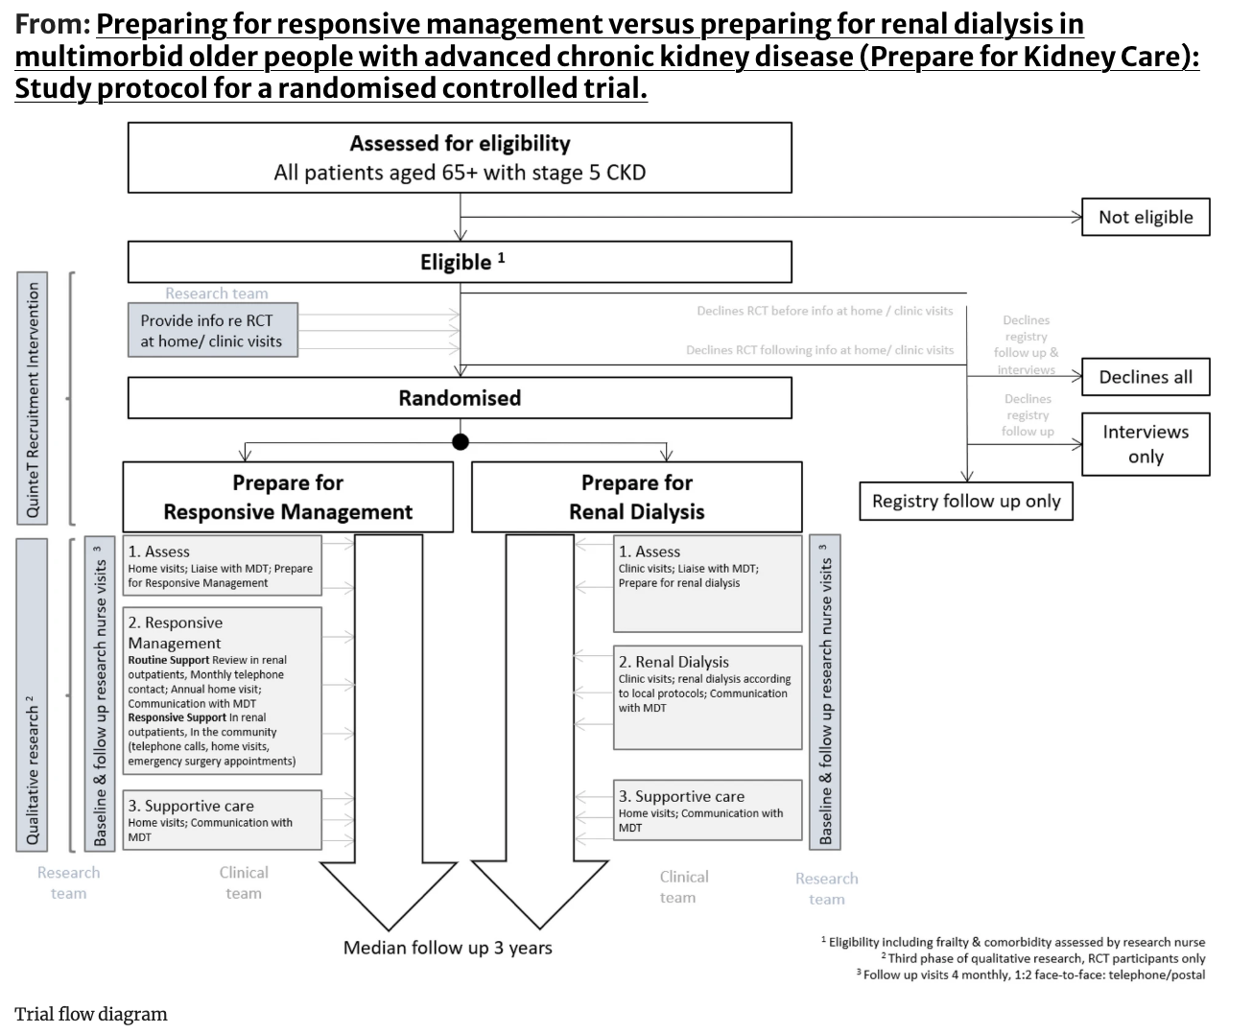
Worthington, J., Soundy, A., Frost, J. et al. Preparing for responsive management versus preparing for renal dialysis in multimorbid older people with advanced chronic kidney disease (Prepare for Kidney Care): Study protocol for a randomised controlled trial.. Trials 25, 688 (2024). https://doi.org/10.1186/s13063-024-08509-8

Slide 45
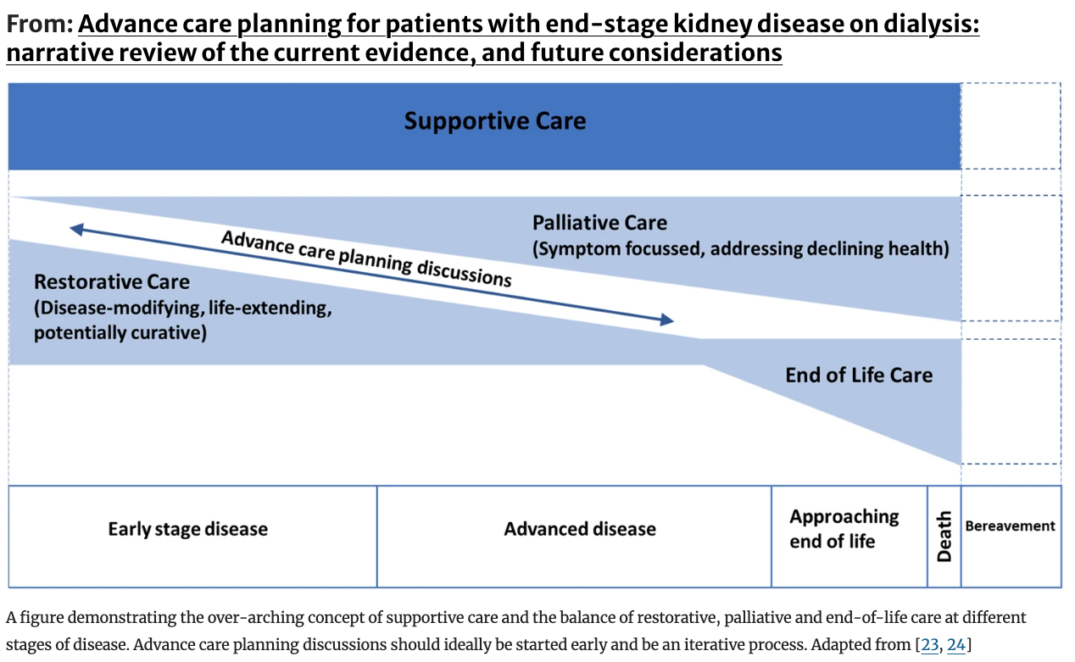
Adenwalla, S.F., O’Halloran, P., Faull, C. et al. Advance care planning for patients with end-stage kidney disease on dialysis: narrative review of the current evidence, and future considerations. J Nephrol 37, 547–560 (2024). https://doi.org/10.1007/s40620-023-01841-3

Slide 46
Renal replacement therapy – considerations for the elderly population: conclusions
All modalities possible
Likely that RRT expedites functional decline
Supportive Care may be most appropriate – shared decision making is key
Increasingly Geriatricians are embedded within Nephrology teams

Slide 47
Conclusion
CKD common in old-age and with mental illness (mild and severe)
In most cases most benefit from managing cardiovascular risk
Some will benefit from seeing Nephrology
Medication selection and dosing may need to be tailored
Benefits of renal replacement therapy in this cohort are not necessarily clear

Slide 48
Thank you
Jennifer.joslin@nhs.net

